Slide 1
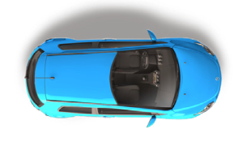
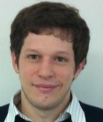
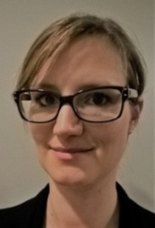
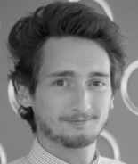
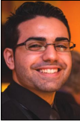
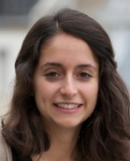
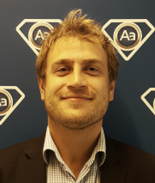
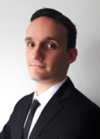
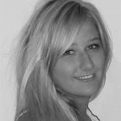
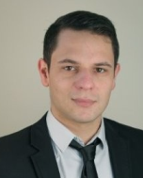
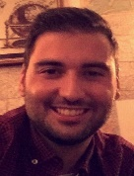
Purchasing department – New Cars and 0km
Florent Perrot
Purchasing Director
florent.perrot@aramisauto.com
+33 1.49.12.36.42
Claudia Hanoteau
Purchasing Manager
claudia.hanoteau@aramisauto.com
+33 1.49.12.36.34
Adrien Puy
Purchasing Manager
adrien.puy@aramisauto.com
+33 1.49.12.36.44
Generic address
achats@aramisauto.com
Nicolas Biton
Purchaser Renault – Dacia
nicolas.biton@aramisauto.com
+33 1.49.12.36.39
Olivia Tardieux
Purchaser Audi - Seat
olivia.tardieux@aramisauto.com
+33 1.49.12.36.48
Guillaume Chavanne
Purchaser Asian Brands
guillaume.chavanne@aramisauto.com
+33 1.49.12.36.44
Bertrand Genon Catalot
Purchaser Renault – Citroën
bertrand.genoncatalot@aramisauto.com
+33 1.49.12.36.97
Samanta Vidovic
Purchaser VW – Skoda
samanta.vidovic@aramisauto.com
+33 1.49.12.36.35
Thomas Sinet
Purchaser Peugeot – Ford – Opel
thomas.sinet@aramisauto.com
+33 1.49.12.36.46
Benoit Michaux
Purchaser Nissan – BMW
benoit.michaux@aramisauto.com
+33 1.49.12.36.32
Stéphane Devezeaud
Purchasing Assistant
stephane.devezeaud@aramisauto.com
+33 1.49.12.79.88

