Slide 1

Tim Burton

Slide 2
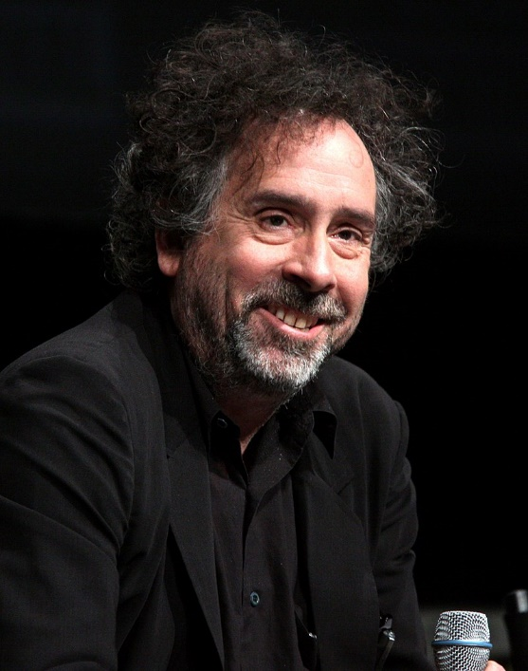
Bio:
August 25th 1958
American (California)
Film director, film producer, writer, artist
Style:
Gothic
S-F

Slide 3
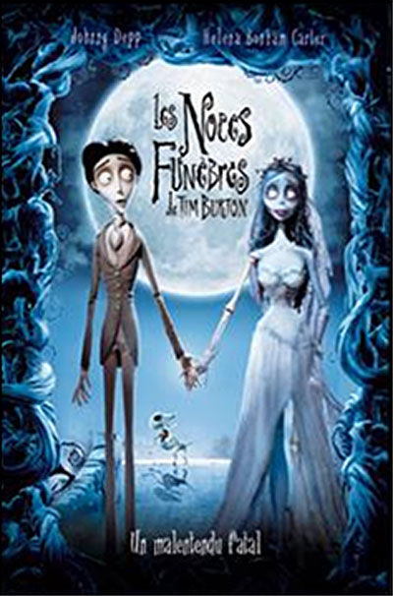
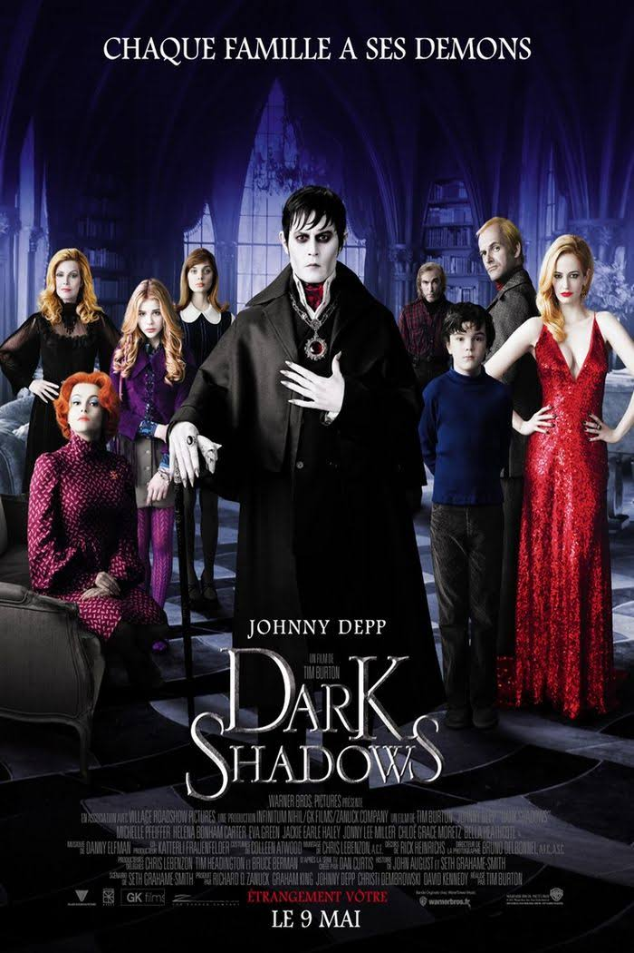
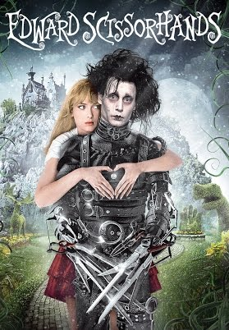
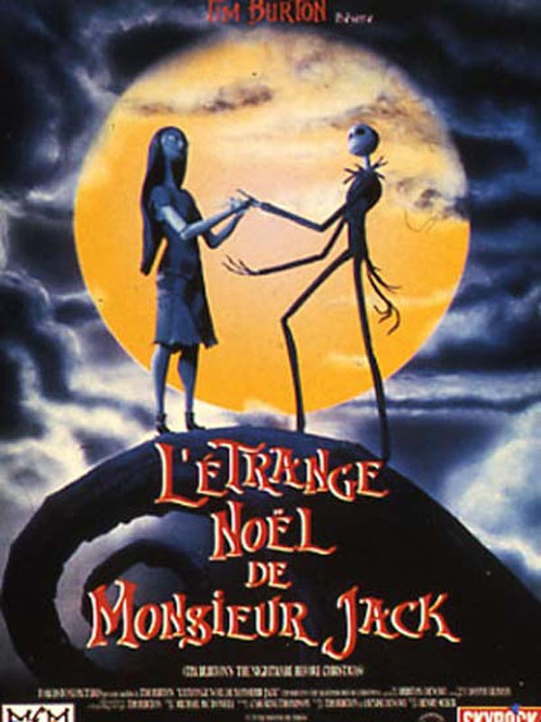
Know For:

Slide 4
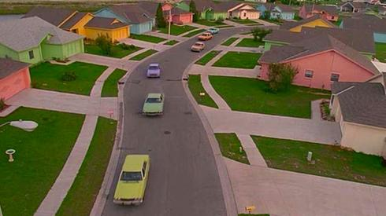
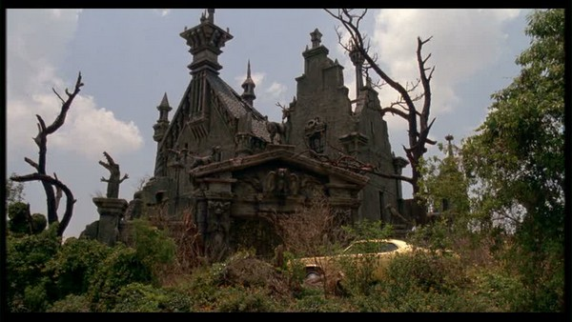
Edward Scissorhands:
1990
Johnny Depp, Winona Ryder (Beetlejuice)
Gothic Castle, Dark, Magic, make-up, ambience
Flashy colors, “ Normal Houses ”

Slide 5
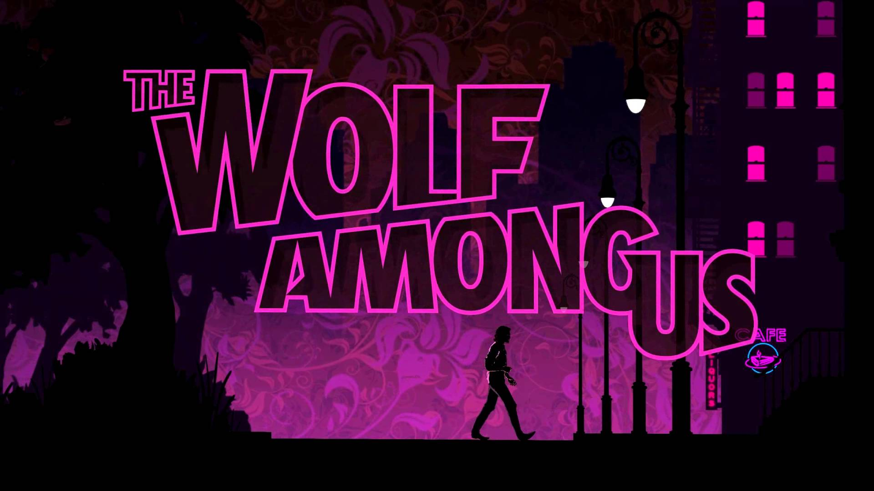

Slide 6
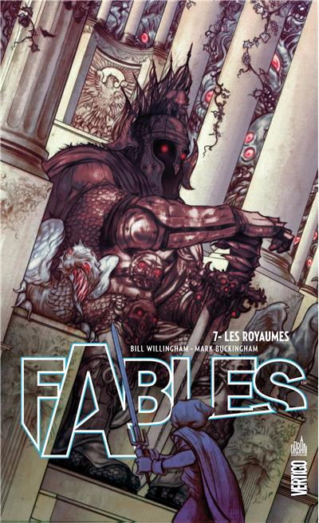
The Wolf Among Us
Fantasy interactive story game
Developped by Telltale Games
Inspired by Fables.
Some context
Crime and detective game.
Fantasy aspects (creatures and characters from Fables)
Dystopia

Slide 7
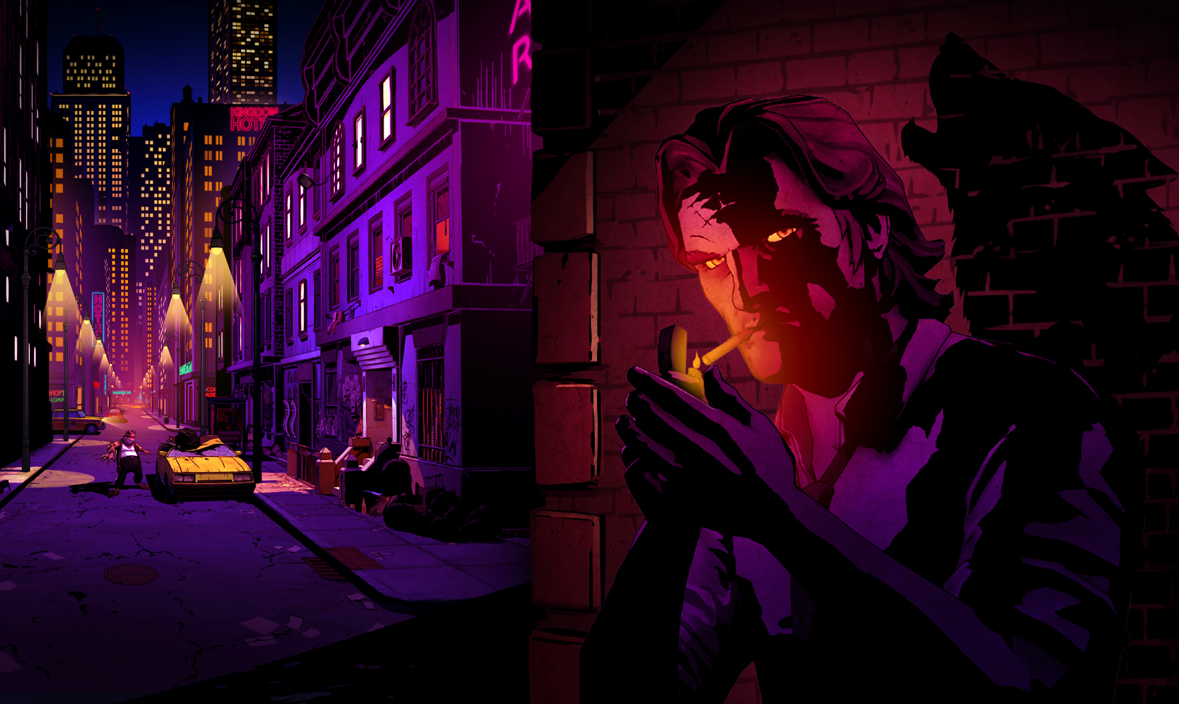

Gothic aspects
Always night.
Dark visual and ambiance
Narrow streets and places.
Monsters
High buildings

Slide 8
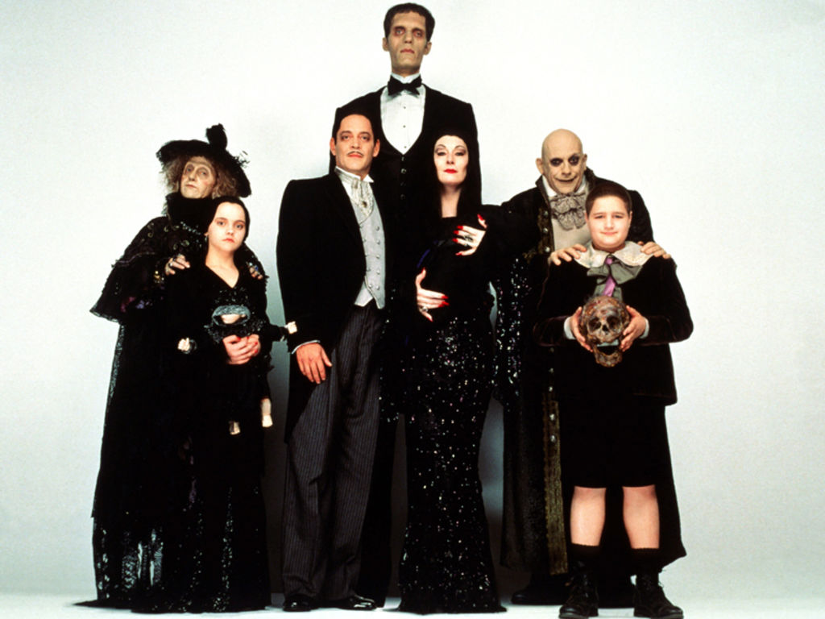
La Famille Adams

Slide 9
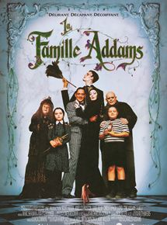
Bio:
Charles Addams
1930
Series, Film
Style:
- Gothic

Slide 10
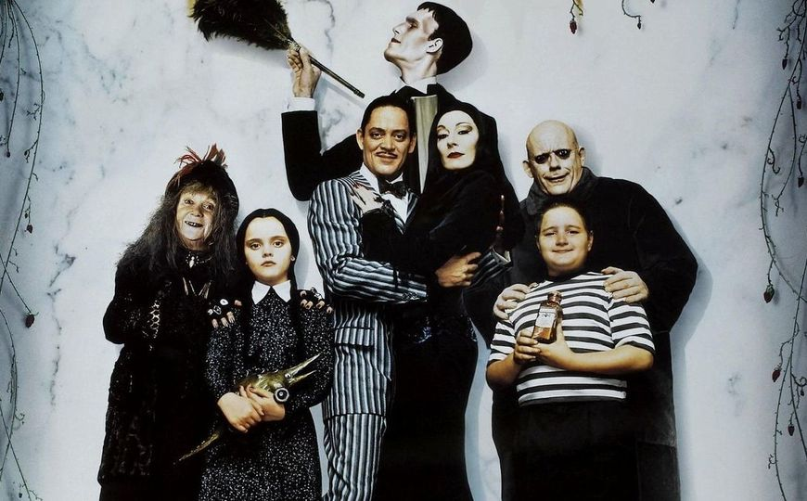
Members

Slide 11
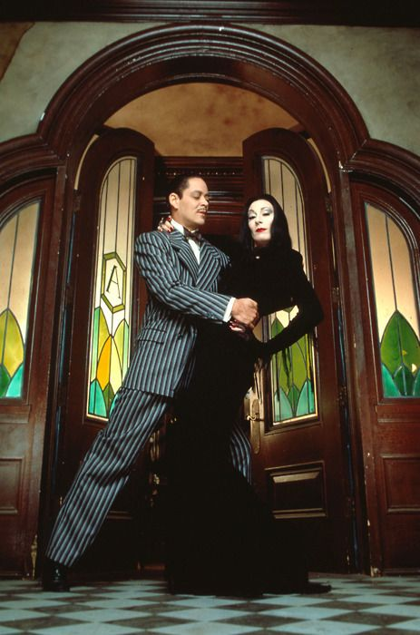
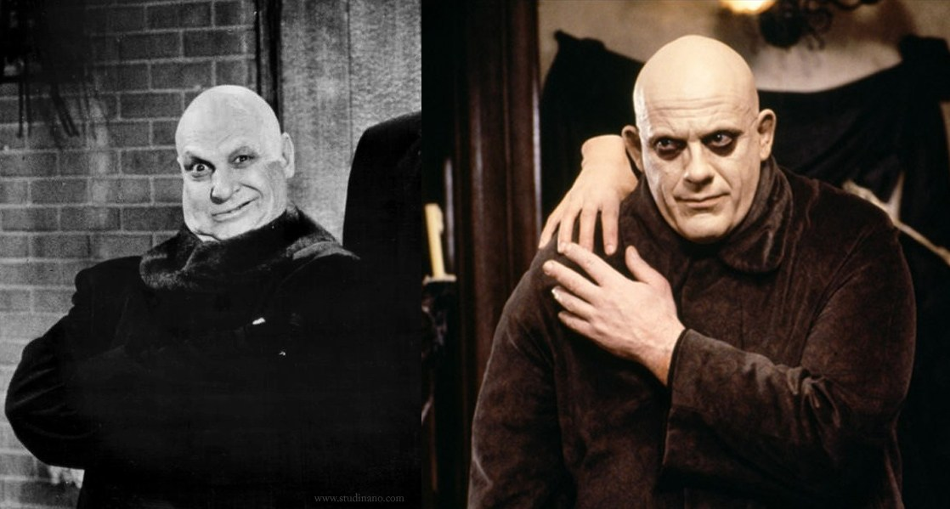
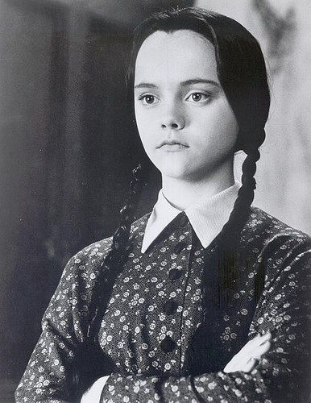
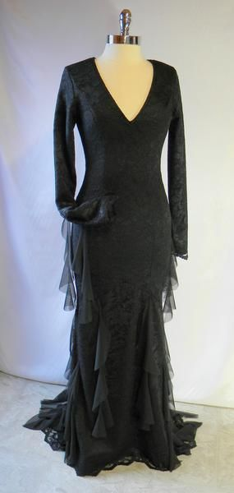
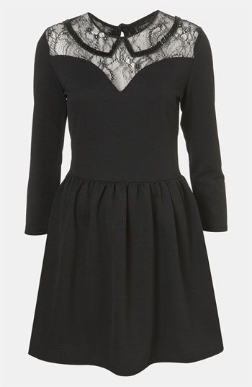
Style and Clothes

