Slide 1
Vehicle routing in Python
December 6th 2017
Guillaume Crognier
Ecole polytechnique, Paris

Slide 2
Summary
I Problem presentation
II First approach: the standard formulation
III Second approach: master-slave formulation
IV Valid inequalities
V Computational results and conclusion
Vehicle routing in Python

Slide 3
I Problem presentation
Vehicle routing in Python

Slide 4
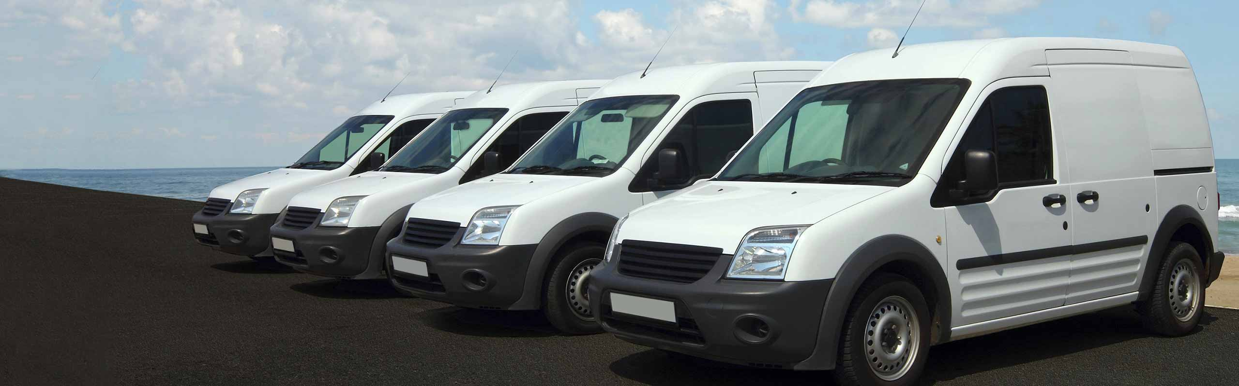
I Problem presentation
II First approach: the standard formulation
III Second approach: master-slave formulation
IV Valid inequalities
V Computational results and conclusion
Problem description
A set of vehicles
Streets to be served
Limited capacity
How to serve every street in a minimum of time ?
Vehicle routing in Python

Slide 5
I Problem presentation
II First approach: the standard formulation
III Second approach: master-slave formulation
IV Valid inequalities
V Computational results and conclusion
Why is it interesting for Orange ?
A set of vehicles
External problems (clients)
-Various problems (eg: waste collection)
Problems directly related to Orange
-Network maintenance
-Infrastructure deployment
Streets to be served
Limited capacity
How to serve every street in a minimum of time ?
Vehicle routing in Python

Slide 6
II First approach: the standard formulation
Vehicle routing in Python

Slide 7
I Problem presentation
II First approach: the standard formulation
III Second approach: master-slave formulation
IV Valid inequalities
V Computational results and conclusion
Notations
Parameters
Let E be the set of the edges. For every e in E, e⁺ et e⁻ will be the corresponding arcs.
Let A be the set of the arcs. For every a in A, a will be the corresponding edge.
d_{e} is the edge e demand, and c_{e} is the travel cost.
m is the number of vehicles available, K is the maximum capacity of a given vehicle.
D is the depot: all vehicles must start and end their paths there.
Variables
X^{k}_{a} represents the number of times the vehicle k passes through arc a.
Y^{k}_{e} equals 1 if the vehicle k collects the demand on edge e, 0 otherwise.
Vehicle routing in Python

Slide 8
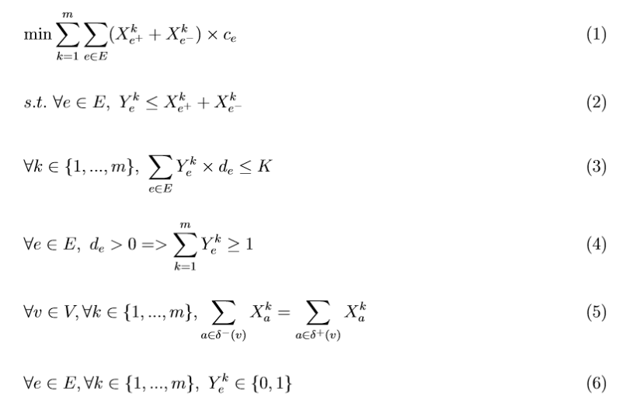
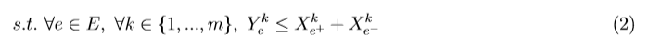
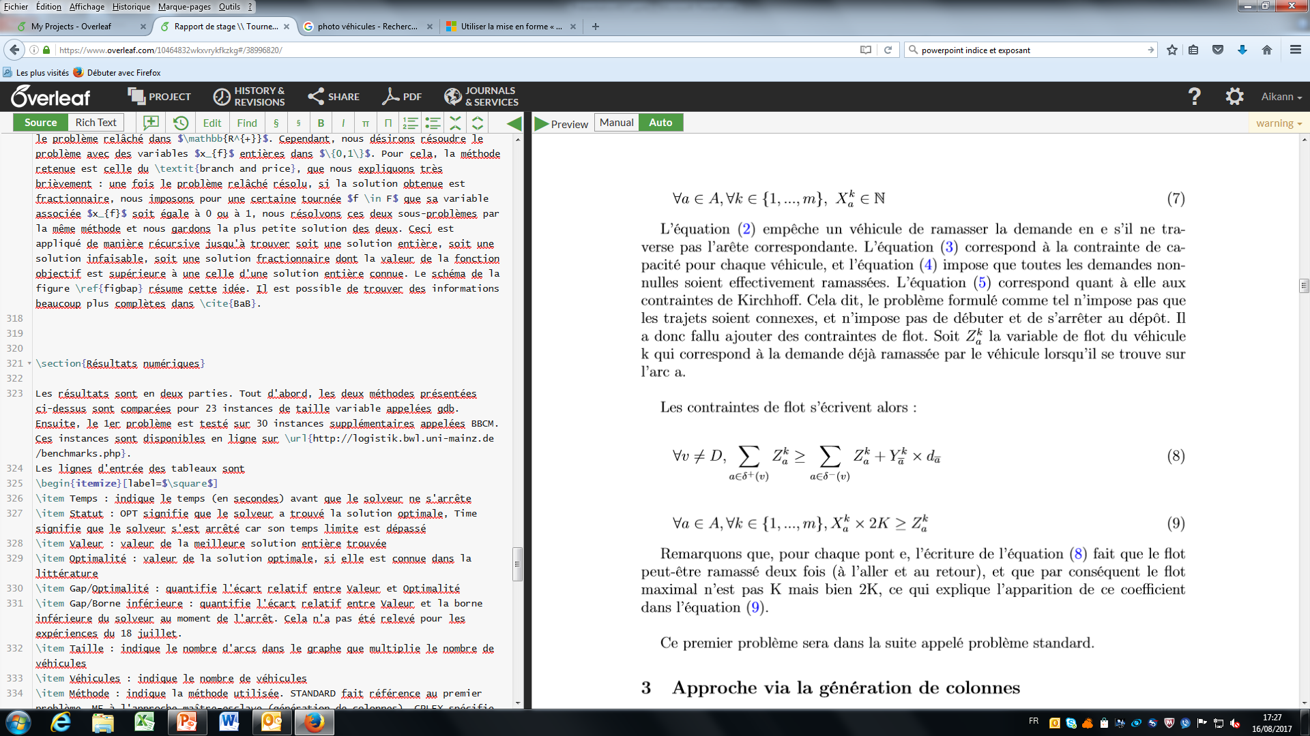
I Problem presentation
II First approach: the standard formulation
III Second approach: master-slave formulation
IV Valid inequalities
V Computational results and conclusion
Standard problem
Goal
Collecting => Passing through
Maximum capacity
Coverage constraints
Kirchhoff’s law
Vehicle routing in Python
et

Slide 9
I Problem presentation
II First approach: the standard formulation
III Second approach: master-slave formulation
IV Valid inequalities
V Computational results and conclusion
Standard problem (2)
Let δ⁺(v) be the outgoing arcs of node v, and δ⁻(v) the incoming arcs
Subtour constraints 1
Subtour constraints 2
0
1
1
4 4
4 4
0
3 3
3 3
2
2 2
0
1
0
0
1
0
1
2
0
Vehicle routing in Python

Slide 10
III Second approach: master-slave formulation
Vehicle routing in Python

Slide 11
I Problem presentation
II First approach: the standard formulation
III Second approach: master-slave formulation
IV Valid inequalities
V Computational results and conclusion
Master problem
Parameters
Let F be the set of feasible and optimal tours.
A tour f is said optimal if there is not any tour which collects the same edges as f with a strictly inferior cost.
For every f in F, let C_{f} be the cost of the tour f.
For every e in E and f in F, let χ_{e}(f) be the function equal to 1 if e is collected by f, 0 otherwise.
Variables
x_{f} equals 1 if the tour f is used, 0 otherwise.
Vehicle routing in Python

Slide 12
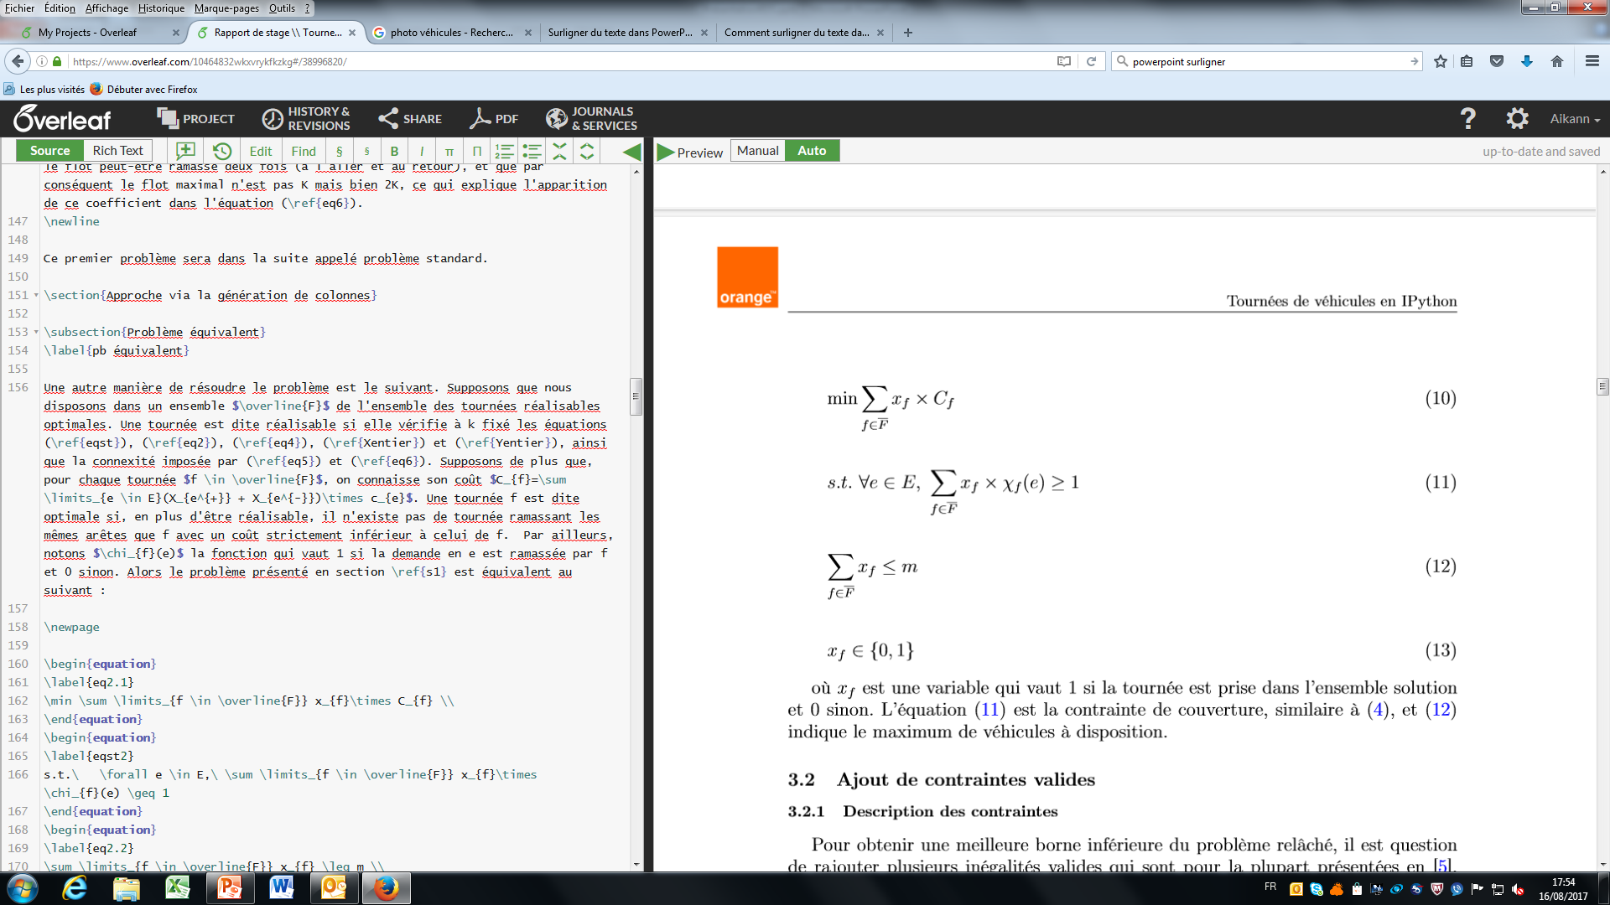
I Problem presentation
II First approach: the standard formulation
III Second approach: master-slave formulation
IV Valid inequalities
V Computational results and conclusion
Master problem (2)
Goal
Coverage constraints
Maximum number of vehicles
Integrity constraints
Vehicle routing in Python

Slide 13
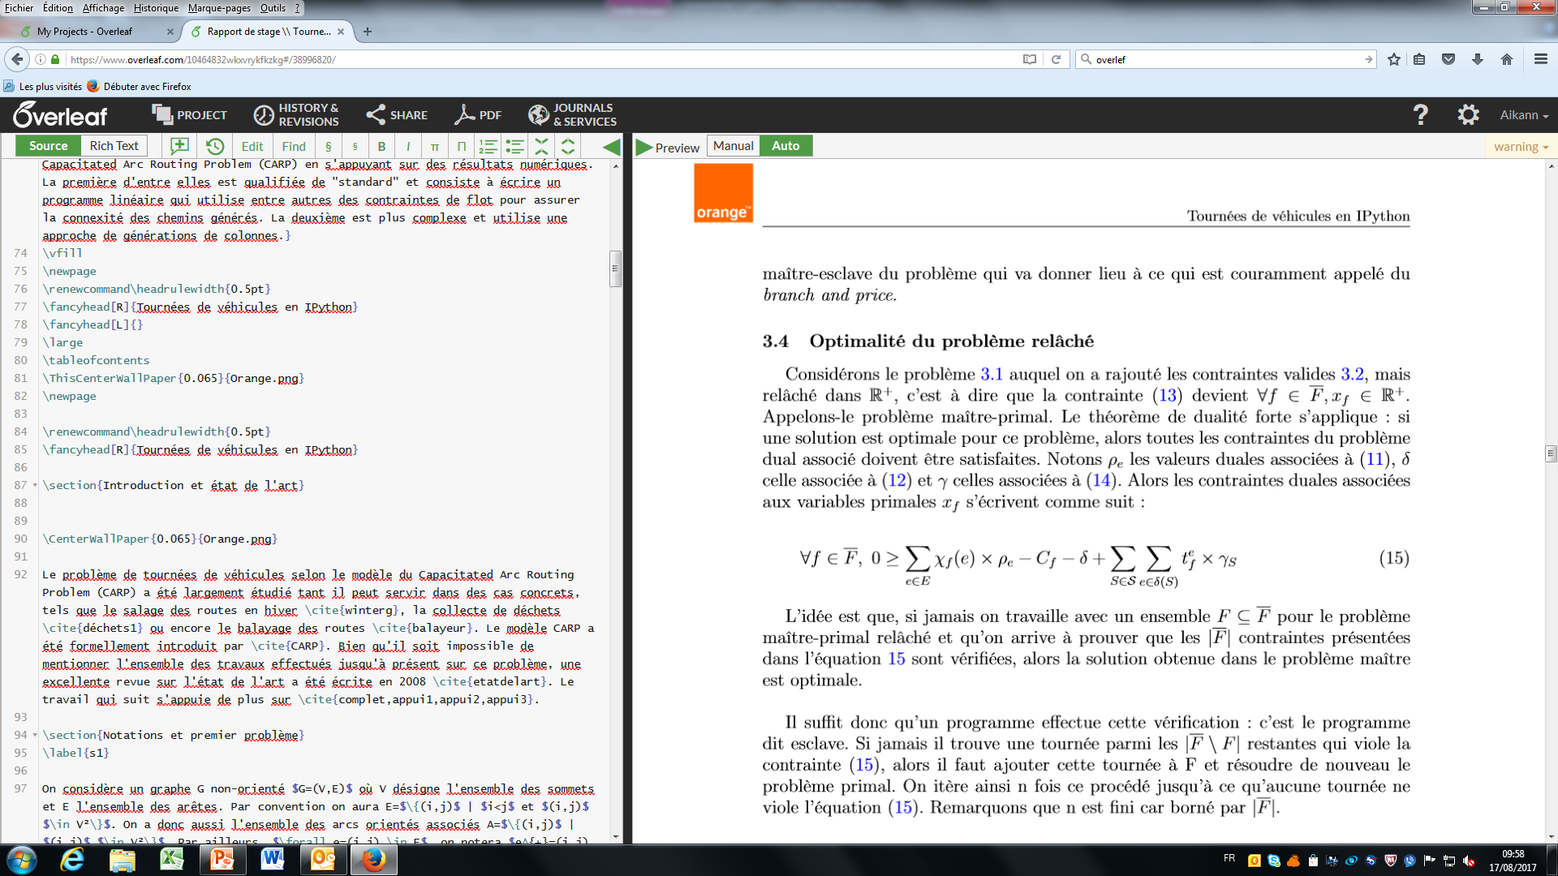
I Problem presentation
II First approach: the standard formulation
III Second approach: master-slave formulation
IV Valid inequalities
V Computational results and conclusion
Continuous master problem
Goal
Coverage
Maximum number of vehicles
Non-negative constraints
Vehicle routing in Python

Slide 14
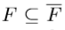
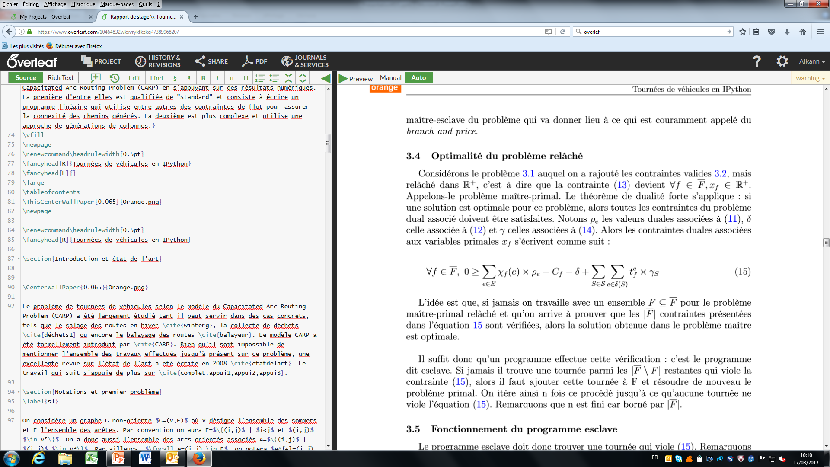
I Problem presentation
II First approach: the standard formulation
III Second approach: master-slave formulation
IV Valid inequalities
V Computational results and conclusion
Dual problem
Dual variables
ρ_{e}
Coverage
Maximum number of
vehicles
δ
Dual constraints
The idea: rather than working with F, let’s work with a smaller set
And then one has to ensure that all of the |F | dual constraints hold.
In order to do so, a slave programme will be used. This one has to find a tour which violates (15).
x_{f}
Vehicle routing in Python

Slide 15
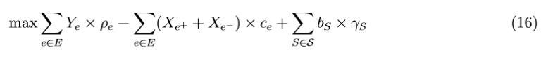
I Problem presentation
II First approach: the standard formulation
III Second approach: master-slave formulation
IV Valid inequalities
V Computational results and conclusion
Slave programme
It has to find a tour which violates (15)
The associated linear programme is
s.t. the tour is valid (same constraints as in the standard problem)
Vehicle routing in Python

Slide 16
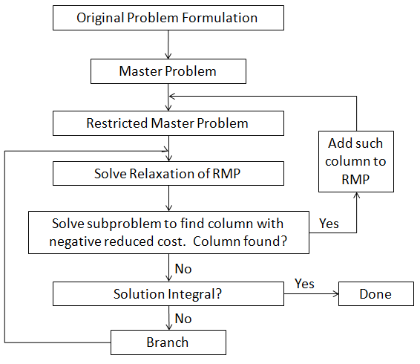
I Problem presentation
II First approach: the standard formulation
III Second approach: master-slave formulation
IV Valid inequalities
V Computational results and conclusion
Global view
Vehicle routing in Python

Slide 17
I Problem presentation
II First approach: the standard formulation
III Second approach: master-slave formulation
IV Valid inequalities
V Computational results and conclusion
Branch and bound
Vehicle routing in Python

Slide 18
I Problem presentation
II First approach: the standard formulation
III Second approach: master-slave formulation
IV Valid inequalities
V Computational results and conclusion
Branch and bound principle
Upper bound : +inf
Lower bound : -inf
Upper bound : +inf
Lower bound : 432,3
432,3
X₁₂=1
433,7
X₇=1
Vehicle routing in Python

Slide 19
I Problem presentation
II First approach: the standard formulation
III Second approach: master-slave formulation
IV Valid inequalities
V Computational results and conclusion
Branch and bound principle
Upper bound : +inf
Lower bound : 432,3
Upper bound : 436
Lower bound : 432,3
432,3
X₁₂=1
433,7
X₇=1
X₇=0
436
Unfeasible
Vehicle routing in Python

Slide 20
I Problem presentation
II First approach: the standard formulation
III Second approach: master-slave formulation
IV Valid inequalities
V Computational results and conclusion
Branch and bound principle
Upper bound : 436
Lower bound : 432,8
Upper bound : 436
Lower bound : 432,3
432,3
X₁₂=1
X₁₂=0
433,7
432,8
X₇=1
X₇=0
X₈=1
436
Unfeasible
437,1
Vehicle routing in Python

Slide 21
I Problem presentation
II First approach: the standard formulation
III Second approach: master-slave formulation
IV Valid inequalities
V Computational results and conclusion
Branch and bound principle
Upper bound : 436
Lower bound : 432,8
Upper bound : 436
Lower bound : 435,2
432,3
X₁₂=1
X₁₂=0
433,7
432,8
X₇=1
X₇=0
X₈=1
X₈=0
436
Unfeasible
437,1
435,2
Lower bound = Upper bound => End of the algorithm
Vehicle routing in Python

Slide 22
I Problem presentation
II First approach: the standard formulation
III Second approach: master-slave formulation
IV Valid inequalities
V Computational results and conclusion
Branch and bound principle
How to choose the tour to branch on ?
Chosen method: Maximum feasibility
The algorithm branches on the tour f whose corresponding x_{f} is the highest possible
In which order will the algorithm explore the nodes ?
Chosen method: Deep exploration, and always branching the tour on 1 before branching on 0.
The objective is to obtain a feasible solution quickly.
Vehicle routing in Python

Slide 23
IV Valid inequalities
Vehicle routing in Python

Slide 24
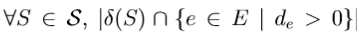
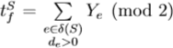
I Problem presentation
II First approach: the standard formulation
III Second approach: master-slave formulation
IV Valid inequalities
V Computational results and conclusion
Valid inequalities
Let S be the set of odd group nodes
is odd.
Required edge
Non-required edge
Then there is a tour collecting an odd number of
edges which have one node in S and the other outside S.
In order to formalize this:
Vehicle routing in Python

Slide 25
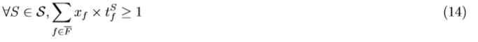
I Problem presentation
II First approach: the standard formulation
III Second approach: master-slave formulation
IV Valid inequalities
V Computational results and conclusion
Continuous master problem
Goal
Coverage
Maximum number of vehicles
Non-negative constraints
Valid inequalities
Vehicle routing in Python

Slide 26
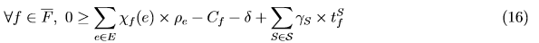
I Problem presentation
II First approach: the standard formulation
III Second approach: master-slave formulation
IV Valid inequalities
V Computational results and conclusion
Dual problem
Dual variables
ρ_{e}
Coverage
Maximum number of
Vehicles
Valid inequalities
δ
γ_{S}
Dual constraints
The idea: rather than working with F, let’s work with a smaller set
And then one has to ensure that all of the |F | dual constraints hold.
In order to do so, a slave programme will be used. This one has to find a tour which violates (16).
x_{f}
Vehicle routing in Python

Slide 27
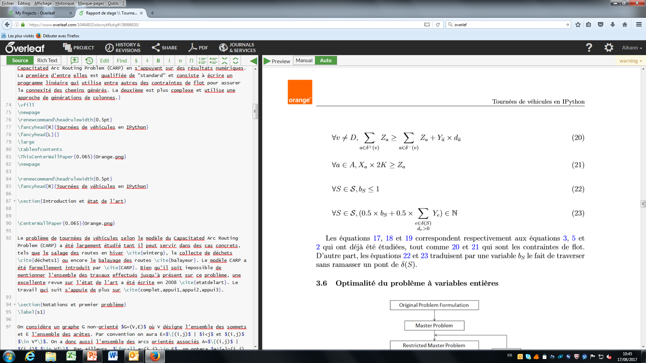
I Problem presentation
II First approach: the standard formulation
III Second approach: master-slave formulation
IV Valid inequalities
V Computational results and conclusion
Slave programme
It has to find a tour which violates
The associated linear programme is
7
s.t. the tour is valid
Vehicle routing in Python

Slide 28
I Problem presentation
II First approach: the standard formulation
III Second approach: master-slave formulation
IV Valid inequalities
V Computational results and conclusion
Un mot sur l’instabilité du code
Du code très simple en Python…
file = open(‘myfile.txt’,’r’)
a=file.readlines()
file.close()
Qui parfois renvoie des erreurs surprenantes !
PermissionError : Access denied
OSError : Invalid argument
FileNotFoundError : myfile.txt does not exist
Des erreurs propres à Windows ?
Vehicle routing in Python

Slide 29
I Problem presentation
II First approach: the standard formulation
III Second approach: master-slave formulation
IV Valid inequalities
V Computational results and conclusion
Un mot sur l’instabilité du code
Comment les prévenir ?
check=True
while(check):
try:
…code…
check=False
except(PermissionError,FileNotFoundError,OSError):
continue
Pas très joli mais fonctionnel…
Vehicle routing in Python

Slide 30
V Computational results and conclusion
Vehicle routing in Python

Slide 31
I Problem presentation
II First approach: the standard formulation
III Second approach: master-slave formulation
IV Valid inequalities
V Computational results and conclusion
Where to find benchmarks ?
A website provides examples which are used a lot in the literature
http://logistik.bwl.uni-mainz.de/benchmarks.php
-A lot of researchers use these benchmarks
-For most of them, the optimal solution has been found
-But there are still unsolved problems !
Vehicle routing in Python

Slide 32
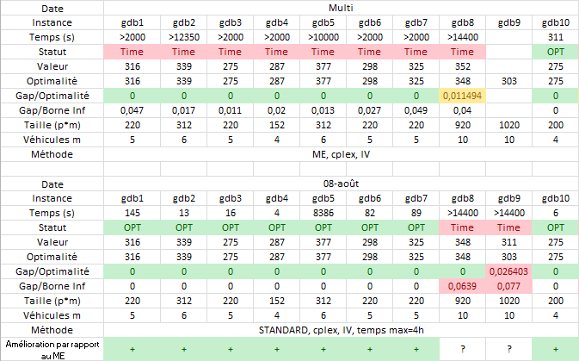
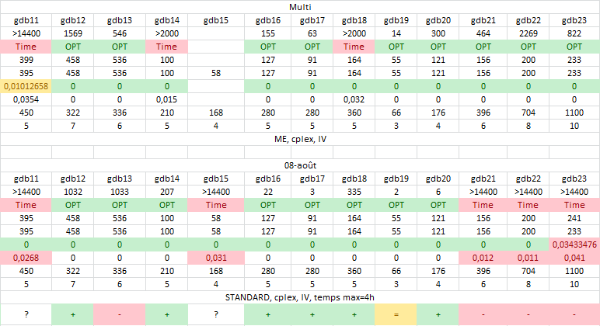
I Problem presentation
II First approach: the standard formulation
III Second approach: master-slave formulation
IV Valid inequalities
V Computational results and conclusion
Comparative results
Vehicle routing in Python

Slide 33
I Problem presentation
II First approach: the standard formulation
III Second approach: master-slave formulation
IV Valid inequalities
V Computational results and conclusion
Comparative results
The standard problem pros… and cons
-CPLEX handles the integrity constraints efficiently
-The lower bound is often of poor quality
-Often very quick on small problems
-Unable to solve large problems
The master-slave formulation pros… and cons
-The quality of the lower bound at the root of the
branch and bound is often excellent
-Able to find quickly a feasible solution
-Able to solve larger problems
-If the lower bound is not optimal, the convergence
time can be unreasonably high
-Much more complex to implement
Vehicle routing in Python

Slide 34
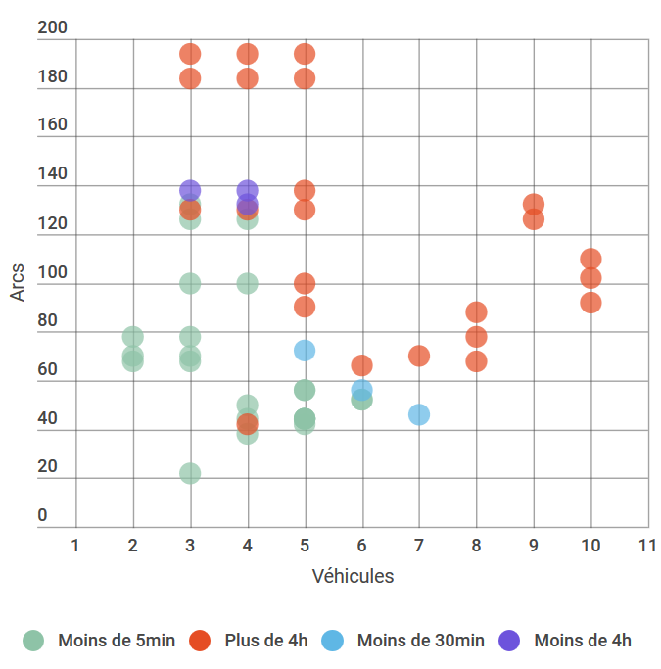
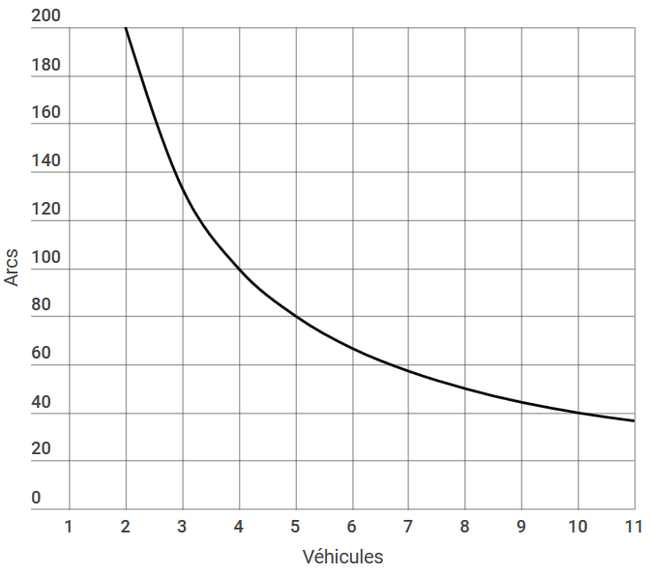
I Problem presentation
II First approach: the standard formulation
III Second approach: master-slave formulation
IV Valid inequalities
V Computational results and conclusion
Standard problem results
Vehicles x Arcs = 400
Vehicles
Vehicle routing in Python
Less than 5min
More than 4h
Less than 30min
Less than 4h

Slide 35
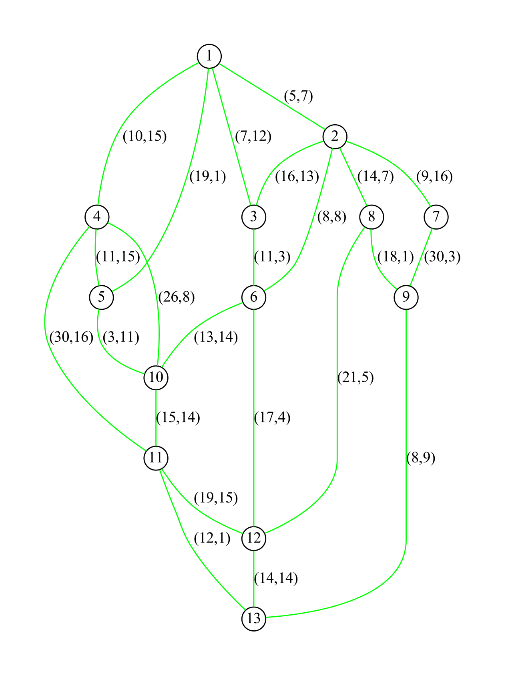
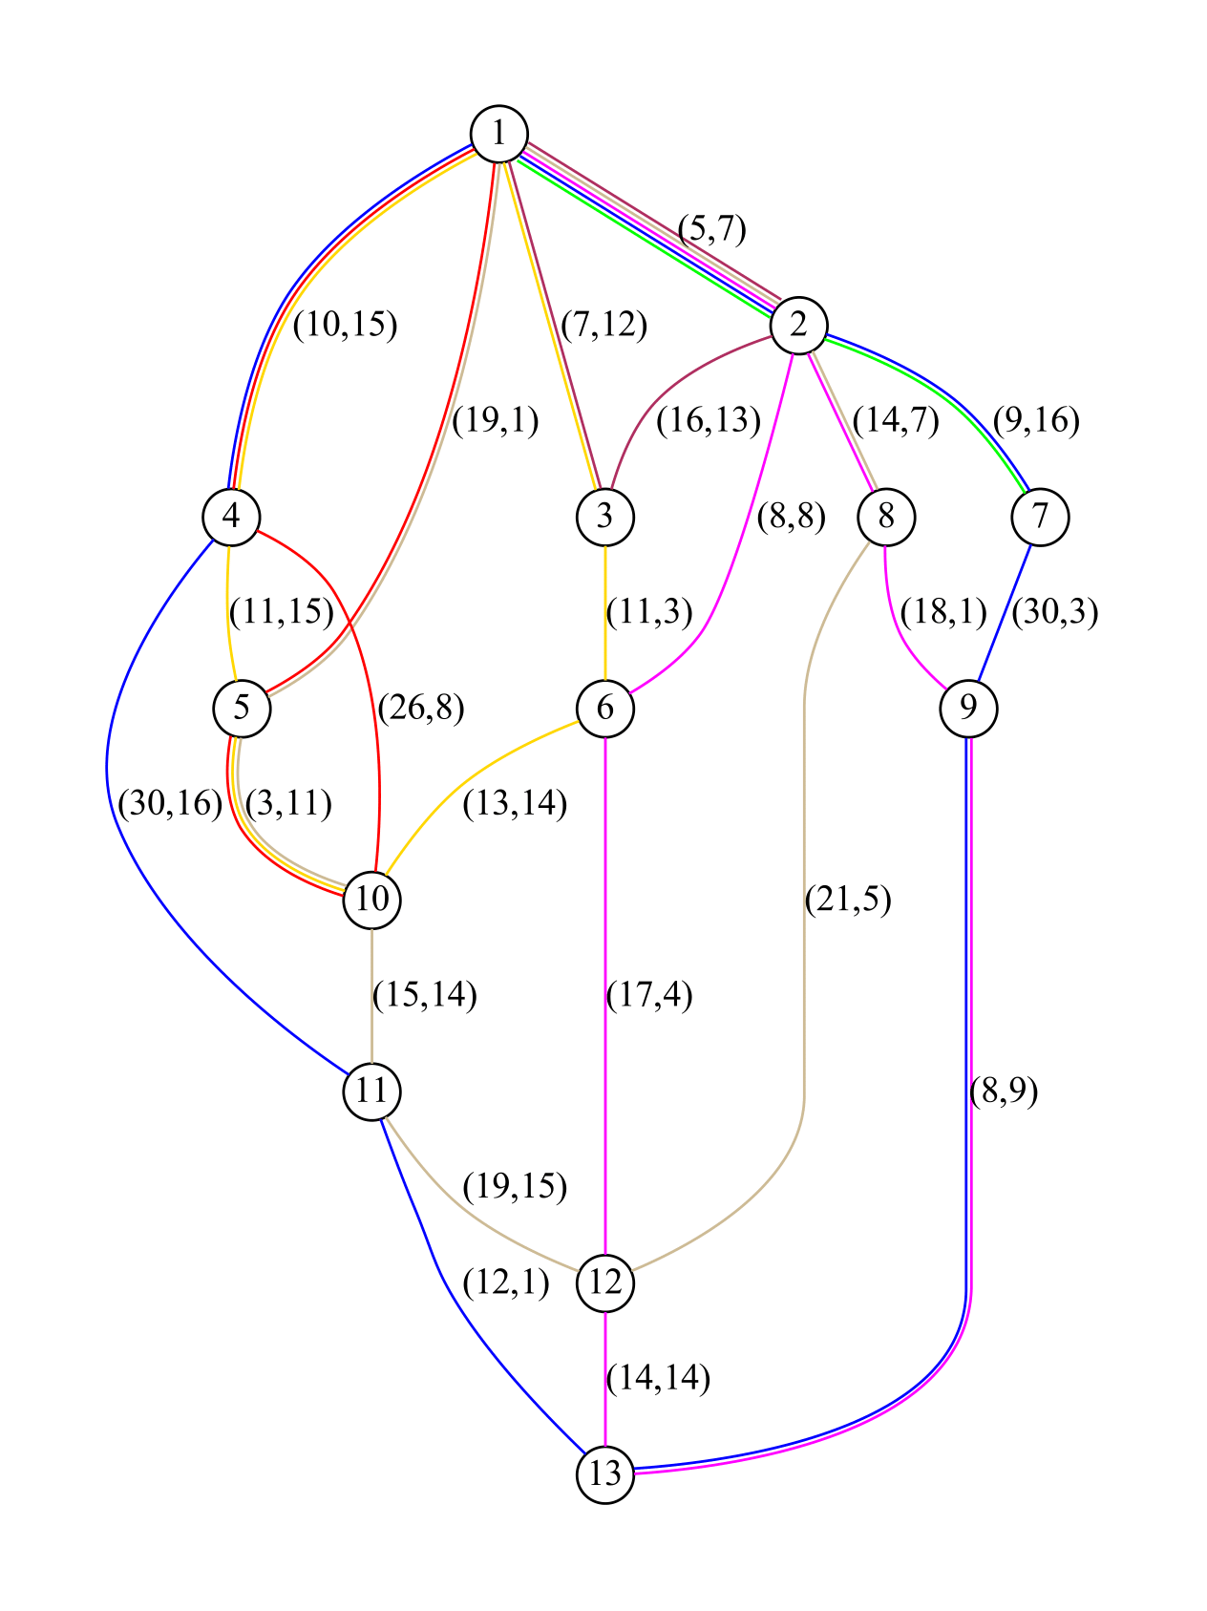
I Problem presentation
II First approach: the standard formulation
III Second approach: master-slave formulation
IV Valid inequalities
V Computational results and conclusion
Graphic results
Size 322
7 vehicles
46 arcs
Vehicle routing in Python

Slide 36
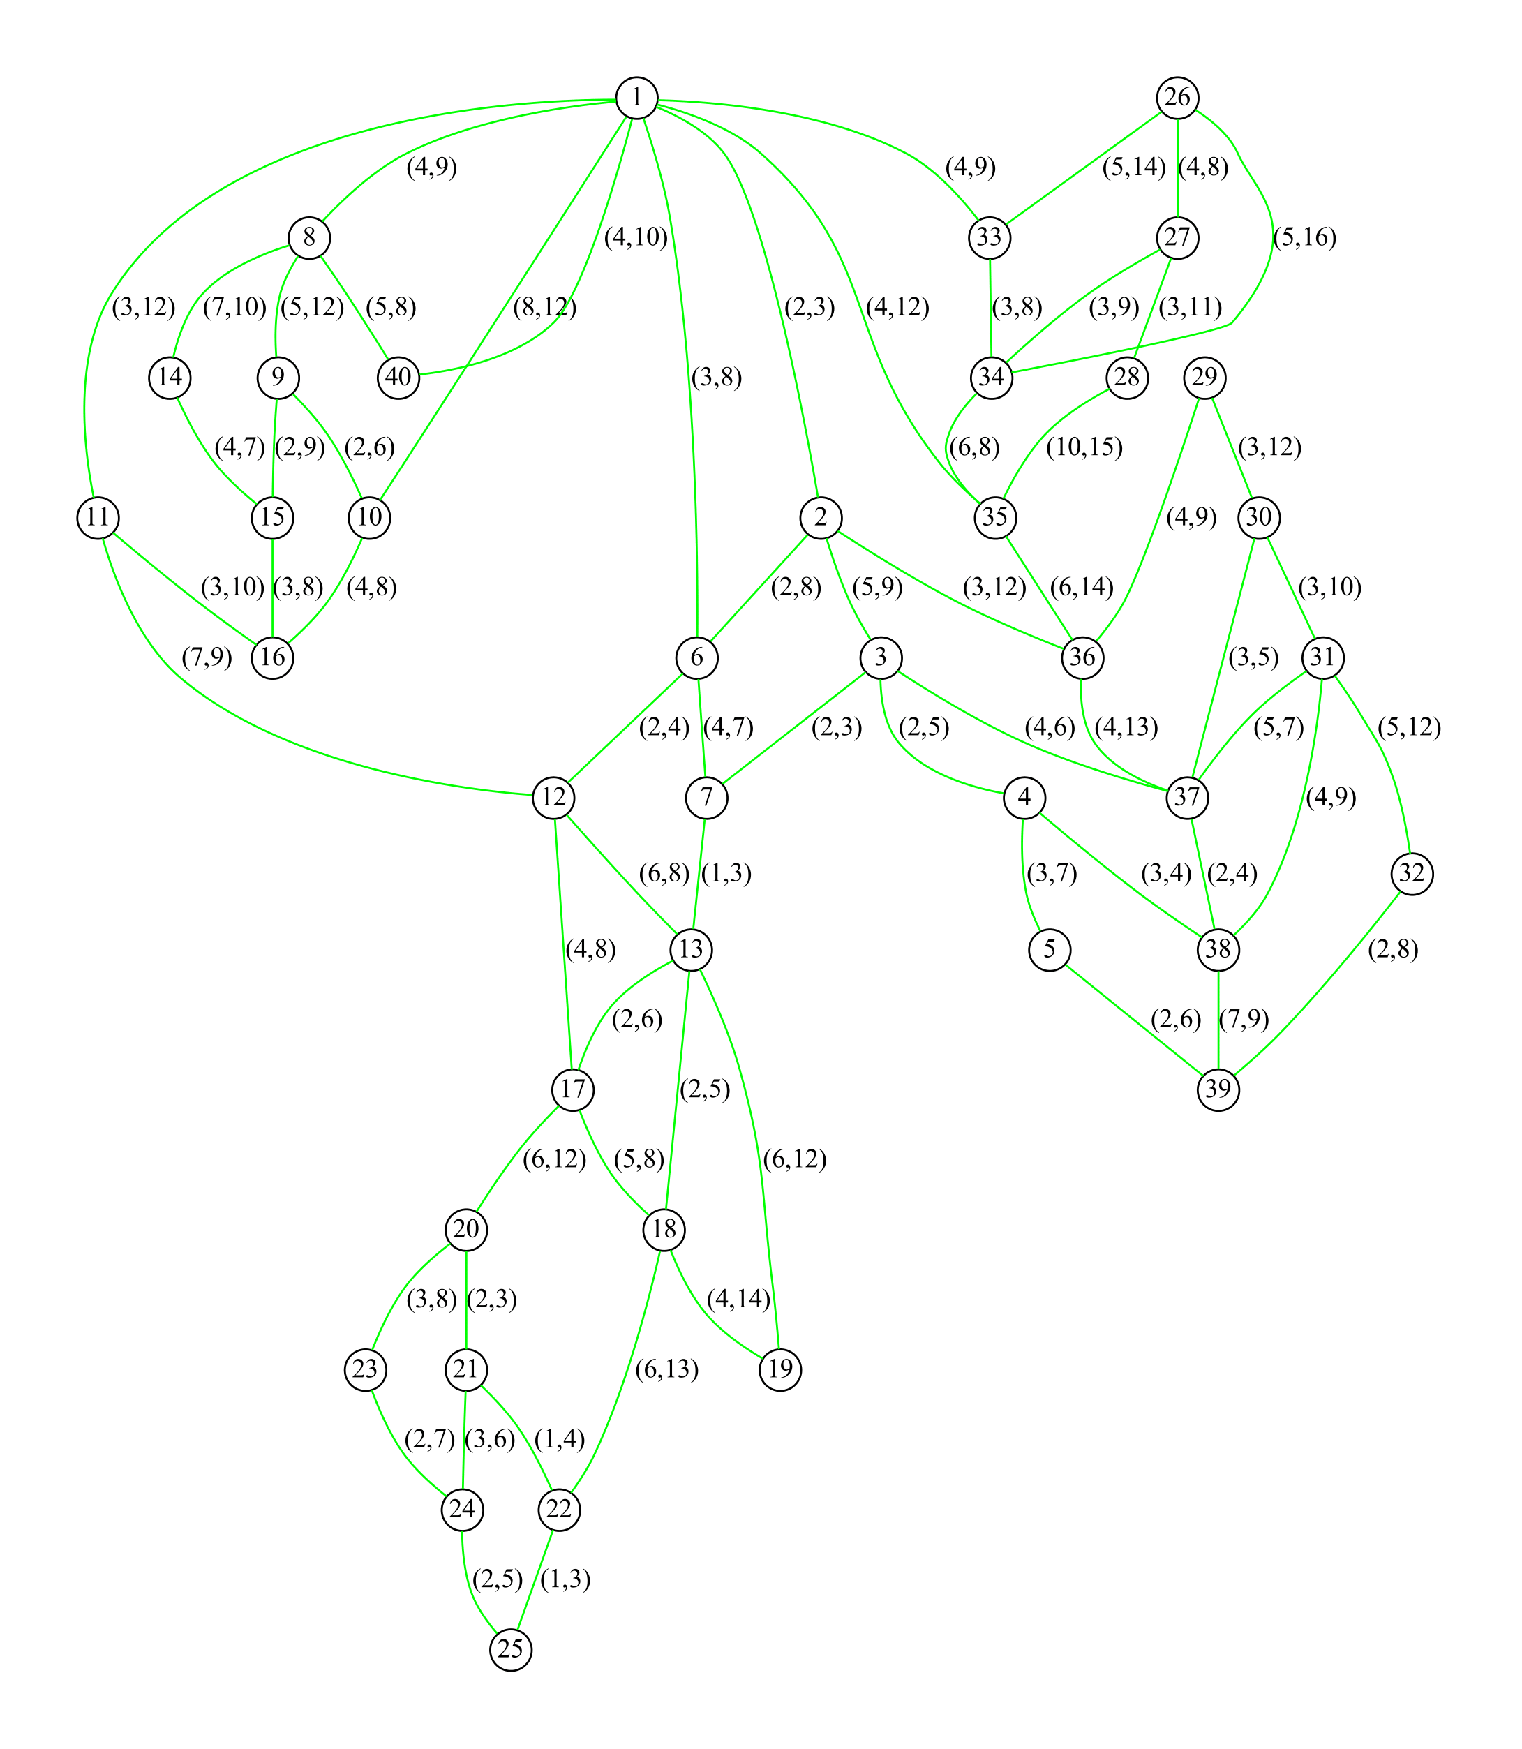
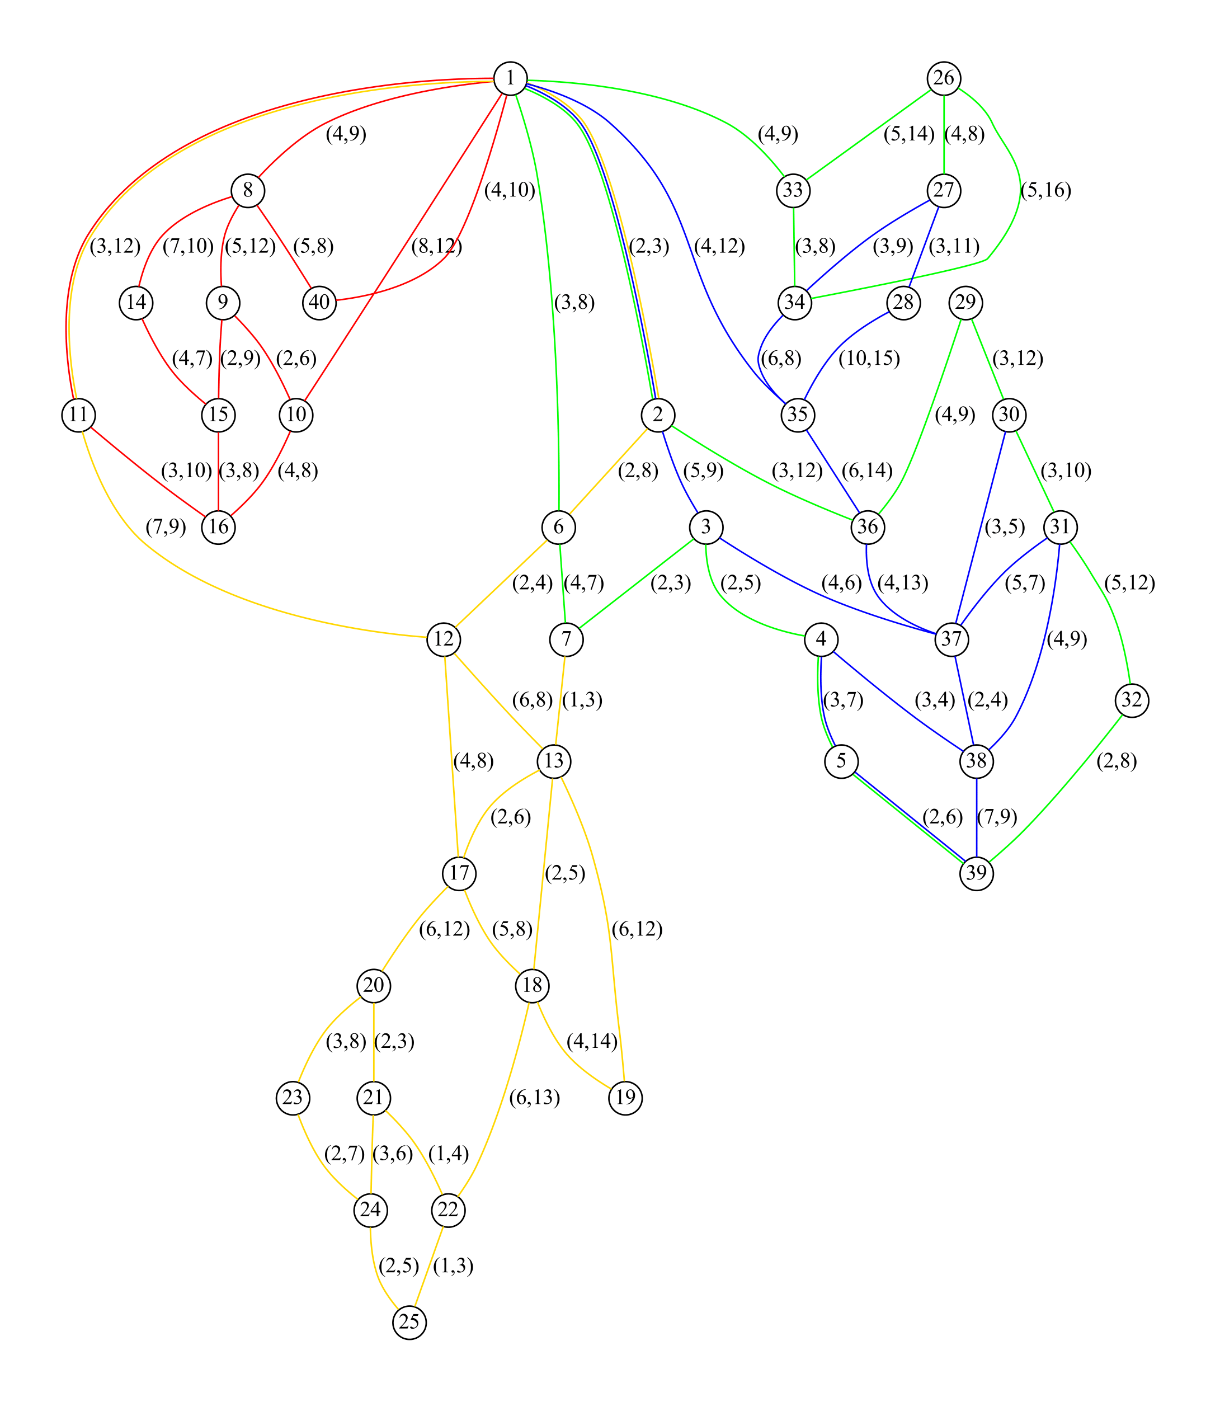
I Problem presentation
II First approach: the standard formulation
III Second approach: master-slave formulation
IV Valid inequalities
V Computational results and conclusion
Graphic results (2)
Size 528
4 vehicles
132 arcs

Slide 37
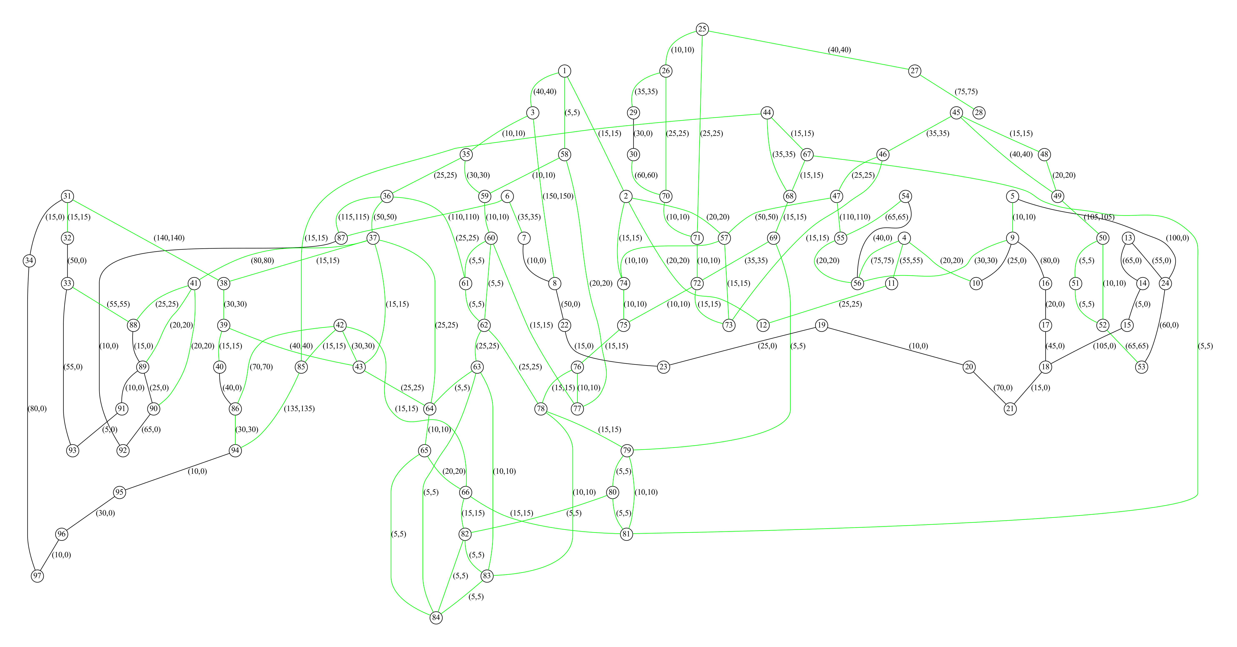
I Problem presentation
II First approach: the standard formulation
III Second approach: master-slave formulation
IV Valid inequalities
V Computational results and conclusion
What I would want to do
Size 3080
11 vehicles
280 arcs
Vehicle routing in Python

Slide 38
I Problem presentation
II First approach: the standard formulation
III Second approach: master-slave formulation
IV Valid inequalities
V Computational results and conclusion
Conclusion
Both approaches are complementary
A lot of improvements are yet possible
-Adding other valid inequalities
-Creating a mixed approach
-Changing the branching methods
At the end of the internship, the algorithm solved 400-size problems in less than 5 minutes
This code is now included in an Orange project
Vehicle routing in Python

Slide 39
Thank you for your attention !
Vehicle routing in Python

