Slide 1




Slide 2
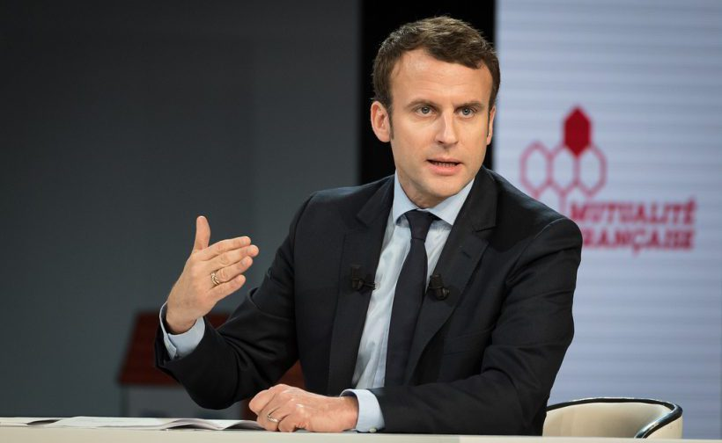
Politics
New controversy after French President said « Shit, you all piss me off bordel de merde »
Renaud Garioud please stop sleeping. There is nothing to read here. Dunkin Donuts has the best coffee ever made. If you are reading this, then you are not paying attention to what we are saying : shame ! There is still nothing to read here. Mrs Robinson is the best teacher we have ever had. CAPITAL LETTERS ALWAYS CATCH ATTENTION.

Slide 3
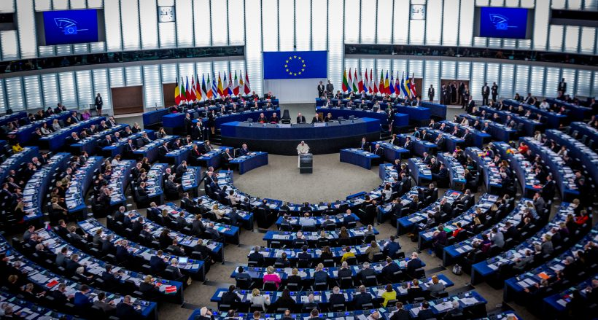
Politics
Glyphosate: The EU decided to report his decision in order to examine all the bribes given by lobbies
If you like this presentation, send an e-mail to Constant at constant.roussel@polytechnique.edu. You can also give us gifts, cakes and money. Opinion poll : is PSG the best football club in France ? Answer yes or no with the new app PSG4EVER.

Slide 4
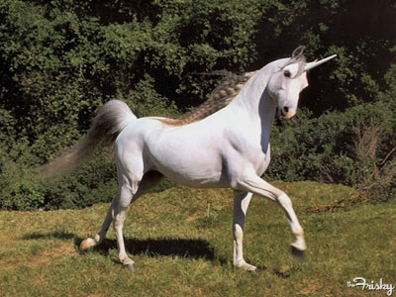
North Korea
Unicorn lair discovered in North Korea
N’importe Kes approved. There is nothing to read here. Starbucks has the best coffee ever made (Sorry Guillaume, your donuts make me sick). If you are reading this, then you are reading this ! There is still nothing to read here. Mrs Robinson is the best teacher we have ever had. CAPITAL LETTERS ALWAYS CATCH ATTENTION and small letters you really don’t care.

Slide 5
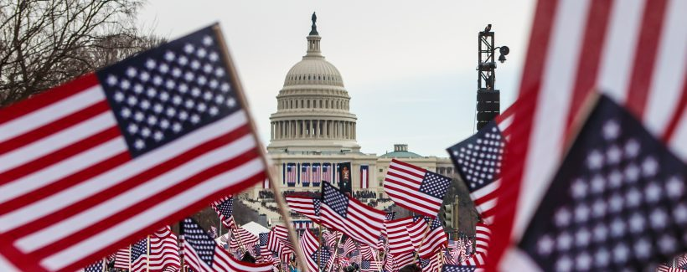
USA
After leaving the Unesco, the United States now leave North America
Renaud Garioud please stop sleeping. There is nothing to read here. Dunkin Donuts has the best coffee ever made. If you are reading this, then you are not paying attention to what we are saying : shame ! There is still nothing to read here. Mrs Robinson is the best teacher we have ever had. CAPITAL LETTERS ALWAYS CATCH ATTENTION.

Slide 6
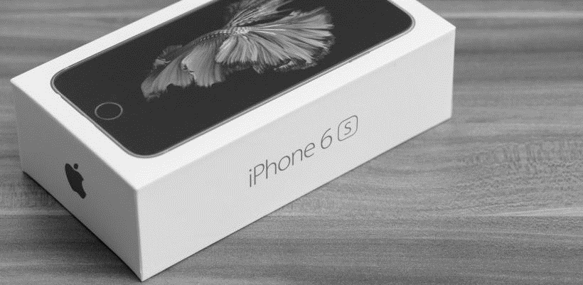
Hi-tech
Sales: Apple announced +40% on accessories
Be careful, there might be a quiz at the end of these TV news. Everyone enjoys quiz, does it ? Actually if you don’t, it is the same thing. If you like this presentation, send an e-mail to Constant at constant.roussel@polytechnique.edu. You can also give us gifts, cakes and money. Opinion poll : is PSG the best football club in France ?

Slide 7
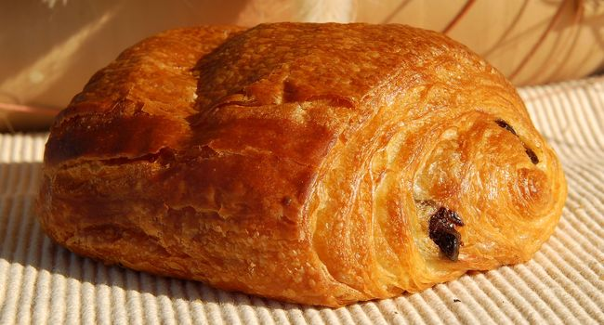
France separatist
A Parisian was shot in a bakery after asking for a ‘ pain au chocolat’ in Toulouse.
Torus Horoscope: Inspiration and insights that come through dreams could give you the boost you need to get your career on track. You may have been kicking different ideas around for a while, but what you realize today could motivate you to act. Formulate a strategy before you begin. As long as you make the effort to stay focused, efficient, and practical, whatever you decide today might work. There is nothing to read here. Capricorn Horoscope: Your imagination might soar into the wild blue yonder today. You may envision wonderful new plans for your future. Some money may be coming your way. There's the possibility of a pending raise. Let your imagination roam freely. Over the next day, make a list of your options. Weed out the unworkable ones. Don't rush to decide. Dunkin Donuts has the best coffee ever made. If you are reading this, then you are not paying attention to what we are saying : shame ! There is still nothing to read here. Mrs Robinson is the best teacher we have ever had. CAPITAL LETTERS ALWAYS CATCH ATTENTION.

Slide 8

Sports
Paris 2024: Breathing air in Paris centre will be added as a new sporting competition
Renaud Garioud please stop sleeping. There is nothing to read here. Dunkin Donuts has the best coffee ever made. If you are reading this, then you are not paying attention to what we are saying : shame ! There is still nothing to read here. Mrs Robinson is the best teacher we have ever had. CAPITAL LETTERS ALWAYS CATCH ATTENTION.

Slide 10

Pay attention, a quiz will follow the ad !
You may win the product

Slide 11
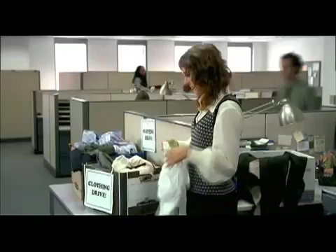

Slide 13
What is the product promoted in the Ad ?

Slide 14
The chance of dying on your birthday are ….. higher than on any other day.
A. 10%
B. 14%
C. 2%
D. 51%

Slide 15
What does SPAM stand for ?
A. Stranger People Annoying mail
B. Stupid Problem at Mailbox
C. Shoulder Pork and Ham
D. Answer D
Notes:
Comes from a sketch

Slide 16
How many cats are eaten every year in China ?
A. 10 million
B. 1,2 million
C. 800 000
D. 4 million

Slide 17
Under extreme high pressure, peanut butter can become:
A. Diamonds
B. Peanut butter
C. An MIE exam
D. Slop

Slide 19
North Korea
Unicorn lair discovered in North Korea
N’importe Kes approved. There is nothing to read here. Starbucks has the best coffee ever made (Sorry Guillaume, your donuts make me sick). If you are reading this, then you are reading this ! There is still nothing to read here. Mrs Robinson is the best teacher we have ever had. CAPITAL LETTERS ALWAYS CATCH ATTENTION and small letters you really don’t care.

Slide 20
Thank you for your attention

