Slide 1




Slide 2

Politics
New controversy after French President said « Shit, you all piss me of bordel de merde »
Renaud Garioud please stop sleeping. There is nothing to read here. Dunkin Donuts has the best coffee ever made. If you are reading this, then you are not paying attention to what we are saying : shame ! There is still nothing to read here. Mrs Robinson is the best teacher we have ever had. CAPITAL LETTERS ALWAYS CATCH ATTENTION.

Slide 3
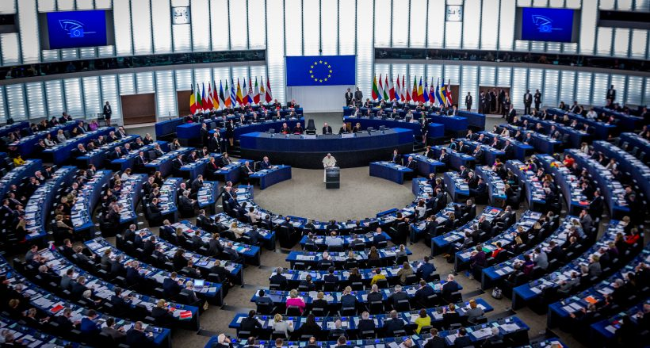
Politics
Glyphosate: The EU decided to report his decision in order to examine all the bribes given by lobbies
If you like this presentation, send an e-mail to Constant at constant.roussel@polytechnique.edu. You can also give us gifts, cakes and money. Opinion poll : is PSG the best football club in France ? Answer yes or no with the new app PSG4EVER.

Slide 4

USA
After leaving the Unesco, the United States now leave North America
Renaud Garioud please stop sleeping. There is nothing to read here. Dunkin Donuts has the best coffee ever made. If you are reading this, then you are not paying attention to what we are saying : shame ! There is still nothing to read here. Mrs Robinson is the best teacher we have ever had. CAPITAL LETTERS ALWAYS CATCH ATTENTION.

Slide 5
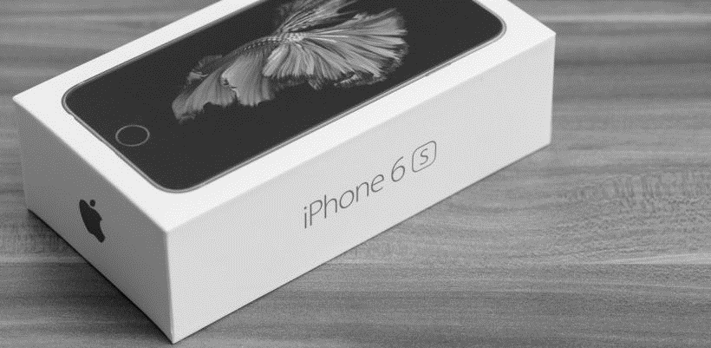
Hi-tech
Sales: Apple announced +40% on accessories
Be careful, there might be a quiz at the end of these TV news. Everyone enjoys quiz, does it ? Actually if you don’t, it is the same thing. If you like this presentation, send an e-mail to Constant at constant.roussel@polytechnique.edu. You can also give us gifts, cakes and money. Opinion poll : is PSG the best football club in France ?

Slide 6

Sports
Paris 2024: A new sporting event in the Olympic Games will be to breath air in the city center
Renaud Garioud please stop sleeping. There is nothing to read here. Dunkin Donuts has the best coffee ever made. If you are reading this, then you are not paying attention to what we are saying : shame ! There is still nothing to read here. Mrs Robinson is the best teacher we have ever had. CAPITAL LETTERS ALWAYS CATCH ATTENTION.

