Slide 1

www.auvieuxcampeur.fr
Julia Petronio - Laurène Mathieu - Valentin Maurice - Bertrand Marquette - Jules Pariot

Slide 2
The company’s activity
What is Au vieux campeur ?
Retail – Outdoor
Almost 30 stores
3 segments
Specialization
Competitors : Montaz.com, ekosport.be, Glissshop.com and more…
Customers - Wide audience
Notes:
Au vieux campeur is retail store chain specialized in outdoor sports. This company was created in 1941 by one familiy which continue to manage the differents stores. Au vieux campeur it’s almost 30 stores located in France. It’s important to mentionned that the most part of Vieux campeurs stores are based in Paris in the Latin district. Store deals with three main parts, Water, Earth, and Winter. In each parts, earth, winter, etc. you will find products such as hardgoods and softgoods such as skis, bindings or just accesories like beanies, hats, socks, pants, whatever. In Paris each store is specialized, there’s one for bagpack, an other for optics, etc. There are customers experience in Au vieux campeur stores due to this specialized stores, however customers have to be informed to go in the right store.
Outdoor sports market is highly competitive, there is a lot of actors and competitors specialized in one outdoor activy such as Rossignol, Speedo, Patagonia or several like Au vieux campeur. Competitors are physical store, Decathlon for exemple, the north face. But there’s also digital competitors more important than Decathlon and other physical stores. Glissshop.com, ekosport.fr, or Montaz are the main competitors of Au vieux campeur on internet.
What about customers ? There is no special age groupe for customers, anyone who is practicing an outdoor activty can be a Vieux campeur customers. The audience/target is wide and people form 3 to 99yo ore more could find what they at Le vieux campeur.

Slide 3
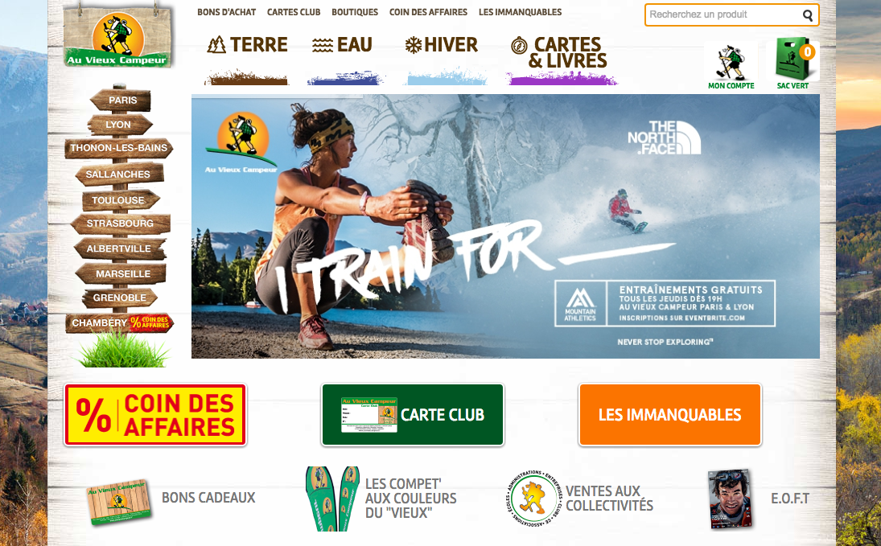
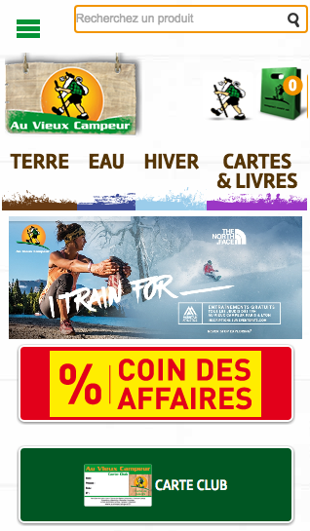
About the website
Notes:
Now we are going to talk about the website and all our recommandations for it.

Slide 4
Functions / Technologies
Hosting
Analytics
CMS
Notes:
We are going to talk about the functions and the technologies of the website
The website is responsive, so the design is adaptable to any device
The hosting is managed by Oxalide, a french company. The website is host in France so it’s very good for the SEO.
About the tracking and the analytics in general, using Google Analytics it’s a good point
About the Content Management System, Magento is a good reference for e-commerce. We can see together for another CMS more « user friendly » like Prestashop.

Slide 5
SEO analysis
Notes:
We are going to talk about the Seo (Search Engine Optimization) for the website.
the SEO is best way to drive trafic to a website without paid advertising.

Slide 6
SEO analysis
External SEO
Internal SEO
Notes:
There are 2 importants points
External SEO
Internal SEO

Slide 7
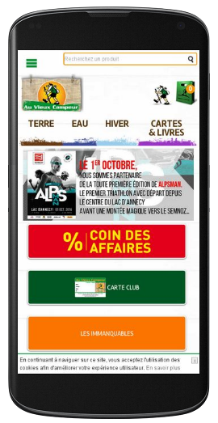
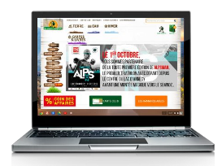


SEO analysis – External SEO
About Loading…
Notes:
Loading more or less fast the website and the pages influences the google ranking. We can see in this analyse somes problems concerning loading on the website.
We recommand to optimize the cache of the website and reduce some too big images.

Slide 8
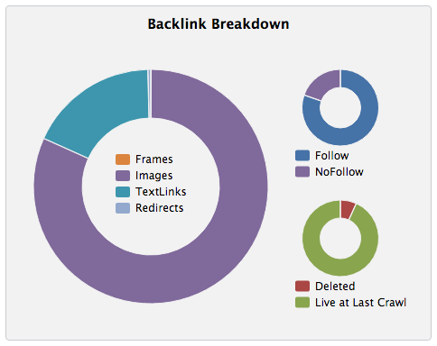
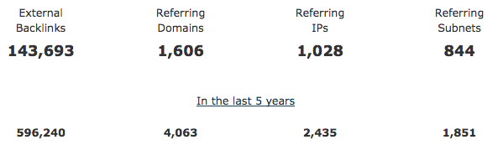
SEO analysis – External SEO
About Backlinks…
Notes:
We know that backlinks are very important for SEO. We can see that the site has a pretty good number of backlinks.
Many of these links are images. However, many of them are « follow » links so they can Boost the external SEO.
It might be interesting to have more text backlinks with optimized anchor.

Slide 9
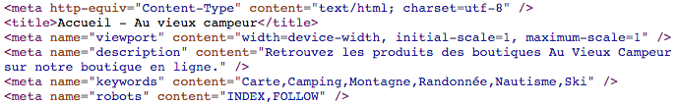
SEO analysis – Internal SEO
About Onpage, Onsite SEO…
Notes:
About Internal linking strategy
There are no internal meshing
It’s important to connect pages in order to create coherence for the SEO
--
About Keywords selection
There are no selection of keywords because it’s often about name of product.
But tit’s possible to boost it by making generic texts by product. Texts are very important for SEO
--
About Meta description
There are an optimised meta description all over the website. It is no longer a factor impacting but it is good to have a coherent description in search results in order to have more clicks
--
About title Tag
The title of the pages are not optimized for Google.
For example : The title of the site's home page is « Accueil – Au vieux campeur »
It’s important to change all page titles for the search engines in order to rank the site properly.
--
The website text content is not optimized for SEO.
There is no text in the footer of pages and no text in the categories of the site.
It would be necessary to integrate more text on the site to create coherent and optimized contents.
--
About the Images :
There are no descriptions of the images with the "alt" tag. It’s important to describe the images of the site for search engines.

Slide 10
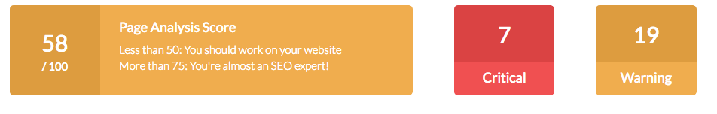
SEO analysis – Internal SEO
In conclusion
With us
Notes:
We will help you creating consistent contents, optimized and effective. We are going to help you in order to boost the visits in your website with a good strategy concerning Search Engine Optimization.
We know the problems of your site and we are going to solve them without any concerns.

Slide 11
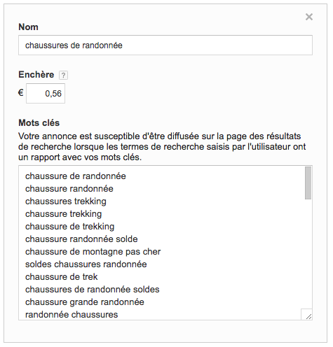
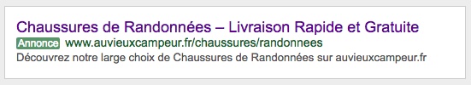
SEA
Why not ?
Notes:
There is no Adwords advertising campaigns for this website.
It would be interesting to make a deep analysis of the keyword In order to obtain a relevant targeting.
The Adwords advertising is essential nowadays to increase the visits and the sales of a Web site.
We can also help you to create your first campaigns.
Here you can see an example of an online campaign concerning the keyword « Chaussures de Randonnées »

Slide 12
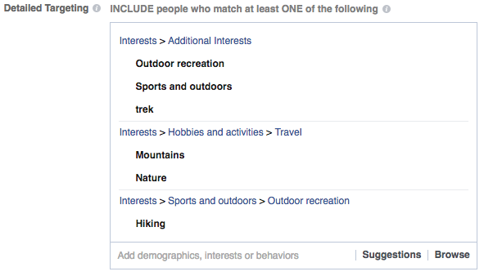
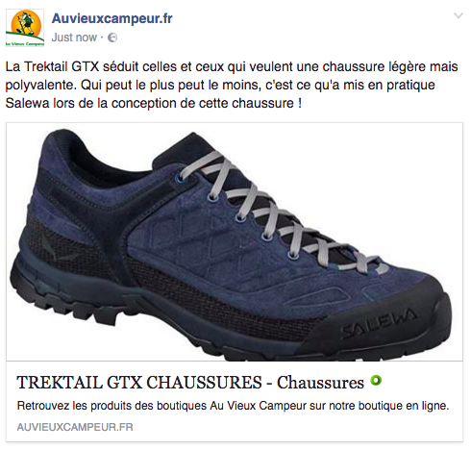
Social Medias
Sponsoring…
Notes:
Auvieuxcampeur don’t sponsorise any publications in social medias.
It can be interessant to sponsorise some products over Facebook for example because the targeting is very effective.

Slide 13
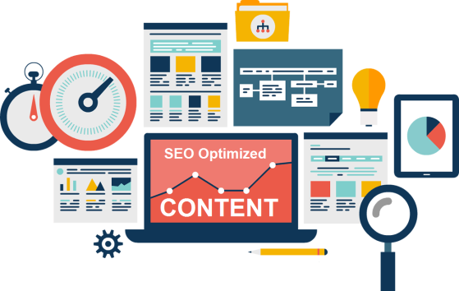
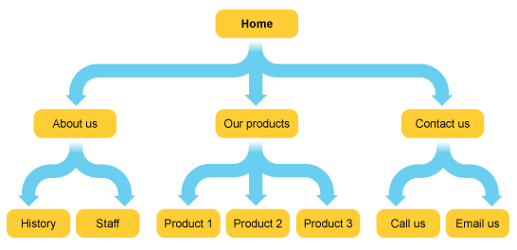
Structure
Website arborescence
Notes:
We will now analyze the website structure, the arborescence. That is to say, how it is organized.
We can notice that the arborescence is very complex. The website content is poorly organized and poorly structured. Navigation for a visitor is not logical and not at all easy.

Slide 14
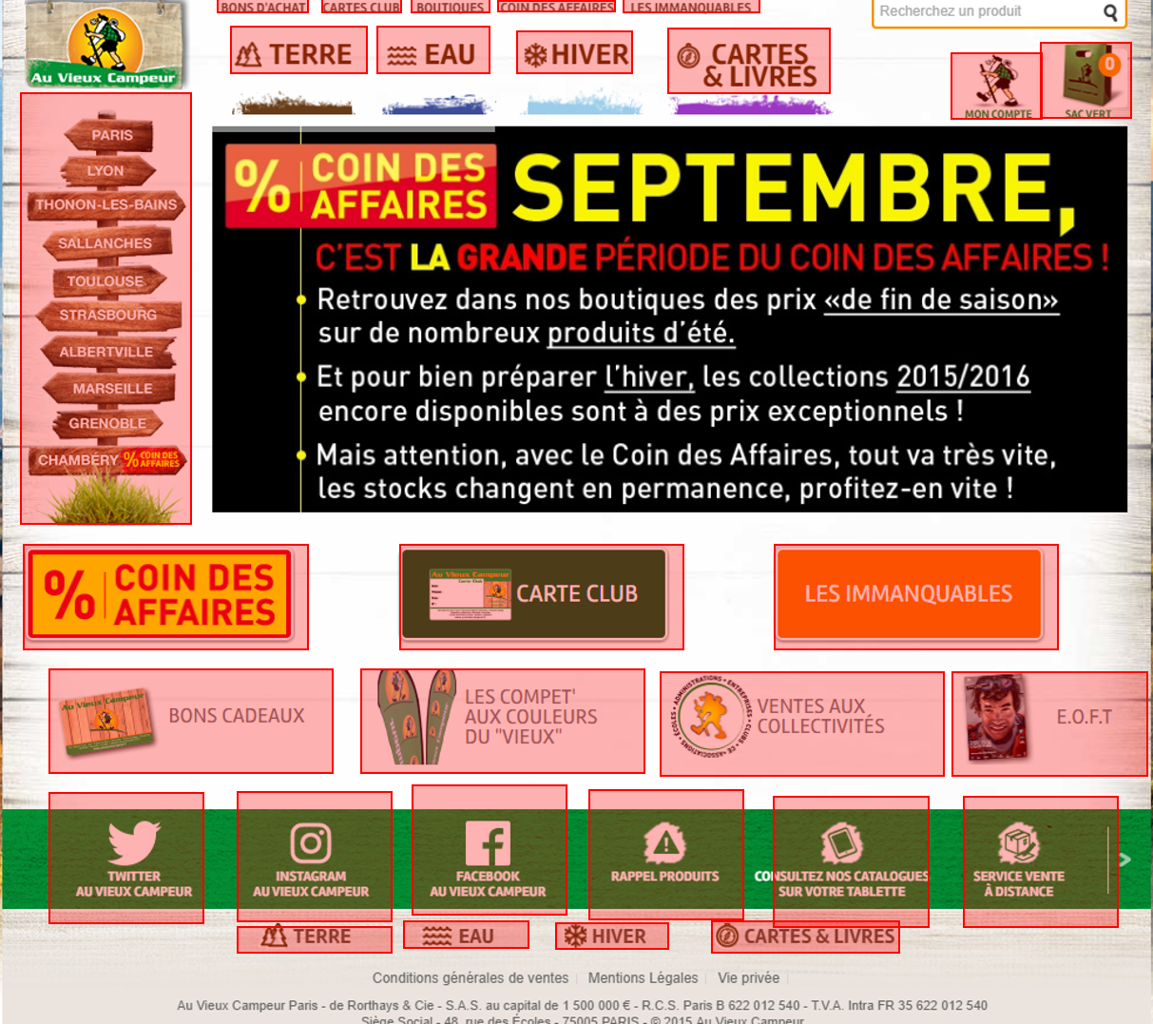



Too much informations !
Notes:
Here, circled in red it’s all the link clickable on the homepage. Almost everything is clickable, there is oftentoo much useful information on the front page as "Ventes aux collectivités locales, les compets aux couleurs du vieux… "
But we realize that important information such as « Nous contacter » or « qui sommes-nous »do not appear directly on the first page.

Slide 15
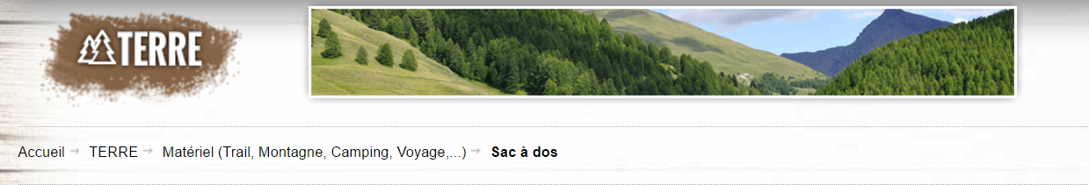
Breadcrumb
Notes:
The site also uses a navigation path called "breadcrumb" which helps users find their way and search engines to understand the structure of your information. It is very good.

Slide 16

Structure
Home Page
Three-click rule
x 3
1
2
3
Notes:
Also we can see that the three click rule is pretty well respected. Indeed, imagine that we are looking for a hat for child we must perform 3 clicks to find our request.

Slide 17
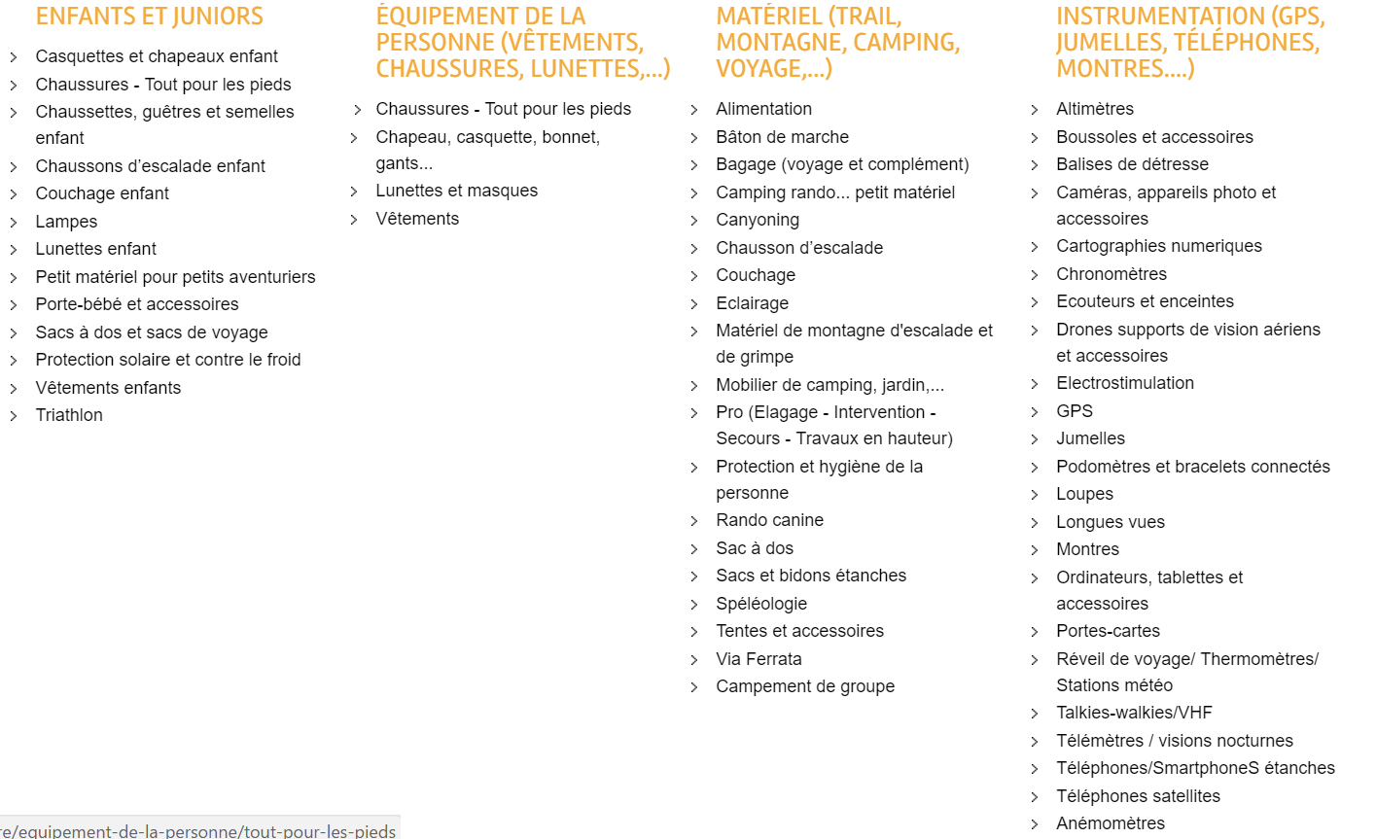
Structure
Before…
Notes:
But the drop-down menus are really too long. Which can quickly discourage the user! Remember that the user is idle. We therefore recommend integrating some categories they fall. And even create new subcategories. This will make the search much easier online.

Slide 18
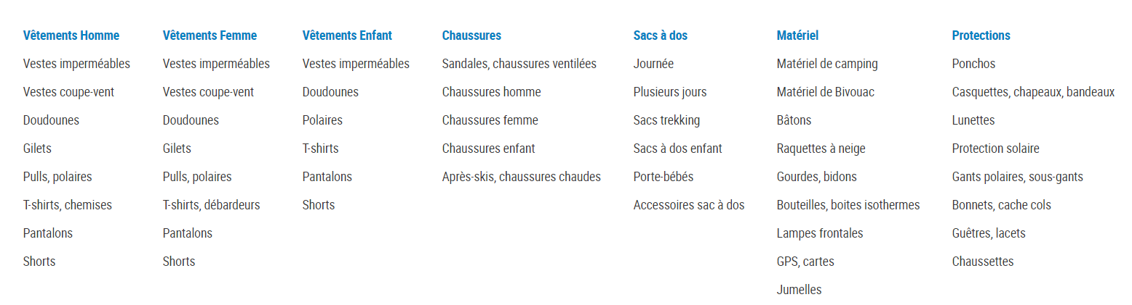
Structure
…After

Slide 19
Design & Customers experience
Our proposition…
The website
http://www.auvieuxcampeur.fr
Our proposition
http://www.bit.ly/auvieuxcampeur
Notes:
The design of the website has a strong influence on the customer’s experience.
The website auvieuxcampeur.fr has some difficulties with the design and the customer can easily be lost.
First, we can notice that the website does not have a defined corporate identity and style guide (=charte graphique). There are too many colours especially because of the 2 advertisement banners on the right and on the left and because of the category “Le coin de affaires” wrote in white, yellow and red meanwhile the main colours of auvieuxcampeur are green and orange.
Plus all the pages and banners contain too many colours and texts, which make the customers lost with a huge quantity of information. The Internet user get difficulties to find the information he is looking for. Important information like the “Qui sommes-nous?” rubric or “Contacts” are difficult to find in the home page, meanwhile some secondary information are highlighted.
About the organization and the ergonomics, the main structure would require some improvements. For example drop-down menus are or overly detailed like the “Terre” section or empty like the “Cartes & Livres” section. The customer is frustrated either by the lack or by the excess of information. He doesn’t know where he should look to find what he wants.
Moreover, when he chooses one of the four categories such as “Terre” or “Eau”, the four main categories disappear from the top of the page so he can’t go to another category easily, he has to go back to the home page.
Concerning the presentation of the products, we noticed a positive point : customers can choose between two different ways of presentation : linear or mosaic. People have different preferences and it’s a good point to make the website adjustable.
As we noticed previously, the design of a website is strongly linked with the customer’s experience. To improve both of them, we prepared some suggestion illustrated by a new version of the website.
First, it’s very important to have a refined website so the internet user can find what he’s looking for very easily and quickly. He should not have to click more than 3 times to find the information. To facilitate this process, we decided to take off the redundancies, in particular the 4 main categories “Eau” “Terre” “Hiver” “Cartes et Livres” which appeared twice in the home page (at the top and at the bottom). We got rid of the banner at the bottom. The top banner should go down when the user is scrolling the page so he doesn’t have to go up to go on another section.
We also removed two sections “Coin des affaires” and “Carte Club” which were not necessary on the home page and which were saturating the page. However, products with promotion will be the first to appear in each category with a specific mention. We only decided to keep the section “Les Immanquables” and to create a new one “Nouveautés”. We created a dynamic banner with pictures which gives a better visibility.
We want to highlight the three most clicked products of the week.
About the green banner, there were too many categories so we decided to put key information for the customer such as “Paiement sécurisé”, “Livraison 48h Gratuite” and “Services de Proximité”.
We also decided to create a F.A.Q (Q&A) category where we can gather all the important information and the recurrent questions.
We want to give more importance to the user and the UGC (User Generated Content). That’s why we want to create a box under each product so the users can give their opinion. That way the users feel more involved and it helps to create a community. Positive comments lead the other customers to buy the product.
The customer can easily follow the actuality of the website thanks to the several links near the logo at the top.

