Slide 1

www.auvieuxcampeur.fr
Julia Petronio - Laurène Mathieu - Valentin Maurice - Bertrand Marquette - Jules Pariot

Slide 2
The company’s activity
What is Au vieux campeur ?
Retail – Outdoor
Almost 30 stores
3 segments
Specialization
Competitors : Montaz.com, ekosport.be, Glissshop.com and more…
Customers - Wide audience
Notes:
Au vieux campeur is retail store chain specialized in outdoor sports. This company was created in 1941 by one familiy which continue to manage the differents stores. Au vieux campeur it’s almost 30 stores located in France. It’s important to mentionned that the most part of Vieux campeurs stores are based in Paris in the Latin district. Store deals with three main parts, Water, Earth, and Winter. In each parts, earth, winter, etc. you will find products such as hardgoods and softgoods such as skis, bindings or just accesories like beanies, hats, socks, pants, whatever. In Paris each store is specialized, there’s one for bagpack, an other for optics, etc. There are customers experience in Au vieux campeur stores due to this specialized stores, however customers have to be informed to go in the right store.
Outdoor sports market is highly competitive, there is a lot of actors and competitors specialized in one outdoor activy such as Rossignol, Speedo, Patagonia or several like Au vieux campeur. Competitors are physical store, Decathlon for exemple, the north face. But there’s also digital competitors more important than Decathlon and other physical stores. Glissshop.com, ekosport.fr, or Montaz are the main competitors of Au vieux campeur on internet.
What about customers ? There is no special age groupe for customers, anyone who is practicing an outdoor activty can be a Vieux campeur customers. The audience/target is wide and people form 3 to 99yo ore more could find what they at Le vieux campeur.

Slide 3


About the website

Slide 4
Functions / Technologies
Hosting
Analytics
CMS
Notes:
We are going to talk about the functions and the technologies of the website
The website is responsive, so the design is adaptable to any device
The hosting is managed by Oxalide, a french company. The website is host in France so it’s very good for the SEO.
About the tracking and the analytics in general, using Google Analytics it’s a good point
About the Content Management System, Magento is a good reference for e-commerce. We can see together for another CMS more « user friendly » like Prestashop.

Slide 5
SEO analysis
Notes:
We are going to talk about the Seo (Search Engine Optimization) for the website.
the SEO is best way to drive trafic to a website without paid advertising.

Slide 6
SEO analysis
External SEO
Internal SEO
Notes:
There are 2 importants points on a SEO analysis
External SEO
Internal SEO

Slide 7

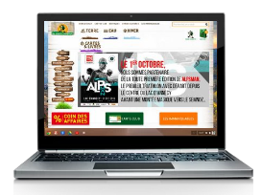


SEO analysis – External SEO
About Loading…
Notes:
Loading more or less fast the website and the pages influences the google ranking. We can see in this analyse somes problems concerning loading on the website.
We recommand to optimize the cache of the website and reduce some too big images.

Slide 8
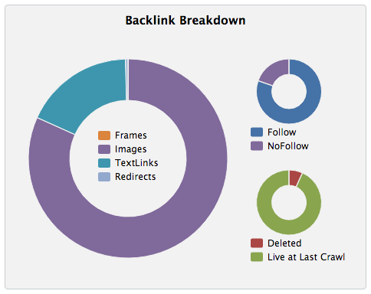
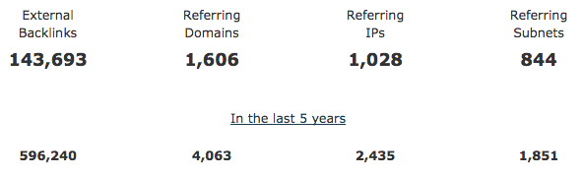
SEO analysis – External SEO
About Backlinks…
Notes:
We know that backlinks are very important for SEO. We can see that the site has a pretty good number of backlinks.
Many of these links are images. However, many of them are « follow » links so they can Boost the external SEO.
It might be interesting to have more text backlinks with optimized anchor.

Slide 9
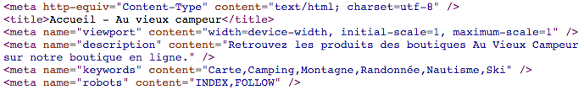
SEO analysis – Internal SEO
About Onpage, Onsite SEO…
Notes:
About Internal linking strategy
There are no internal meshing
It’s important to connect pages in order to create coherence for the SEO
--
About Keywords selection
There are no selection of keywords because it’s often about name of product.
But tit’s possible to boost it by making generic texts by product. Texts are very important for SEO
--
About Meta description
There are an optimised meta description all over the website. It is no longer a factor impacting but it is good to have a coherent description in search results in order to have more clicks
--
About title Tag
The title of the pages are not optimized for Google.
For example : The title of the site's home page is « Accueil – Au vieux campeur »
It’s important to change all page titles for the search engines in order to rank the site properly.
--
The website text content is not optimized for SEO.
There is no text in the footer of pages and no text in the categories of the site.
It would be necessary to integrate more text on the site to create coherent and optimized contents.
--
About the Images :
There are no descriptions of the images with the "alt" tag. It’s important to describe the images of the site for search engines.

Slide 10
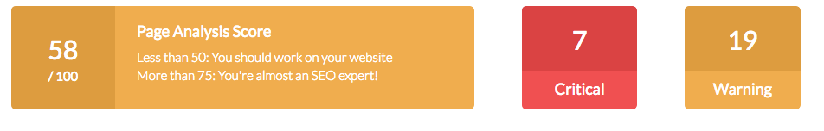
SEO analysis – Internal SEO
In conclusion
With us
Notes:
We will help you creating consistent contents, optimized and effective. We are going to help you in order to boost the visits in your website with a good strategy concerning Search Engine Optimization.
We know the problems of your site and we are going to solve them without any concerns.

Slide 11
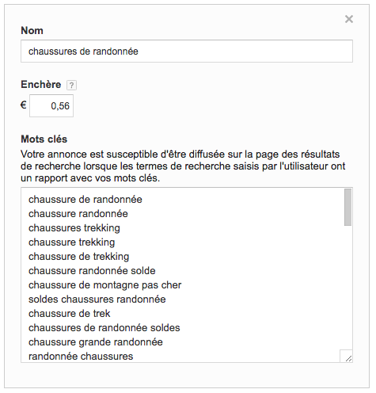
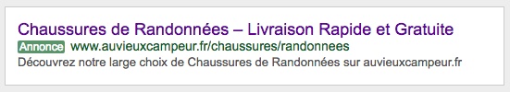
SEA
Why not ?
Notes:
There is no Adwords advertising campaigns for this website.
It would be interesting to make a deep analysis of the keyword In order to obtain a relevant targeting.
The Adwords advertising is essential nowadays to increase the visits and the sales of a Web site.
We can also help you to create your first campaigns.
Here you can see an example of an online campaign concerning the keyword « Chaussures de Randonnées »

Slide 12
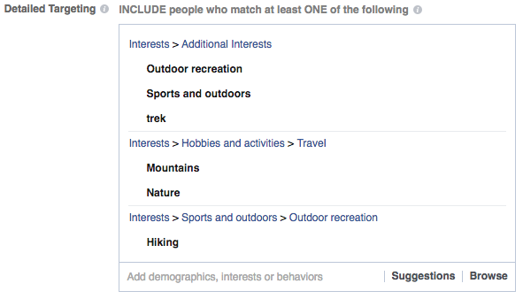
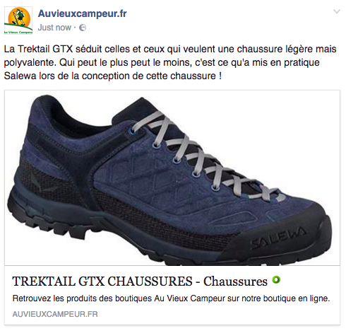
Social Medias
Sponsoring…
Notes:
Auvieuxcampeur don’t sponsorise any publications in social medias.
It can be interessant to sponsorise some products over Facebook for example because the targeting is very effective.

Slide 13





Structure
Home Page
…
…
An example…

