Slide 1
Business Model & Firm Strategy
Anne BERMOND
Aude BROCARD
Tom GAECHTER
Olivier GRTOZ
Marine LAFOREST
Jules PARIOT

Slide 2

A Few Figures
54% 46%
25% - 25 to 44 years
Urbain – 58%
PC & Laptop – 59%
France – 9%

Slide 3
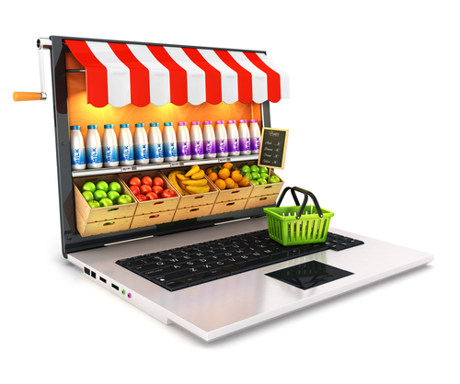
The impact of innovation on physical, alimentary retail stores
Mid-2000 : large retail stores developp their online business
Delivery and Drive-through option
Sales figures increased by 2.5 in 7 years
Responds to a demand of people who : work, have kids or are unable to go to a supermarket

Slide 4
Who is impacted ?
Small & medium size convenience stores
People can shop easily by a click
Don’t have to carry heavy bags
Large supermarket chains are positively impacted
3 different distribution channels
Improve consumer faithfulness
Other innovation :
Created by large supermarket groups in France
Rapidly compare prices
Changed the way of advertising
Consumers easily save money

Slide 5
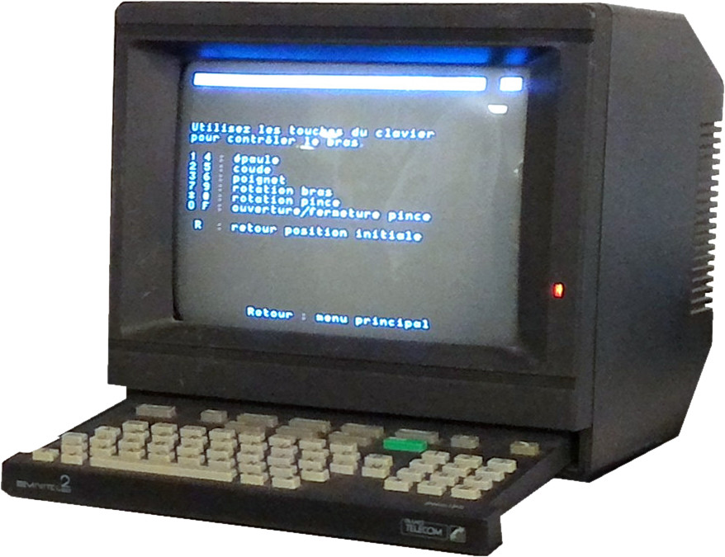
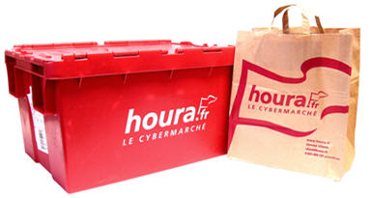
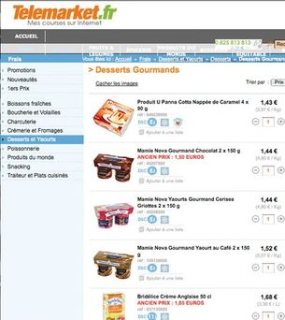

History of « pure-players » in mass market retailing : Food
1983
2012

Slide 6
Consumer Products – Futur innovations
From E to M – commerce
Phones are new shops
Connected fridge
Virtual Reality
Create interactions between customers and advertissements
Issues : Supply chain, Packaging

Slide 7
Thank you for your attention

