Slide 1
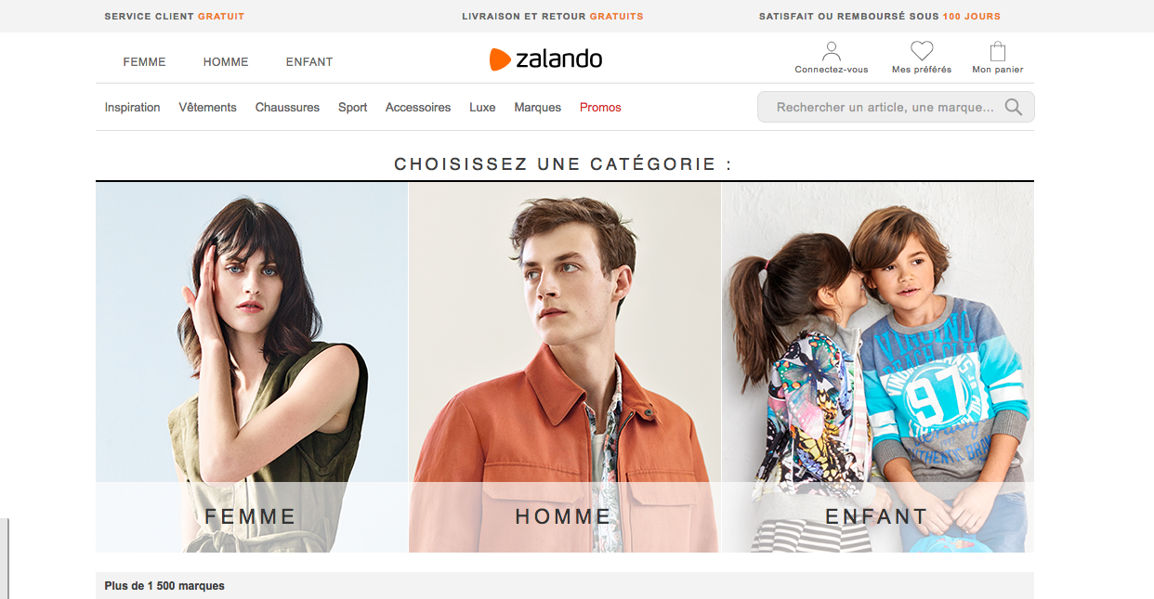

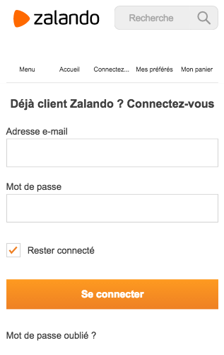


Slide 2





Introduction
Online
Retailer
2008
Pure Player
3 billion €

Slide 3
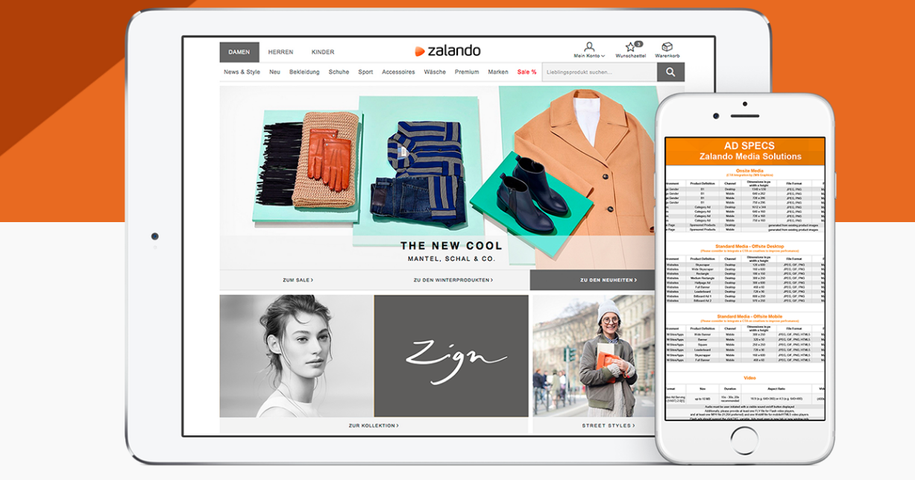
Technology

Slide 4

Digital strategies
Logistic

Slide 5
Digital strategies
Promotion

Slide 6
Digital strategies
Customer knowledge

