Slide 1


Business model and Strategy IN THE RETAIL SECTOR
Comptoir des cotonniers vs Zalando
Bertrand Marquette – Valentin Maurice – Lory Montagnon – Julie Pellestor – Camille Sgubbi

Slide 2
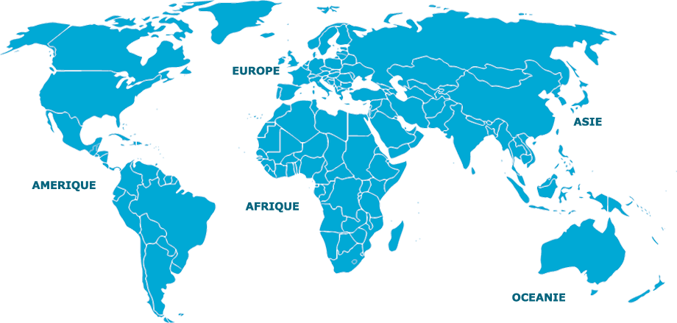
French ready-to-wear-company founded in 1995
96
227
45
8
Focused on innovation and disruption
Comptoir des Cotonniers physical distribution in 2015
Digital transformation since 2005
In 2015, turnover of 166 million euros (15% made on CdC website)
Company strategy : increasing sales by gaining new clients and retaining existent ones
Notes:
For the brick’n’mortar company, we chose the French ready-to-wear company Comptoir des Cotonniers. I’m gonna give a brief presentation of the company to set the context. It was founded in 1995 in Toulouse and since the beginning the company has always chosen the innovation. For example, CdC was the first ready-to-wear company to go on the affordable luxury market. In 2005, the company was taken over by the Fast Retailing Group. In 2015, the company made a turnover of 166 million euros (15% came from CdC website) and had more than 400 physical stores worldwide. Comptoir des cotonniers started its digital transformation in 2005 with Valerie Dassier at the head of the marketing and digital department, and we are going to see how and why.
The core strategy of the company is of course to increase sales by gaining new clients and retaining the existent ones. In order to do so the company had to adapt to the new consumers’ behavior and to develop solutions to fulfill its clients’ new expectations.

Slide 3
Consumers’ new expectations
Save time
Consideration
Personalization
Inspiration
Be connected with the brand anywhere at anytime
Developing digital solutions to fulfill those new needs
Notes:
And the new customers what do they want? They want to save time. They want to be able to search info or to buy a CdC product anywhere at any time. So it can be at home from a tablet or at work during the break from a laptop or from a smartphone. The new clients are looking for personalization and consideration. And finally they don’t just buy a product but they also buy the brand identity that comes with it so they need to feel inspired.
Facing those new characteristics, CdC chose to develop digital strategies because it was implied by its clients’ new needs (to be connected with the brand anywhere at any time).

Slide 4
Digital solutions | Functions | Objectives
Tablets in physical stores | e-catalogue, ordering products non available in stores, pre-reservation | Use of the digital to optimize the client’s experience in store
CdC website (optimized for laptops, smartphones and tablets) | e-commerce, products’ availability in stores, e-catalogue, click and collect, e-reservation | Use of the digital to optimize the client’s experience (need to save time and to be connected)
Blog | Inspirational posts (looks, lifestyle, activities…) | Reinforce the brand image and meet the need for inspiration
Social networks | Clients’ opinions and feedbacks, company news and inspirational posts | Reinforce the brand community and meet the need for consideration
Fast shopping | Get info or buy a product anywhere from its smartphone (bus shelters, tables of a coffee shop…) | Bring the products to the consumer and increase the brand’s visibility thanks to the disruption effect
Notes:
In conclusion we clearly see that CDC objective is not to replace the physical stores by the website and the digital solutions but to use the digital to optimize the client’s experience. The strategy is omnichannel and the physical store is essential. All the contact points are used and connected. The client can search info on its smartphone, reserve a product on the website and pick it up at the physical store later to try it on and buy it.

Slide 5
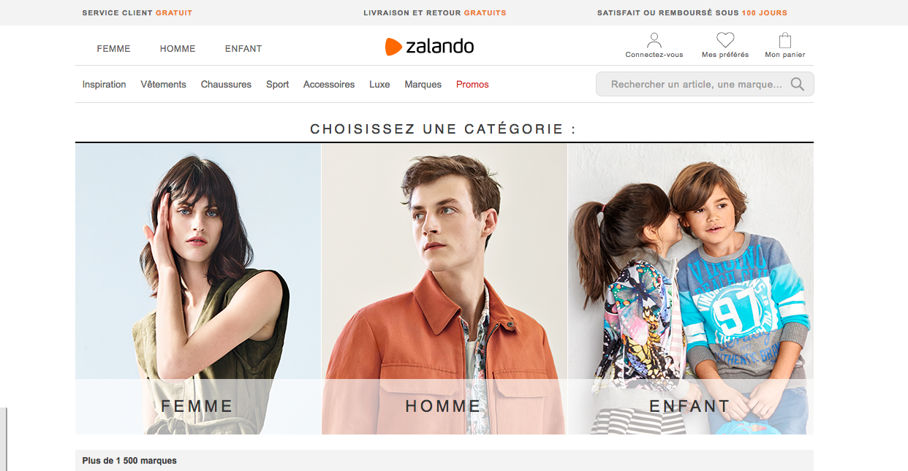

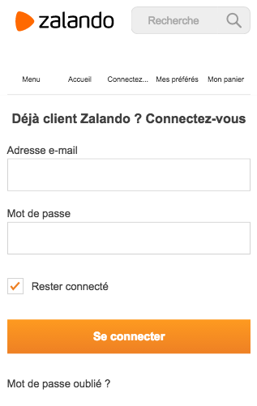


Slide 6





Introduction
Online
Retailer
2008
Pure Player
3 billion €

Slide 7
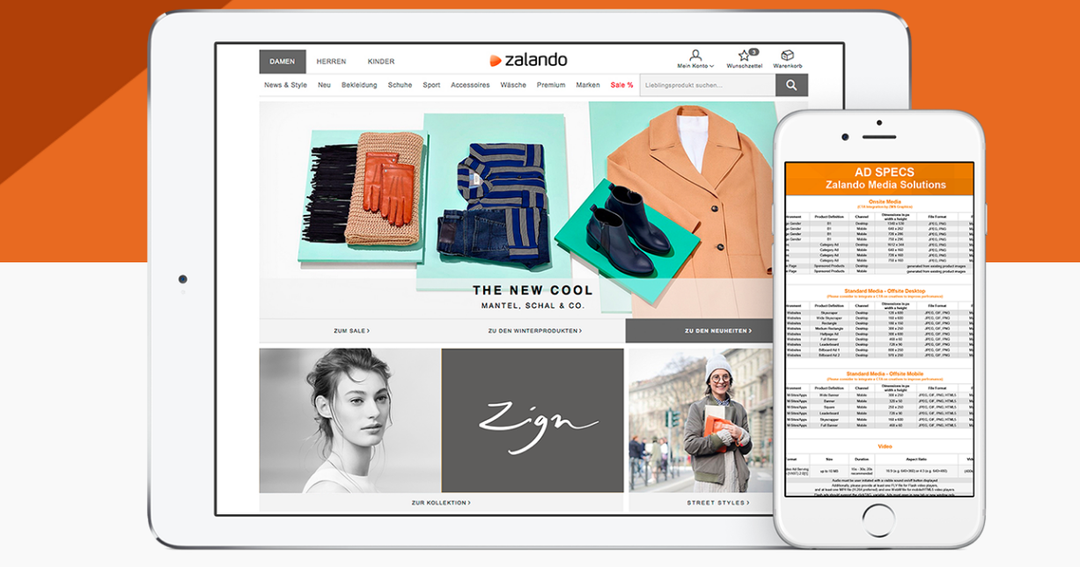
Technology

Slide 8
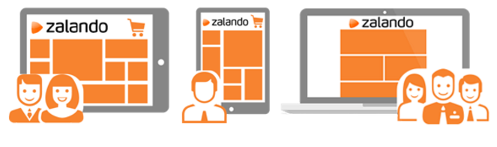
Digital strategies
Logistic

Slide 9


Digital strategies
Promotion

Slide 10
Digital strategies
Customer knowledge

