Slide 1
Module 1
Drivers
HP Designjet T920/T1500 ePrinters Service and Support

Slide 2
Lesson 1
Drivers theory of operation

Slide 3
What is a printer driver?
A printer driver or a print processor is a piece of software that converts the data to be printed to the form specific to a printer. The purpose of printer drivers is to allow applications to do printing without being aware of the technical details of each printer model.

Slide 4
What is a printer driver?
The printer driver sends the printer-setting information, including the specifications needed to produce each character of the document, to the GDI. It also transmits helper services or utilities required to make the output print correctly.

Slide 5
What is a printer spooler?
Printer drivers should not be confused with print spoolers, which is here only to manage all print jobs currently being sent to the computer printer or print server.
Spooling allows multiple print jobs to be given to the printer at one time.

Slide 6

Printing from the computer
When printing from a Windows application such as Microsoft PowerPoint, the Windows application outputs the print job as an EMF file. Please refer to figure below. The EMF (Enhanced Meta File) format is an image description format defined by Microsoft Windows. The printer driver on the server converts the EMF file to the RAW data format appropriate for the target printer.

Slide 7
Printing from the computer
In the Windows' printing system, RAW data is defined, as the data that is sent to the printer in a printer language the printer understands, such as PCL5/6 or PCL3Plus.
The difference in the languages is in the resultant RAW data files. The size of the RAW data 'file' is important because it represents the amount of I/O bandwidth that must be used to get the data to the printer. Please refer to

Slide 8

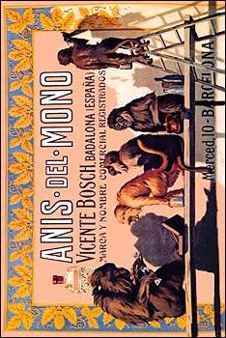
Windows driver architecture
Calls
Application
Driver UI
Job config
Application graphic calls
Status Monitor
GDI
Driver Graphic DLL
Driver graphic calls
Writes to spooler
Reads status
Writes job
Reads job
Spooler
Printer PDL
Language Monitor
Spooler
EMF
Sends
Sends
Port Monitor
Sends
I/O Stack

Slide 9
GDI: Graphical Device Interface
GDI is used by most Windows applications to display images on a monitor, so when printing from a Windows application to a GDI printer, there is no need to convert the output to another format such as PostScript or PCL.
EMF: Enhanced MetaFile and raw are terms for spool file formats used in printing by the Windows.
PDL: Page Description Language, a language for describing the layout and contents of a printed page. The best-known PDLs are AdobePostScript and Hewlett-Packard PCL
Language Monitor: provides the common language needed for the client and printer to understand each other in bidirectional communication, so you can configure the printer and monitor printer status.

Slide 10
Raster printer driver
Text
Text
Text
Document
Spool File
Page

Slide 11
Lesson 2
Printing and Plotting concepts

Slide 12
There are three types of object that you may want to print or plot:
- Image
- Characters
- Vector

Slide 13
Image (or raster graphic)
A raster graphic is an image made of hundreds (or thousands or millions) of tiny squares of color information, referred to as either pixels or dots. (Technically pixels refer to color blocks viewed on an electronic monitor where as dots refer to the ink dots on a printed piece.)

Slide 14
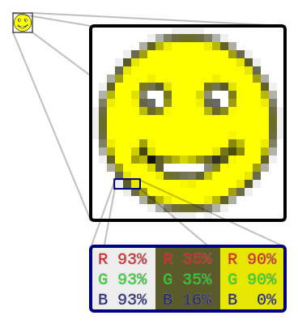

The most common type of raster graphic? A photograph. The designer’s preferred program for creating and editing raster files? Adobe Photoshop.
Popular raster file format extensions include: jpg/jpeg, psd, png, tiff, bmp and gif.

Slide 15
Vector Graphics
A vector graphic uses math to draw shapes using points, lines and curves. So whereas a raster image of a 1” x 1” square at 300 dpi will have 300 individuals pieces of information, a vector image will only contain four points, one for each corner; the computer will uses math to “connect the dots” and fill in all of the missing information.

Slide 16
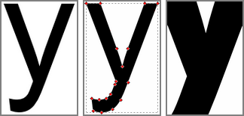
The most common types of vector graphics? Fonts and logos. The designer’s preferred program for creating and editing vector files? Adobe Illustrator.
Popular vector file format extensions include: eps, ai and pdf.

Slide 17
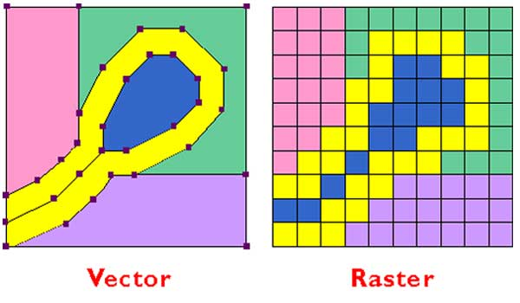

Slide 18
Lesson 3
Different Drivers

Slide 19
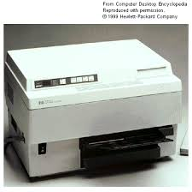
PCL(Printer Command Language)
Hewlett-Packard (HP) originally created the PCL in the early 1980's in an effort to provide an effective language for controlling a variety of printing devices, each having an unique feature set. The protocol has seen continuous development for more than two decades, and now commands more printers than any other language in existence. While not designed for the highest possible color accuracy (e.g. it lacks Pantone support), receiving devices can quickly process the print job and greatly reduce the amount of time required for printing when using the PCL.

Slide 20
PJL (Printer Job Language)
HP designed the PJL such that programmers could provide various job-level settings, including printer language, resolution, etc., as well as request status information from a given device. Hierarchically speaking, the PJL resides above printer languages such as PCL and Postscript.

Slide 21
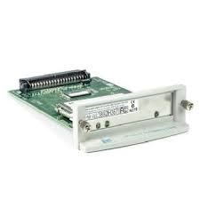
HP-GL/2 (Hewlett-Packard Graphics Language)
HP supplemented the PCL with a set of graphics commands known as HP-GL/2 for the description of vector graphics in a print job. This language allows a print job to specify printed art as a collection of lines, vectors, polygons, and other geometrical objects. Typically, only large format printers support this language.

Slide 22
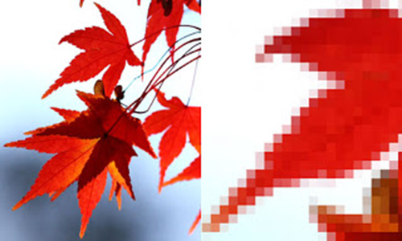
RTL (Raster Transfer Language)
This language exists as a subset of the HP-GL/2, which implies its inclusion in the PCL as well. It was created by HP for the purpose of embedding bitmaps (raster images) into HP-GL/2 print jobs. Accordingly, only large format printers commonly support this language.

Slide 23
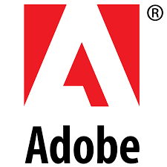
PS (Postcript)
PS (Postscript)Postscript is a language originally developed by Adobe in 1985 for the purpose of describing an image in a device independent manner. Over the course of time, it has received numerous revisions and now exists as the de facto standard for reproducing color-accurate documents. By design, the language extends itself to many different scenarios, and, consequently, boasts a degree of complexity which other languages have tried to avoid.

Slide 24
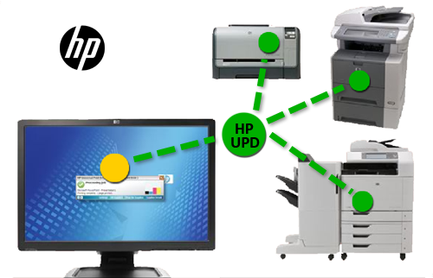
HP Universal Print Driver (UPD)
UPD :is an intelligent print driver that supports a broad range of HP LaserJet printers and MFPs. Developed by Hewlett-Packard, it combines a general purpose driver (UNIDRV or PSCRIPT) and HP proprietary extensions. HP UPD simplifies driver deployment and management. This advanced print driver has the ability to discover HP printing devices and automatically configure itself to the device capabilities (e.g., duplex, color, finishing, etc.).

Slide 25
Lesson 3
HP-GL2 VS Raster Drivers

Slide 26
HP-GL/2
Setting the driver to HP-GL/2 as the graphics mode allows the driver to process the page using the fast and efficient HP-GL/2 language. HP-GL/2 is a vector language which formats images by creating geometrical forms. When the driver is set to HP-GL/2, it uses its own vector processor which allows for the fastest and most efficient transmission of data directly to the printer.

Slide 27
RASTER
Setting the driver to Raster uses Windows as the processor for the data. Because Windows is being used to process information, data is not sent directly to the printer. The extra step of using Windows to process usually results in slower printing in Raster mode. However, because the image is created as a series of small dots, it is more likely to match your intended output than will HP-GL/2. Use the Raster setting when printed output does not match your screen.

Slide 28
Pros and Cons
Raster (Bitmap) • Made of pixels • Represents and edits photo and photo-like elements better than vector programs with the use of continuous tones. The use of different color pixels allows for smooth blends of colors. Disadvantages • Is bound by the number of pixels in the image. It cannot be scaled up without losing quality. •Large dimensions & detailed images equal large file size. • Some service providers like engravers, stencil-cut signs, etc, must have vector art. • It is more difficult to print raster images using a limited amount of spot colors. • Depending on the complexity of the image, conversion to vector may be time consuming.
Vector • Made of mathematical calculations that form objects and lines. • Can be scaled to any size without losing quality. • Resolution-independent: Can be printed at any size/resolution. • Number of colors can be easily increased or reduced to adjust printing budget. • A large dimension vector graphic can maintain a small file size. • Vector art is required by many service providers. • Can be easily converted to raster Disadvantages • It is not the best format for photographs or photo-like elements with blends of color.

Slide 29
Lesson 3
Windows and MAC

Slide 30
Full Feature
A Full Feature driver allows you to get the most out of your printer, and HP includes valuable software to help you do so. If you have an All-in-One, this driver provides complete printer functionality for printing, scanning, copying, and faxing.
Additional Features
Searchable help files tailored to your printer.
Image editing software.
Shop for HP supplies.
During the Full Feature installation process, you can choose a custom installation, where you select the specific software items that you want to install.

Slide 31
In OS
In-OS software is a driver that is already on your computer and allows basic printer functionality; most of the printer control panel buttons do not function, you cannot use eFax functions (if your printer is so equipped), and scanning output functions such as scan-to-email are unavailable.
You do not need to download and install any additional software from HP to use your printer. You can still use the software to perform basic print, scan, and fax tasks, and import images from memory cards if your printer has these features.

Slide 32
Windows Update Driver
Your Windows computer comes with a pre-installed driver called an in-OS driver. This software allows basic functionality for your printer. Windows Update can be used to make sure you have the most current in-OS driver by downloading the driver manually, or setting up the automatic update feature in Windows .

Slide 33
Mac OS X
In Mac OS X 10.5, printers are configured in the Print & Fax pane in System Preferences, and in printer proxy applications which display the print queues and allow additional configuration after printers are set up. Earlier versions of Mac OS X also included a Printer Setup Utility, which supplied configuration options missing from earlier versions of the Print & Fax preference pane.

Slide 34
OSX
If you are having difficulty configuring your printers or even just printing to them in OS X, one thing to try is to reset the print system, which will clear out your printers and allow you to set them up again from scratch. This service mayappear to only remove your printers, but it in fact does a number of checks on the system and restores configuration files to factory defaults.

