Slide 1


Slide 2

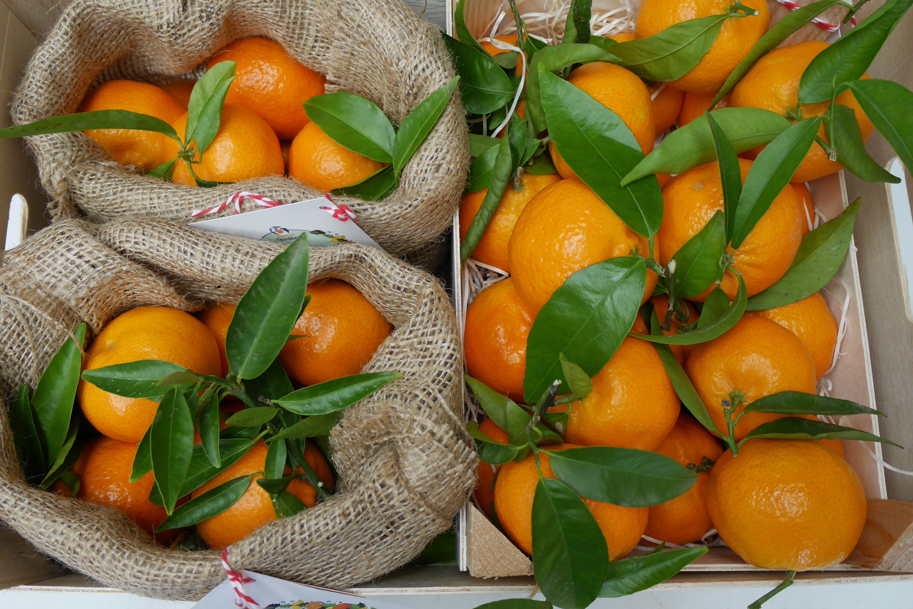
PRESENTATION IDEAS FOR GOURMET STORES
2kg yute bag
Customers can serve theirselves directly from the bag
2kg wooden box
Customers can serve theirselves directly from the box

Slide 3
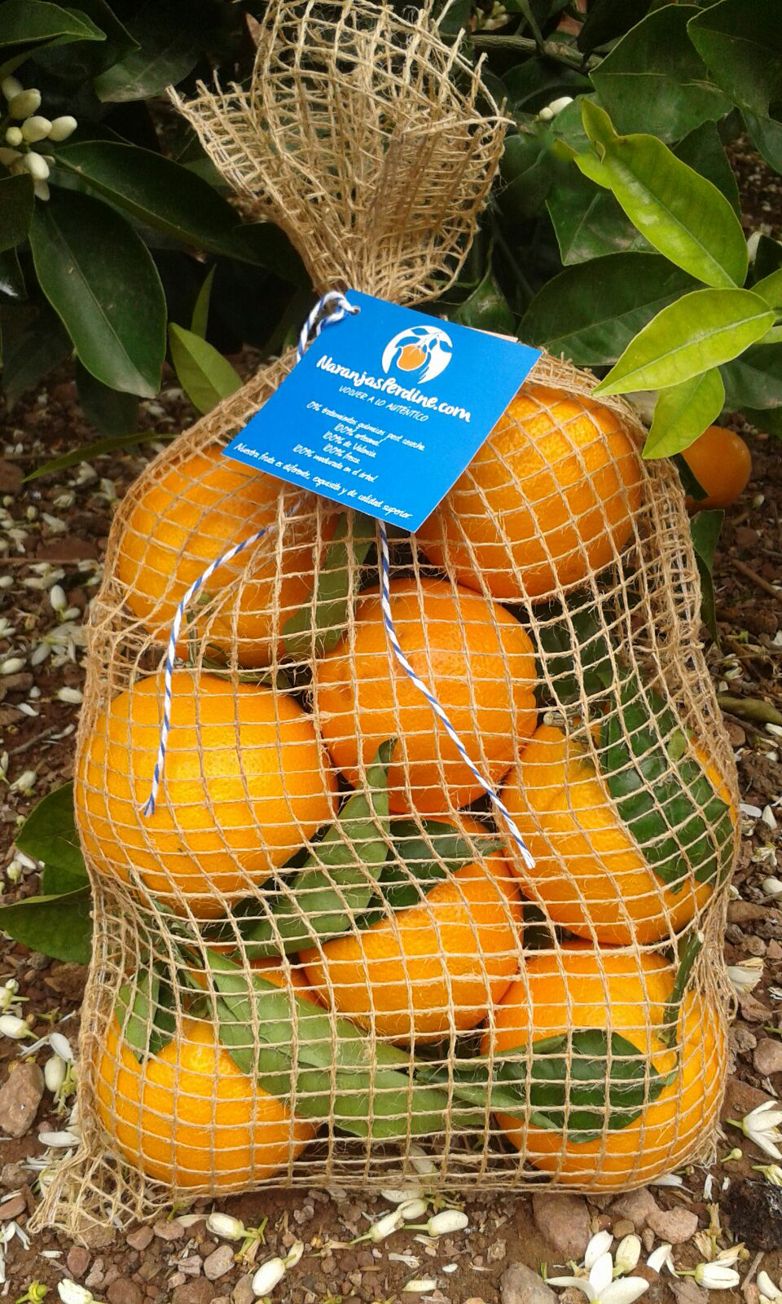
2kg jute bag: pick and go-ideal for table or juice oranges

Slide 4
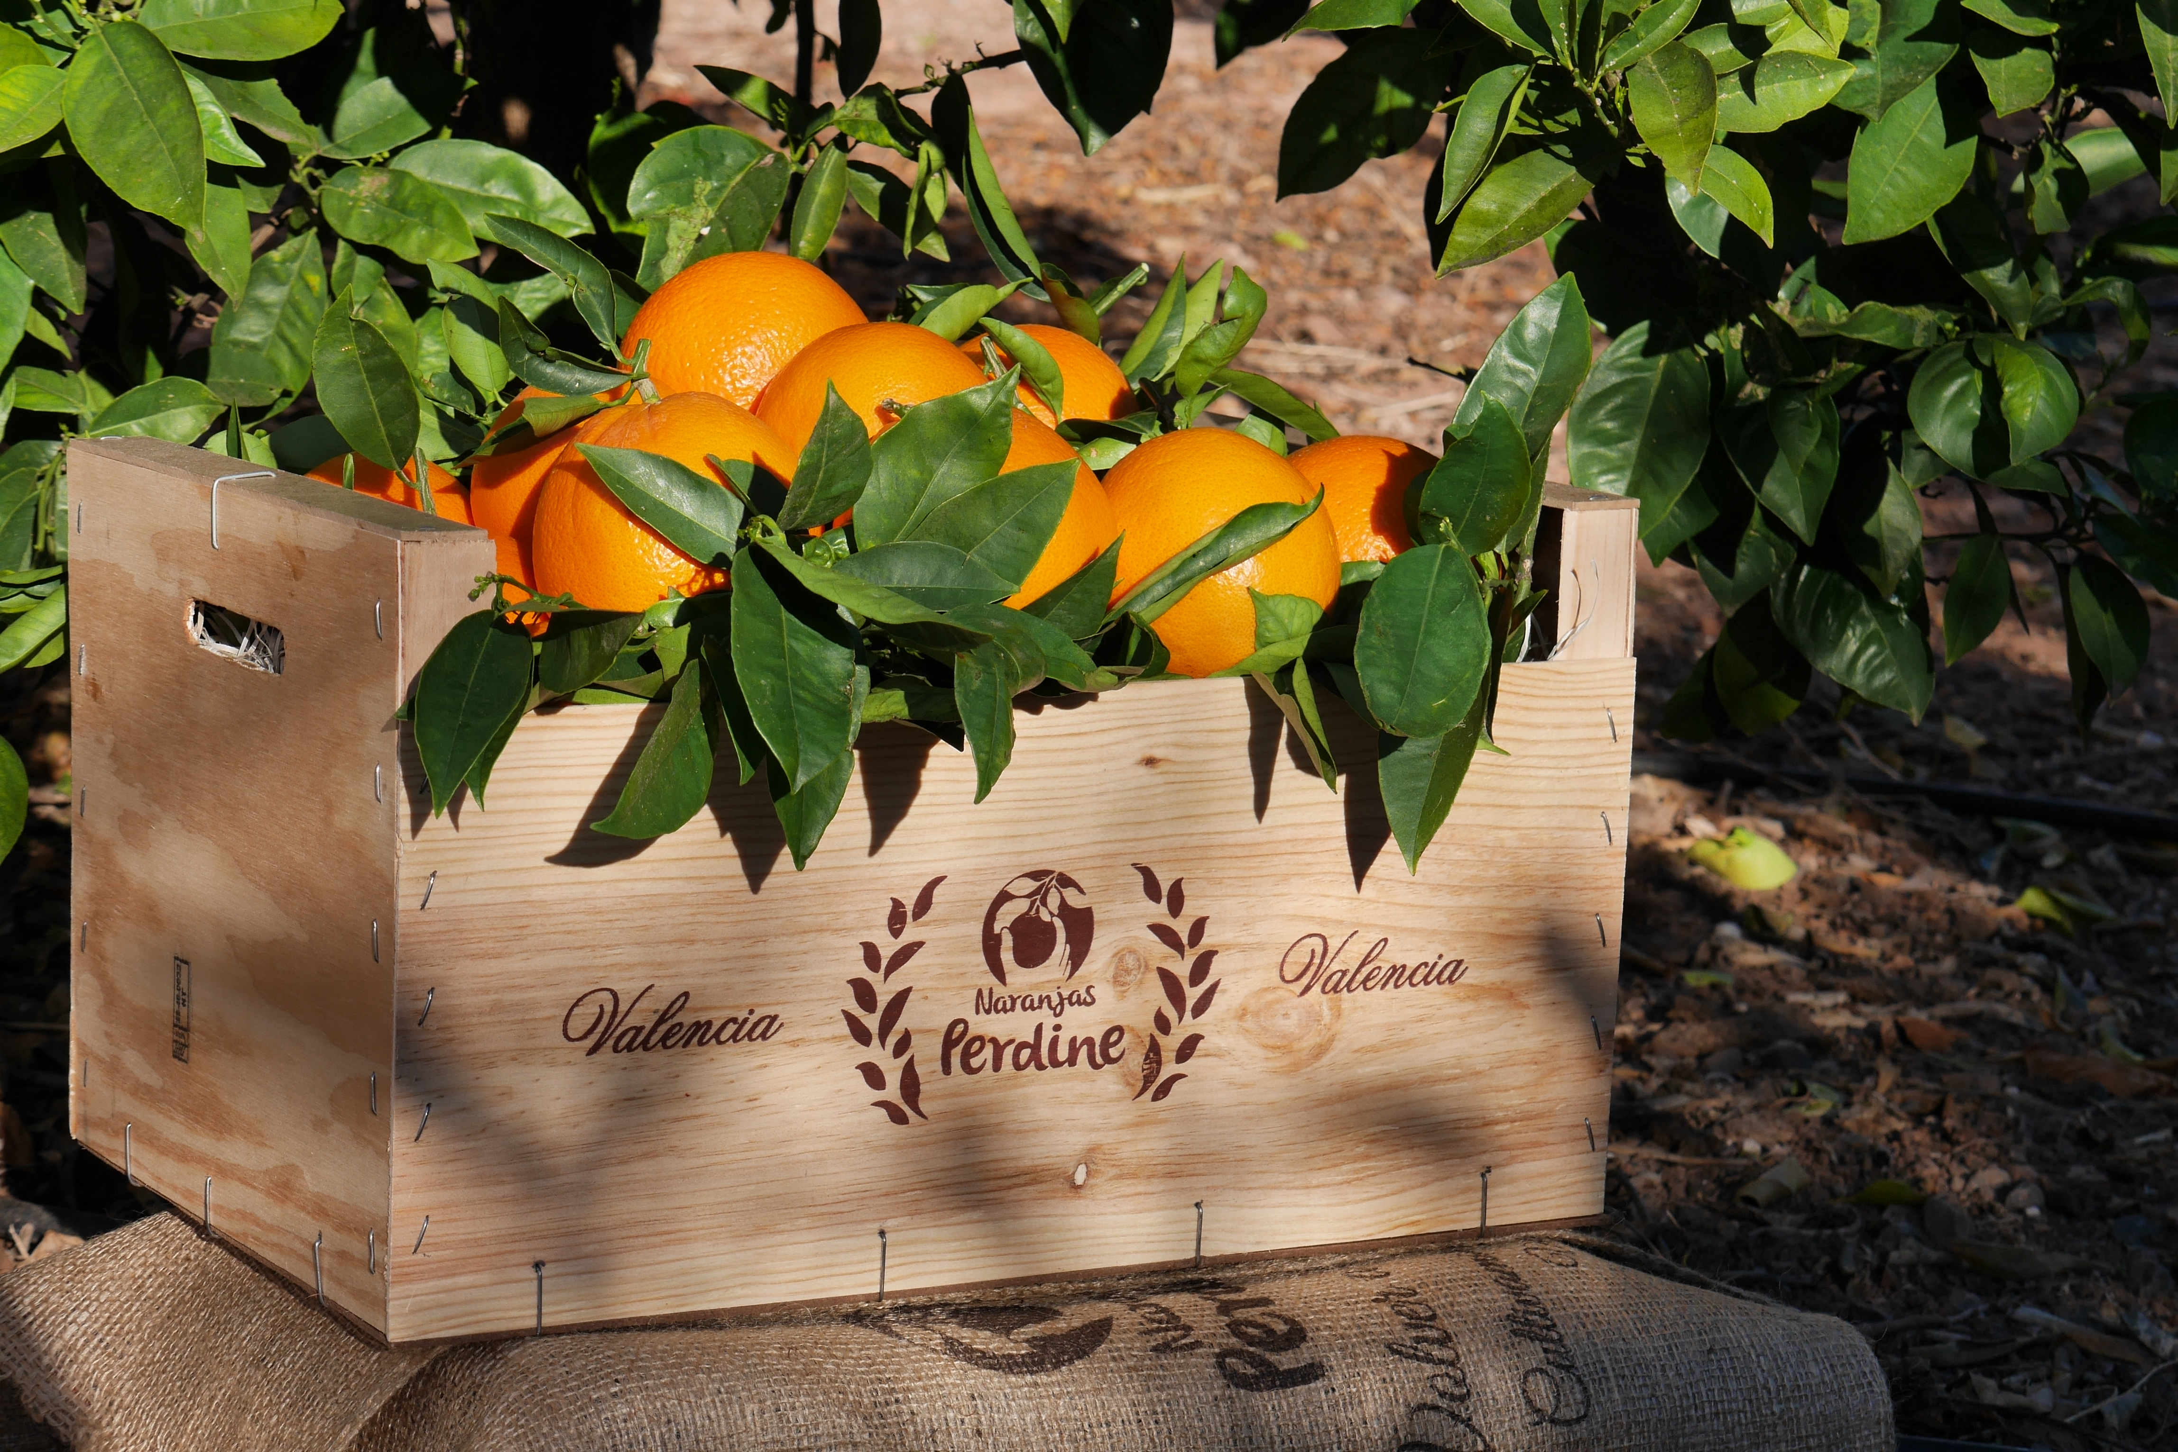
13kg natural wooden box: bulk oranges

Slide 5
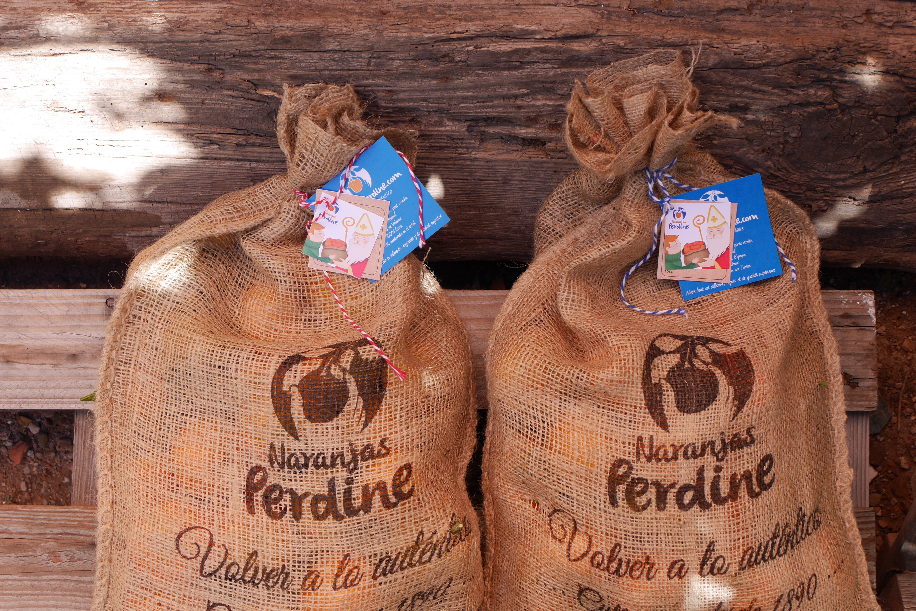
4kg jute bag: you open it and customers can serve theirselves directly from the bag

Slide 8



Contact
PERDINE S.A.
Comercial Department
C/Zorrilla 11, 1º dcha.
28014 Madrid
Spain
Tel. +34 617288696
Fax +34 91 5311989
info@naranjasperdine.com
Follow us
The information and pictures contained in this dossier are the property of Perdine S.A. and can not be used without our written consent

