Slide 1

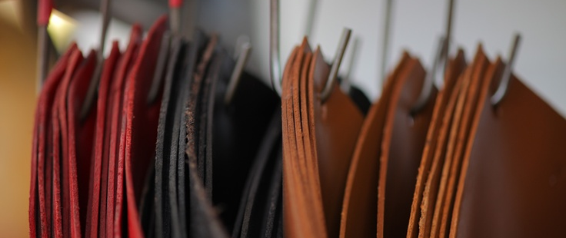
Alizée BOMBARDIER
Nina DEFACHEL
Marie GAY
Chloé GUILLEMART
Hélène MATHIS
Juliane MOREL
MSc Luxury and Design Management
ICN Business School - ENSA

Slide 2
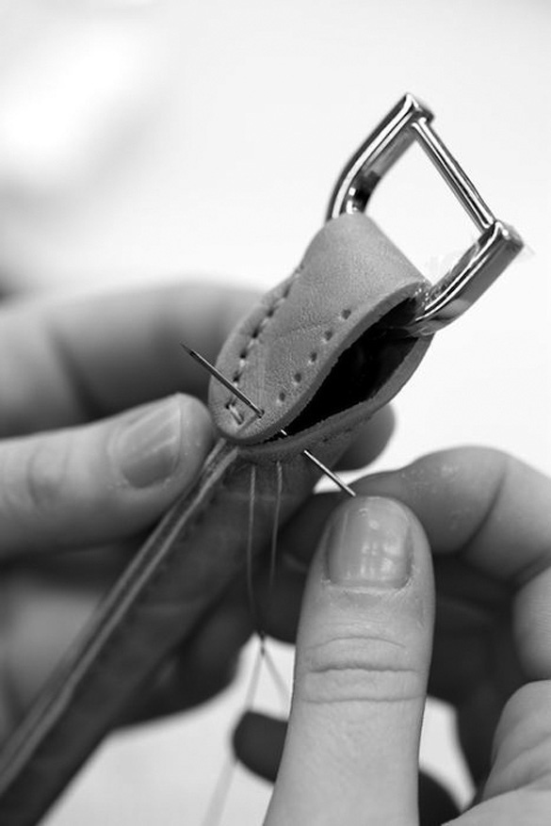
FUNCTIONING OF THE BRAND
Collaborative organisation
Company driven by the employees
Put craftsmen forward
In this company employees are the investors
Benefits reinvested

Slide 3
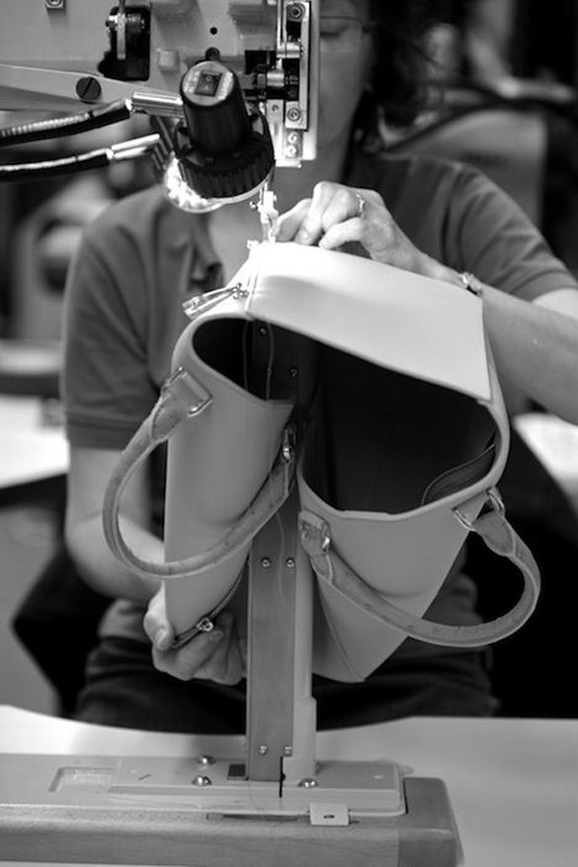
CONCEPT
Leatherwork
Fair trade: inscription of the origin
Share and meet the client
Bespoke products
Each product line wears the name of a craftsman
Fall-Winter collection

Slide 4
BRAND VALUES
COLLABORATIVE
PERSONALIZATION
FAIR TRADE
TEAM SPIRIT

Slide 5
Manifesto

Slide 6
MOODBOARD and inspiration

Slide 7
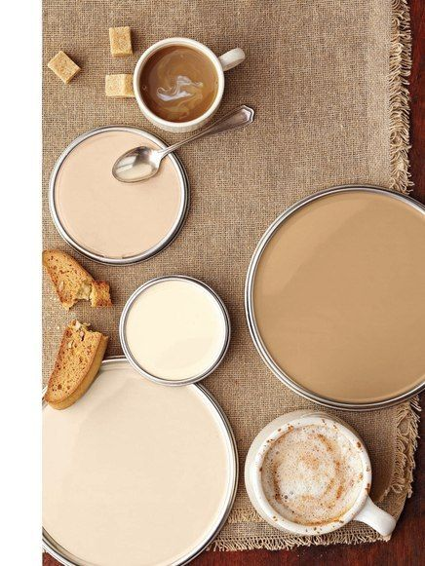
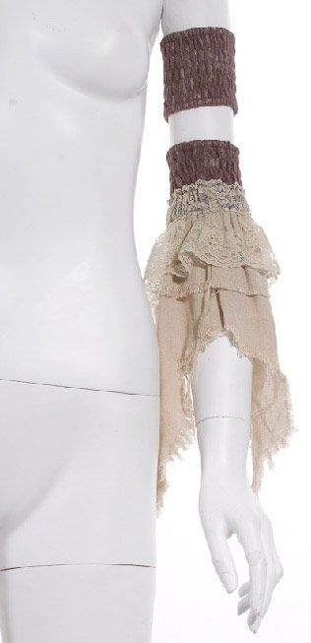

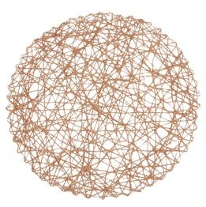
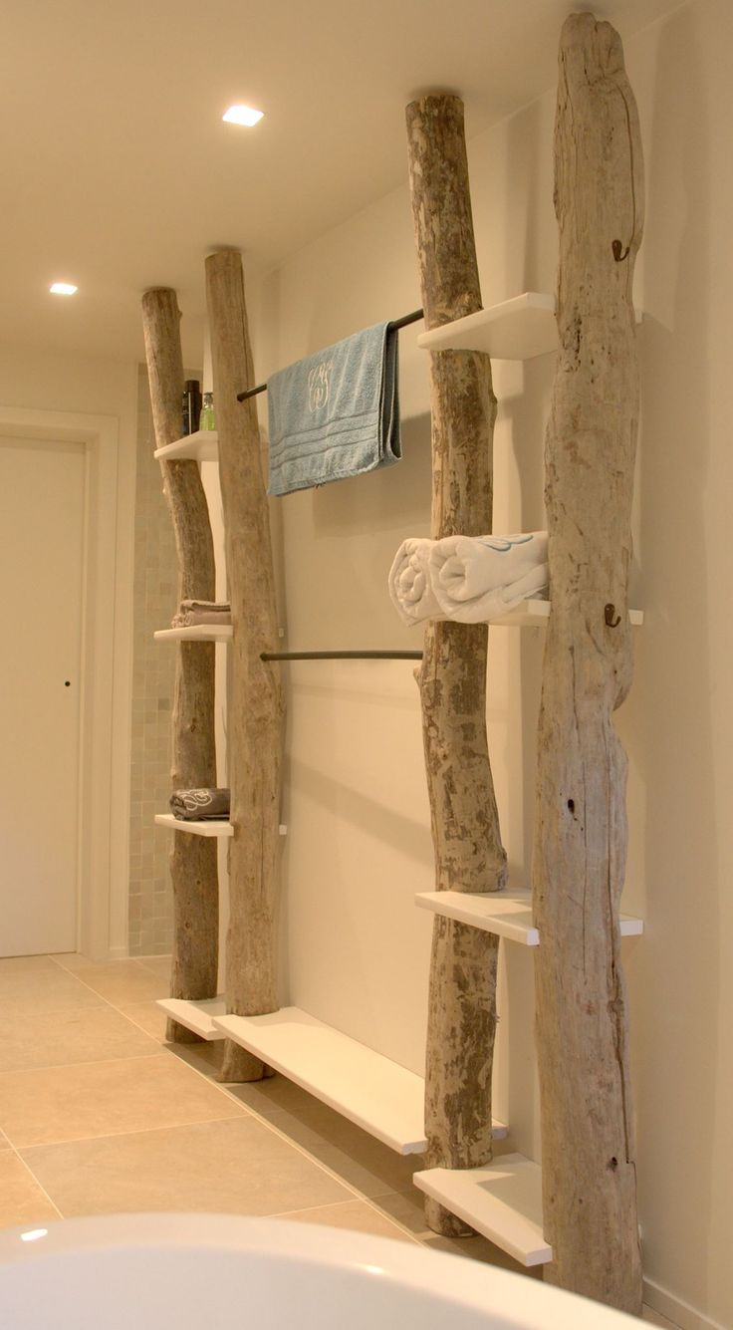
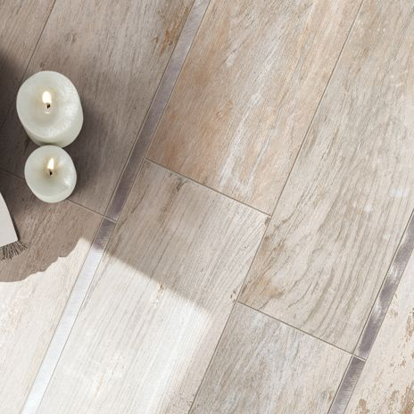
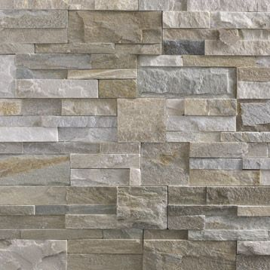

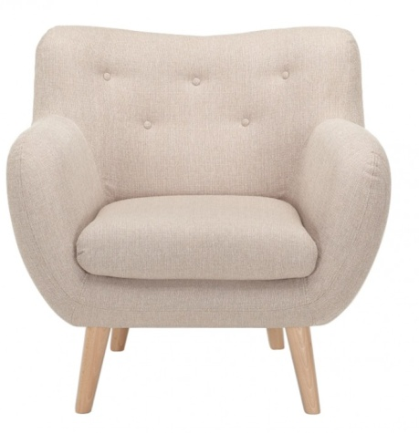
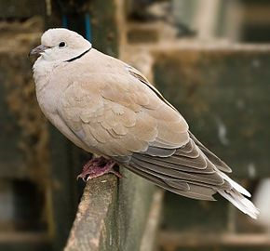
COLORS

Slide 8
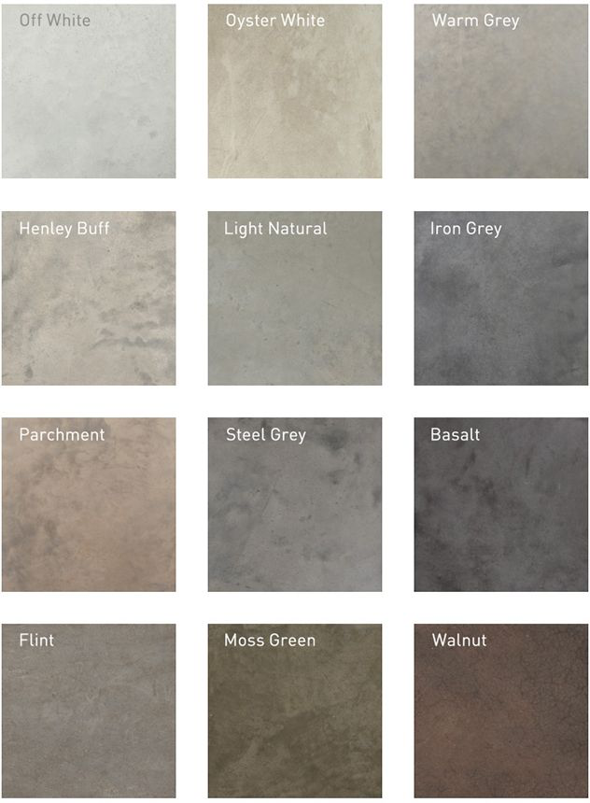
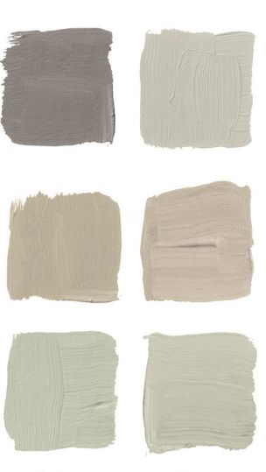
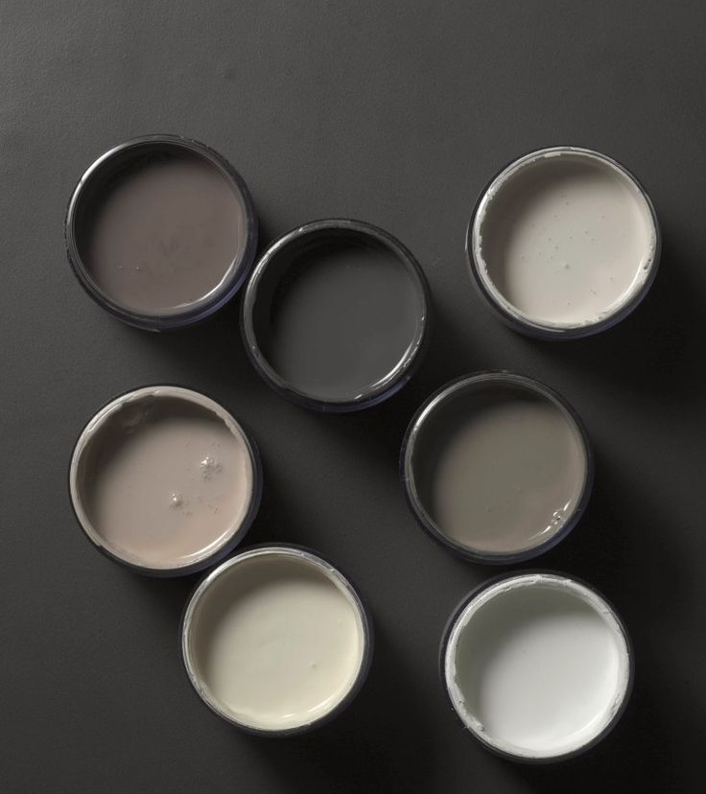
COLORS

Slide 9

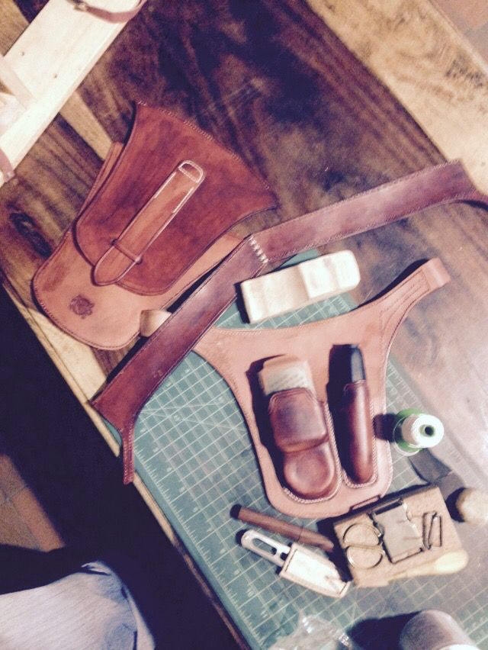
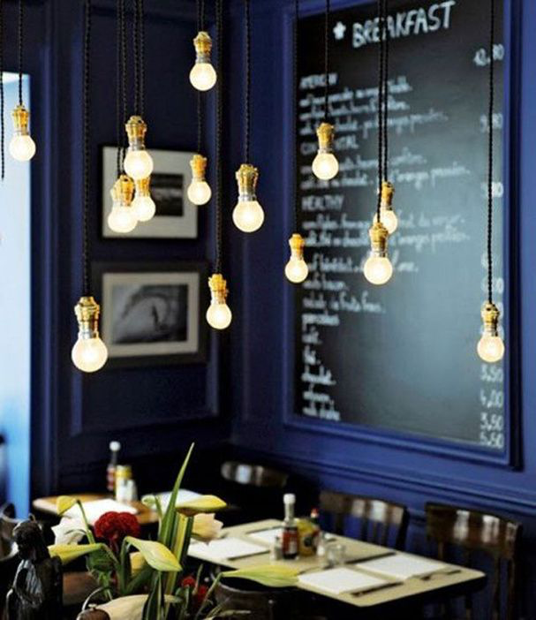
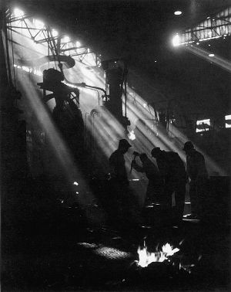
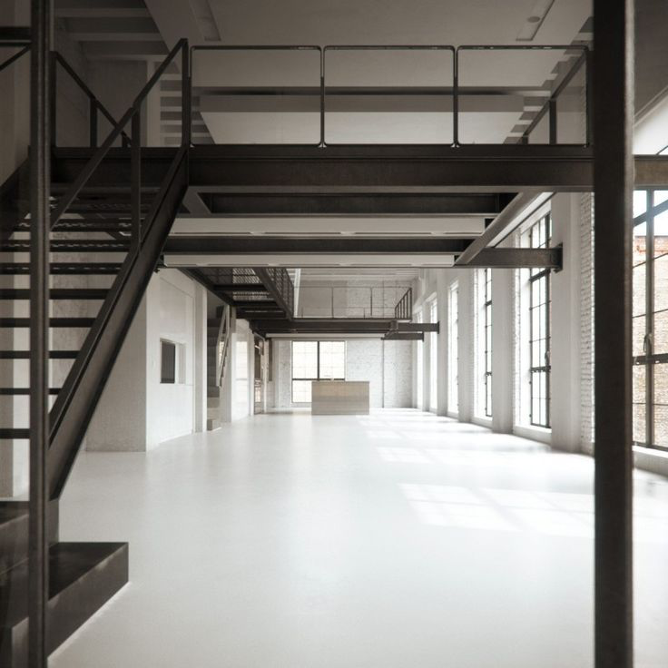
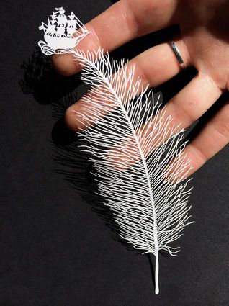
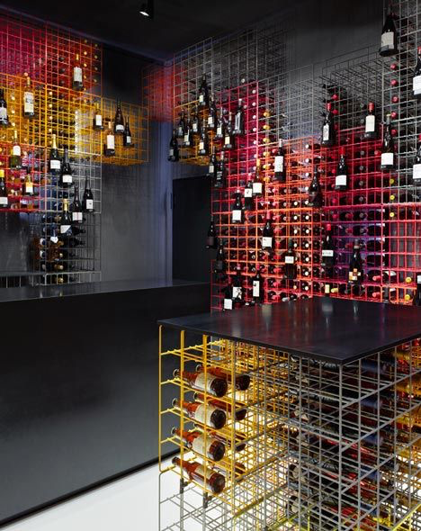

Slide 10
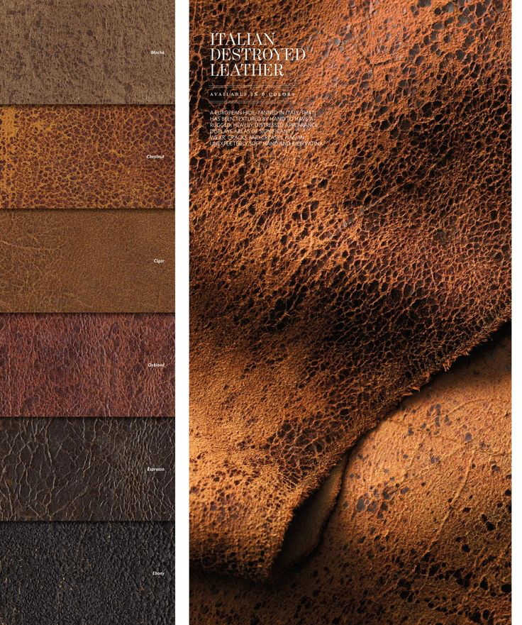
MATERIAL :
LEATHER

Slide 11
BRAND NAME
Transparency
Diaphanês
Dépoli
DIAPHANE

Slide 12
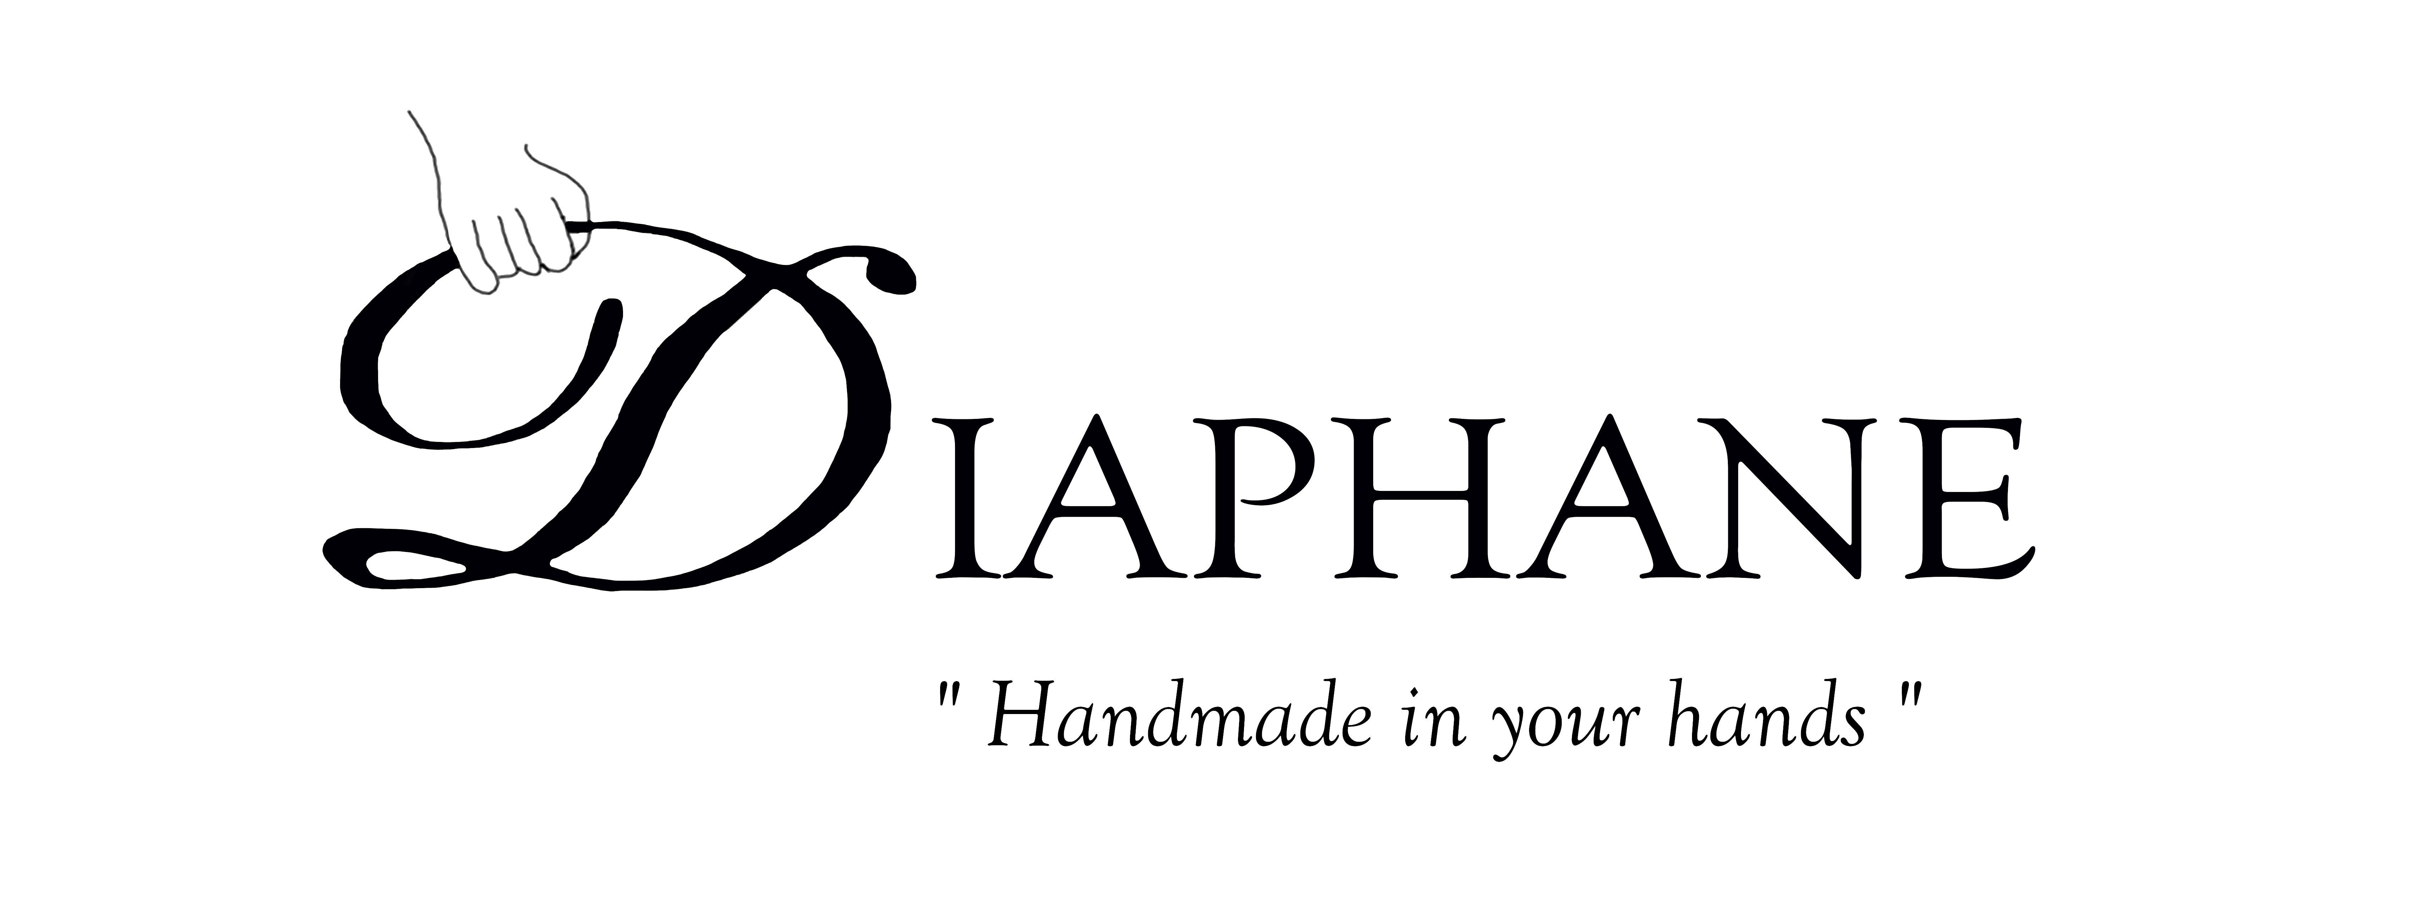
Logo and baseline
Logo
Logo with baseline

Slide 13
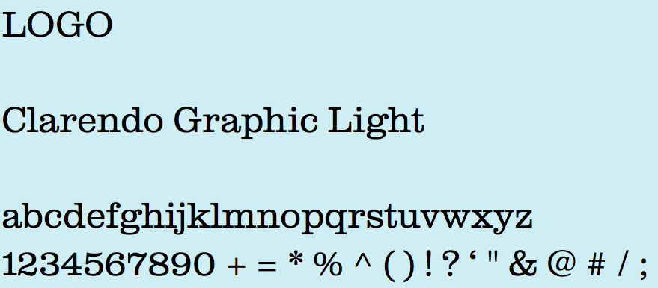
FONT
COMMUNICATION SUPPORT
ARENQ
abcdefghijklmnopqrstuvwxyz
1234567890
BASELINE
Goudy Old Style Italic
abcdefghijklmnopqrstuvwxyz
1234567890 + = * % ^ ( ) ! ? ‘ " & @ # / ;

Slide 14
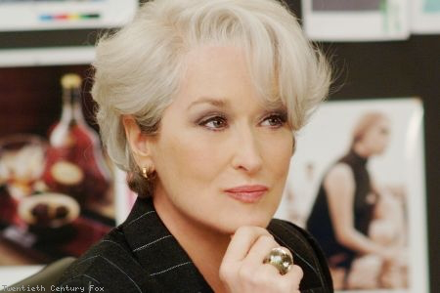
TARGET

Slide 15
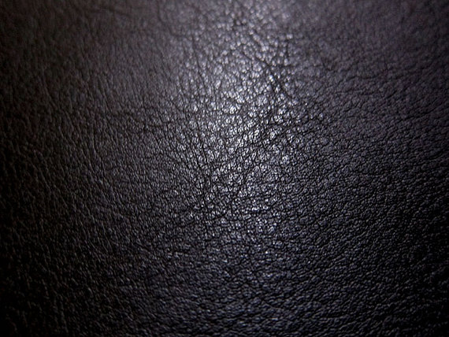
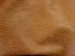
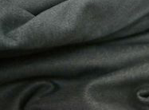
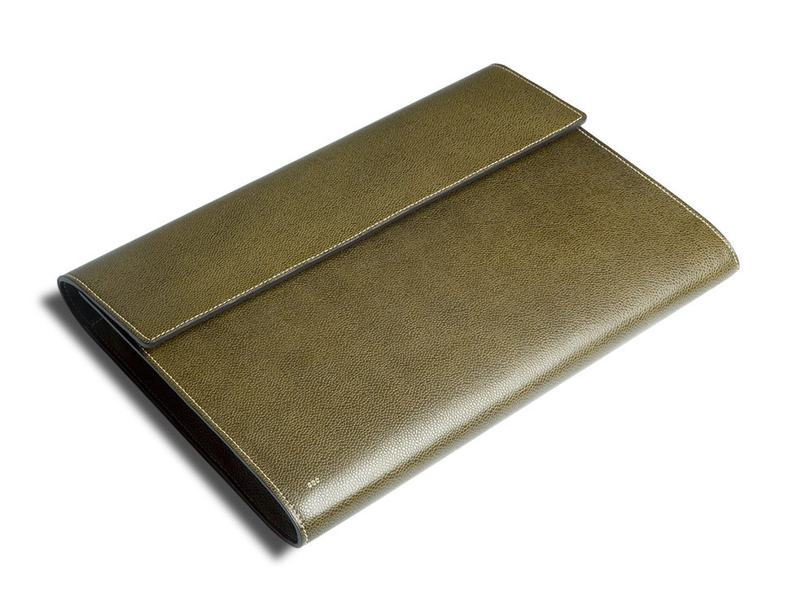
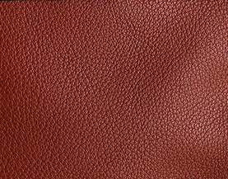
MATERIAL OF THE PRODUCTs
LAMB SKIN
Black
Brown
Grey
CALF SKIN
Kaki
Brown
Red

Slide 16
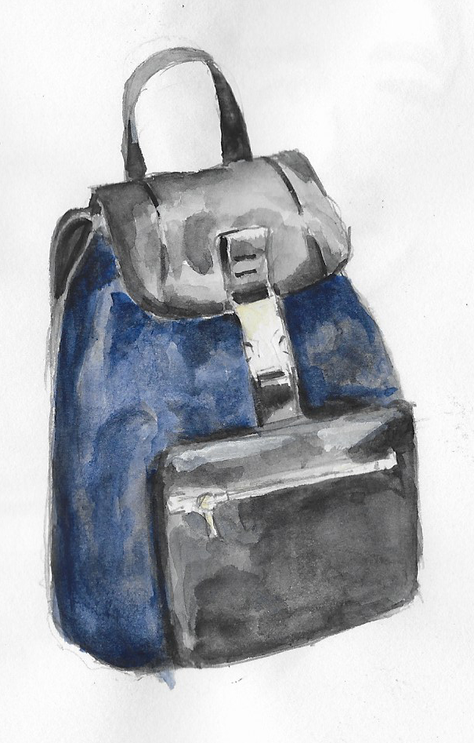
PRODUCTs
Backpack
Model: Emile
Calf Skin
Full grain leather
Mineral tanning
KAKI

Slide 17
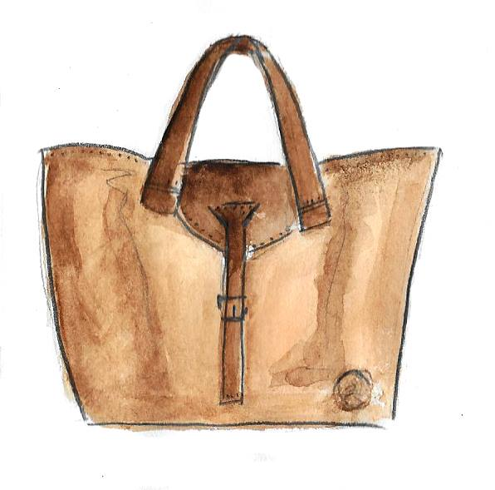
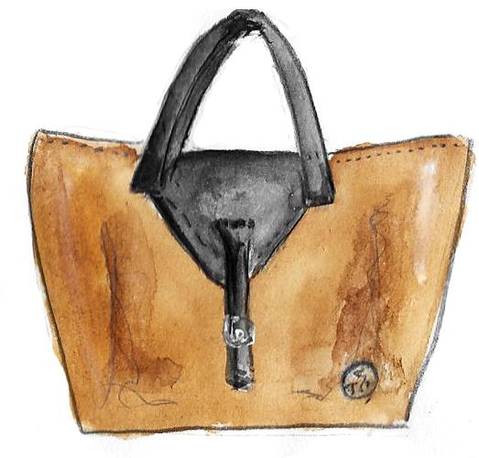
PRODUCTs
Handbag
Model: Andrea
Handbag
Model: Andrea
Calf Skin
Full grain leather
Tumbled grain leather
BROWN
Calf Skin
Full grain leather
Tumbled grain leather
BROWN and BLACK
Calf Skin
Calf Skin
Lamb Skin
Lamb Skin

Slide 18
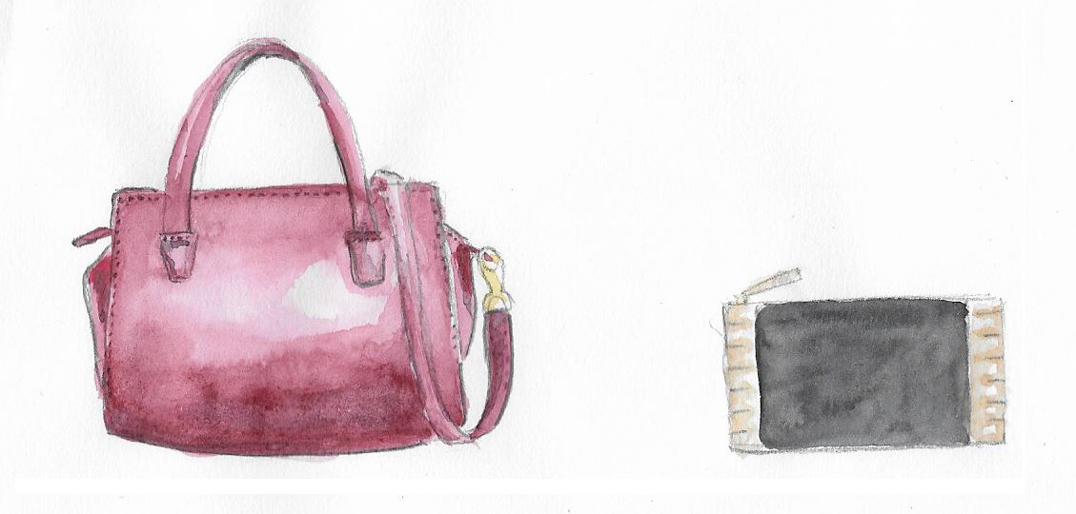
PRODUCTs
Handbag
Model: Carole
Wallet
Model: Emma
Calf Skin
Split leather
Mineral tanning
RED
Lamb Skin
With glazed finishing
GREY
Mettalic
Goat Skin
Lamb Skin

Slide 19
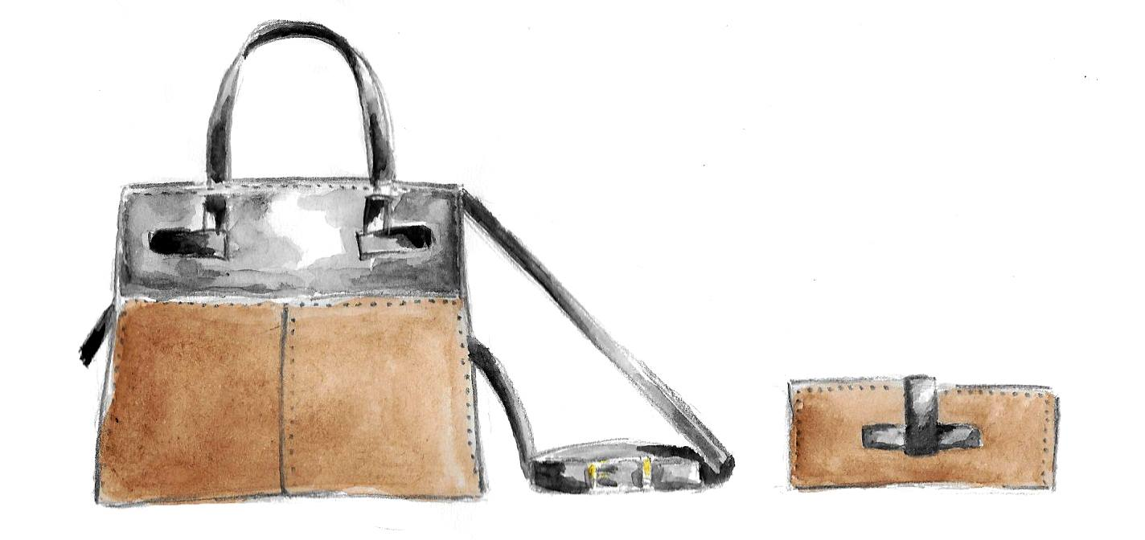
PRODUCTs
Handbag and Wallet
Model: Diaphanesse
Calf Skin
Full grain leather
Mineral tanning
BROWN and BLACK
Lamb Skin
Calf Skin

Slide 20
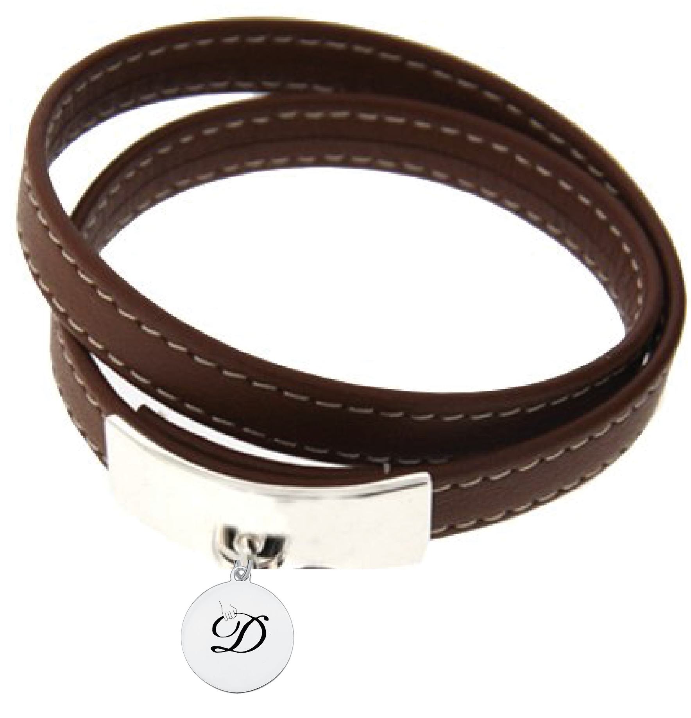
PRODUCTs
Bracelet
Model: Diaphanesse
Calf Skin
Full grain leather
Mineral tanning
SILVER
BROWN

Slide 21
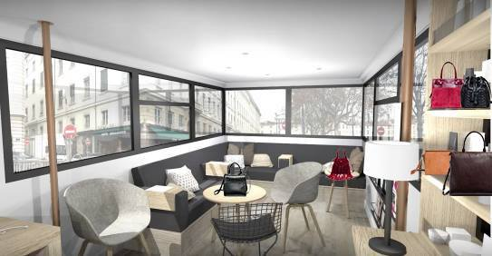
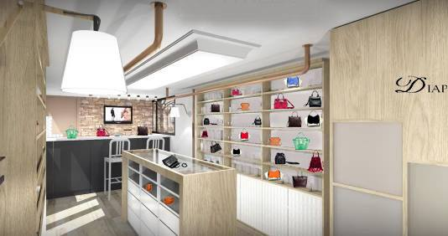
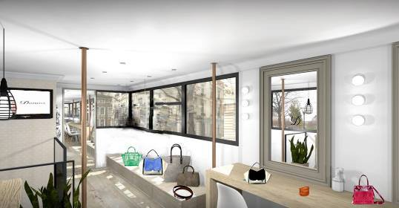

Slide 22
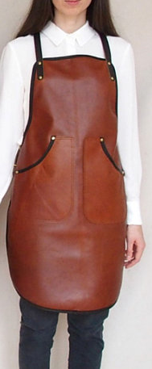
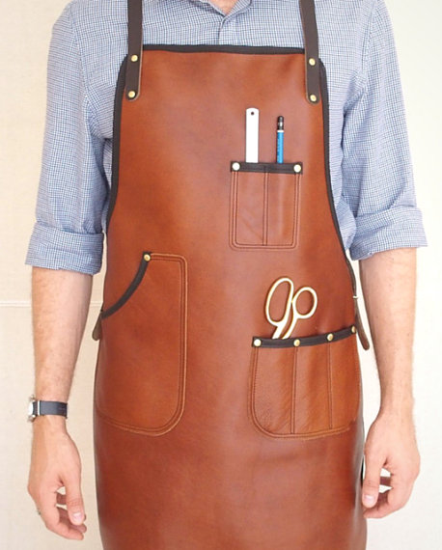
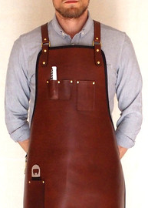
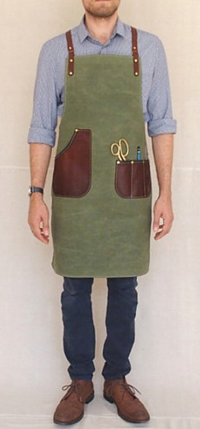
BRAND DRESS-CODE
In accordance with the values of the brand
Bring to light the craftmanship spirit

Slide 23
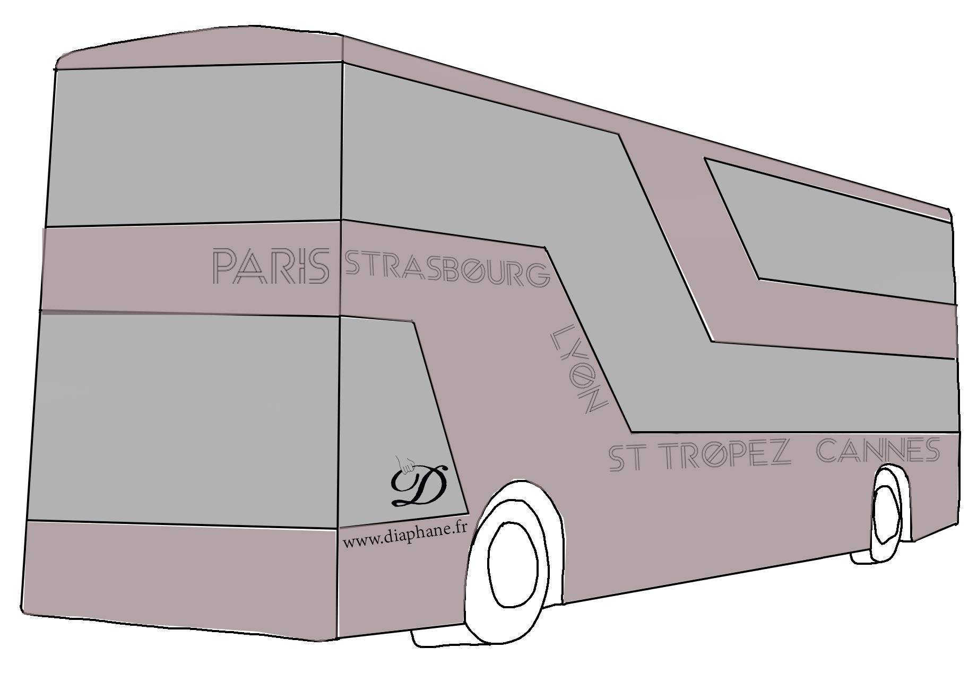
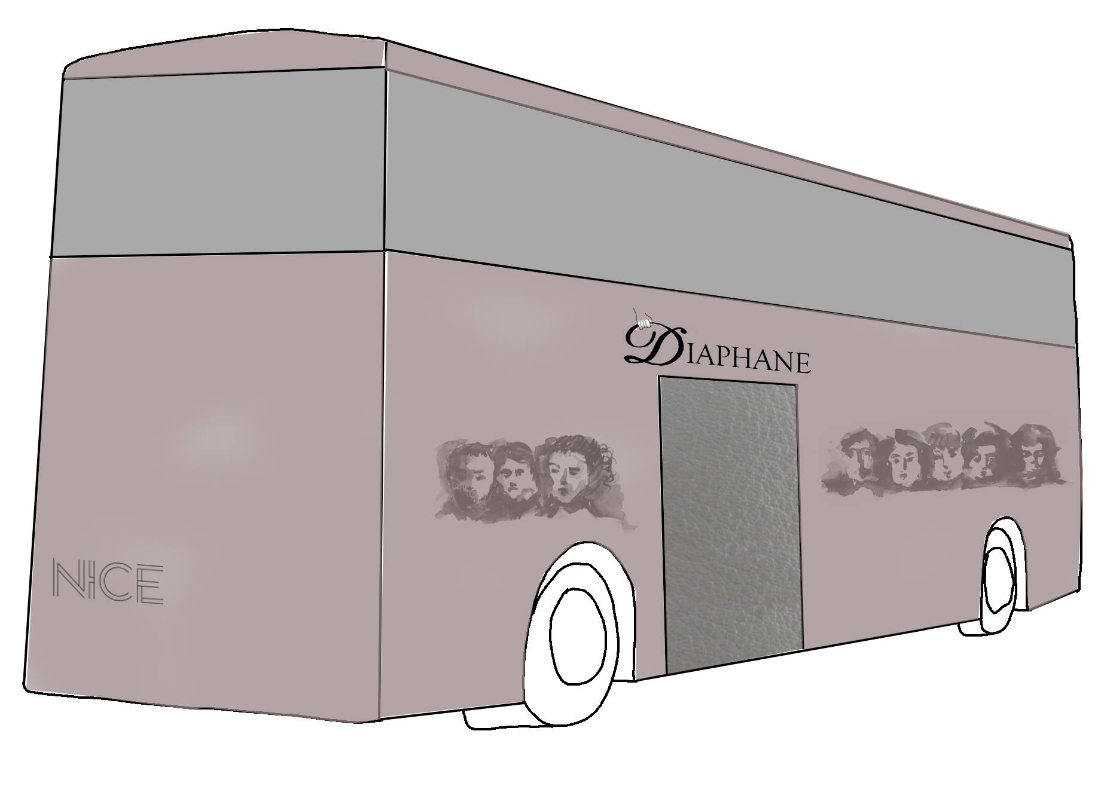
POP-UP BUS
Create a surprise effect Generate media attention
Test the products
Test the concept
Test the locations

Slide 24
COMMUNICATION
STRATEGY

Slide 25
CAMPAIGN STRATEGY
EARNED MEDIA
OWNED MEDIA
PAID MEDIA
Articles published by journalists and photos published by boggers
Comments and actions on Facebook, IG, Twitter
Word-of-mouth thanks to the pop-up bus
« In-store » communication
Diaphane website
Media Kit
Social Network
ELLE magazine partnership

Slide 26
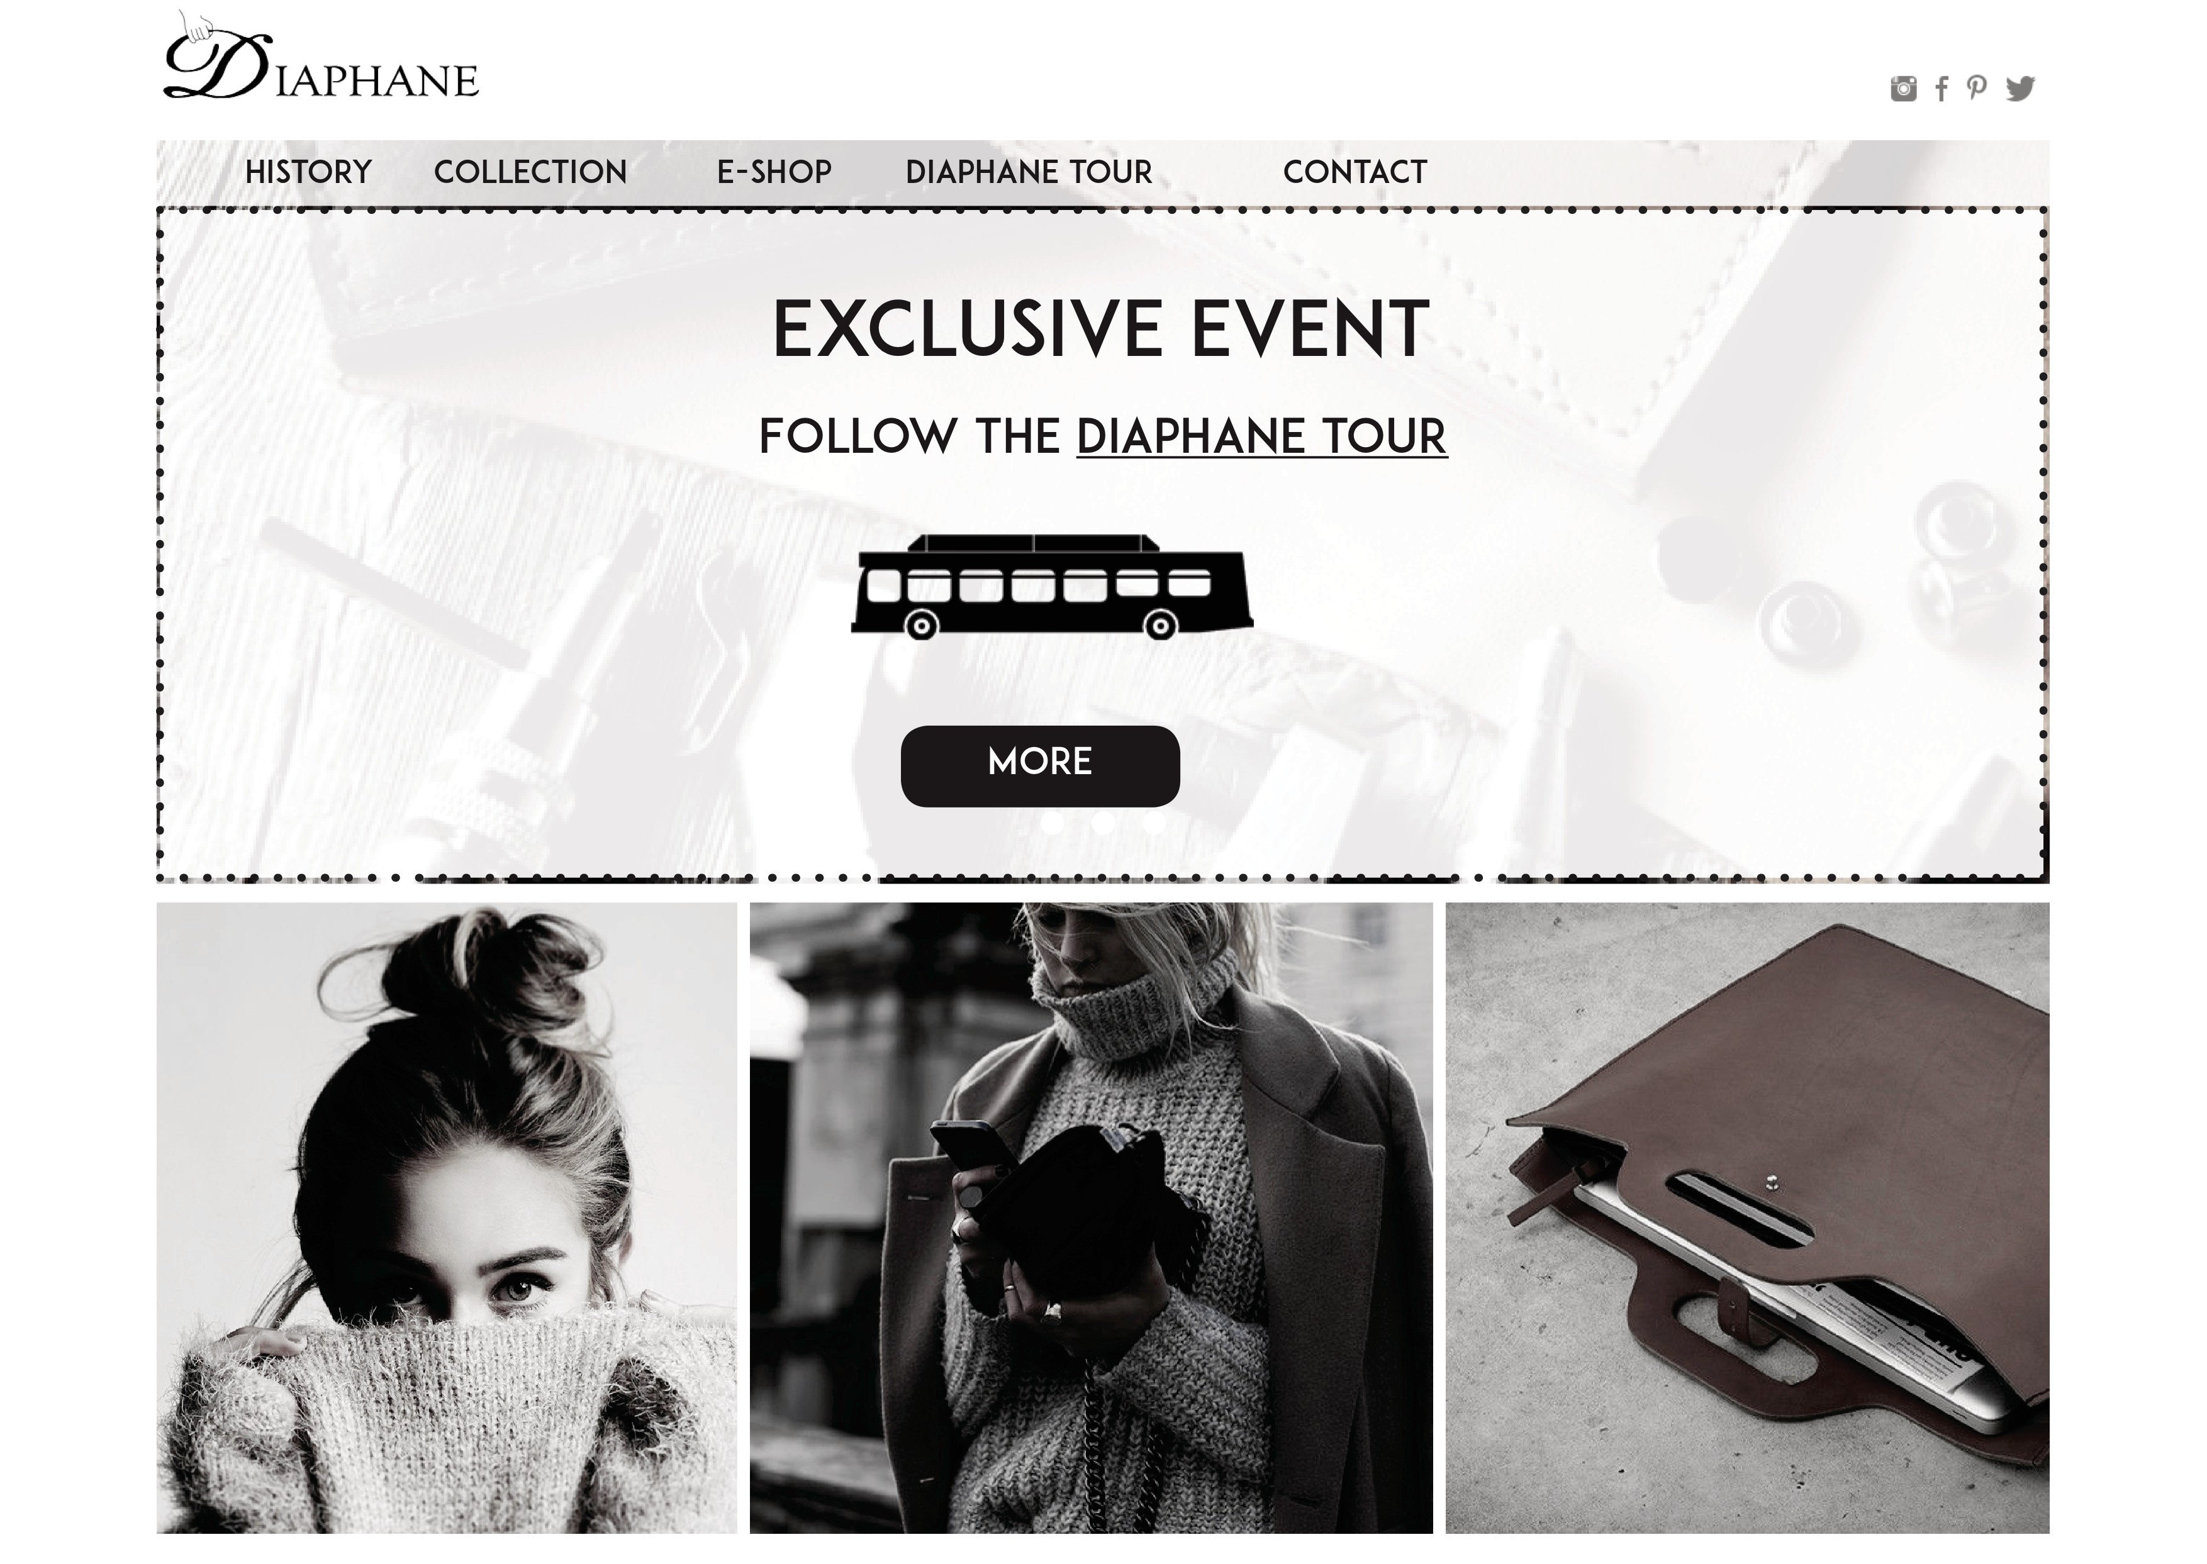
WEBSITE

Slide 27
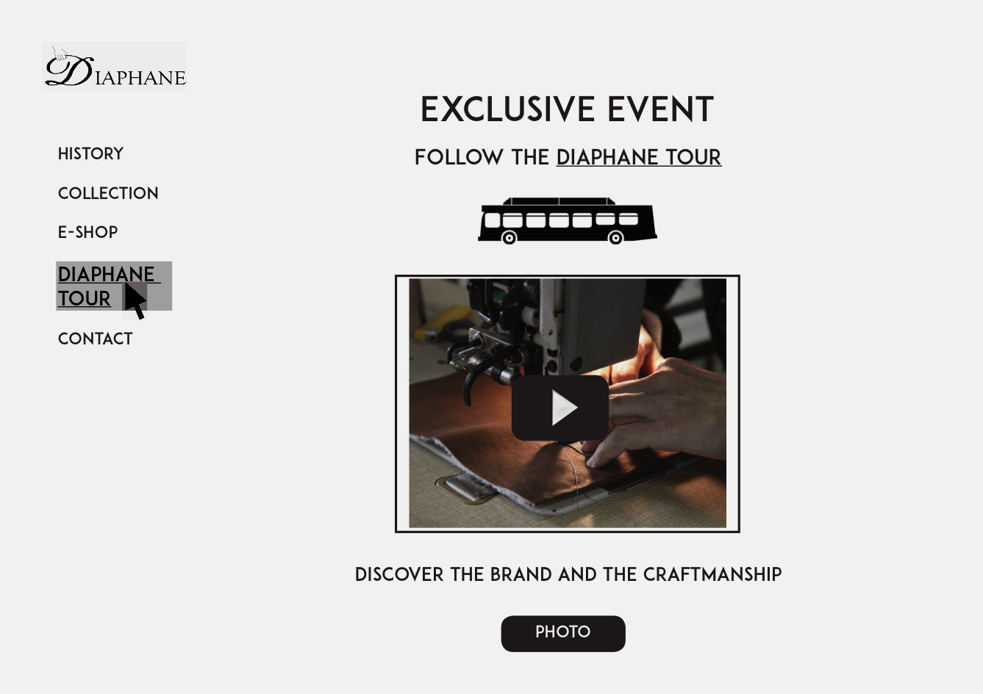

Slide 28
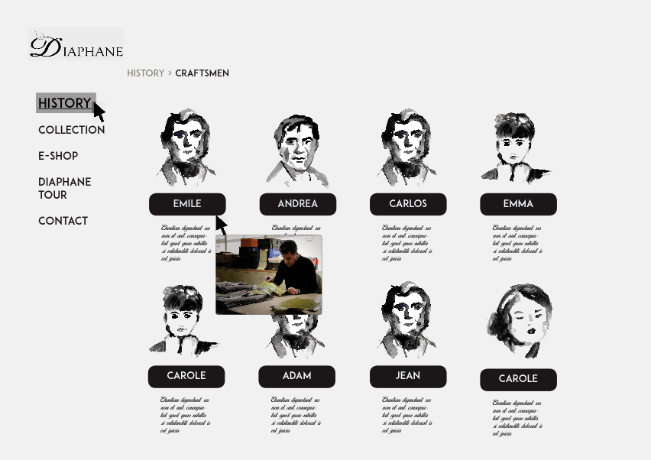

Slide 29
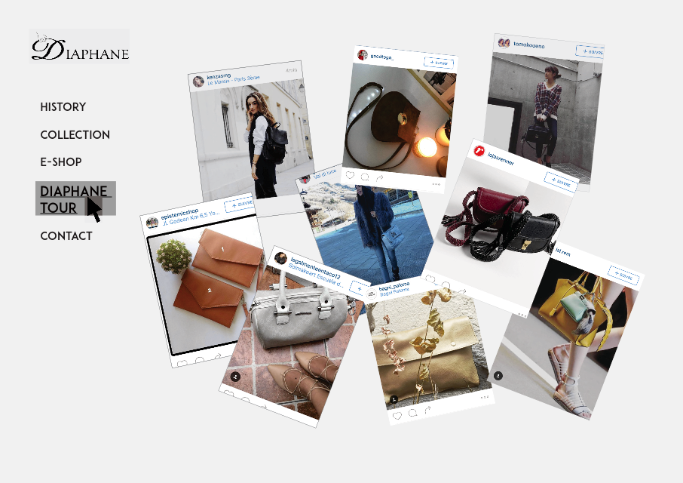

Slide 30
VISUAL OF THE
CAMPAIGN

Slide 31
SOCIAL NETWORKS ADAPT FOR THE CAMPAIGN
FACEBOOK PAGE

Slide 32
SOCIAL NETWORKS ADAPT FOR THE CAMPAIGN

Slide 33
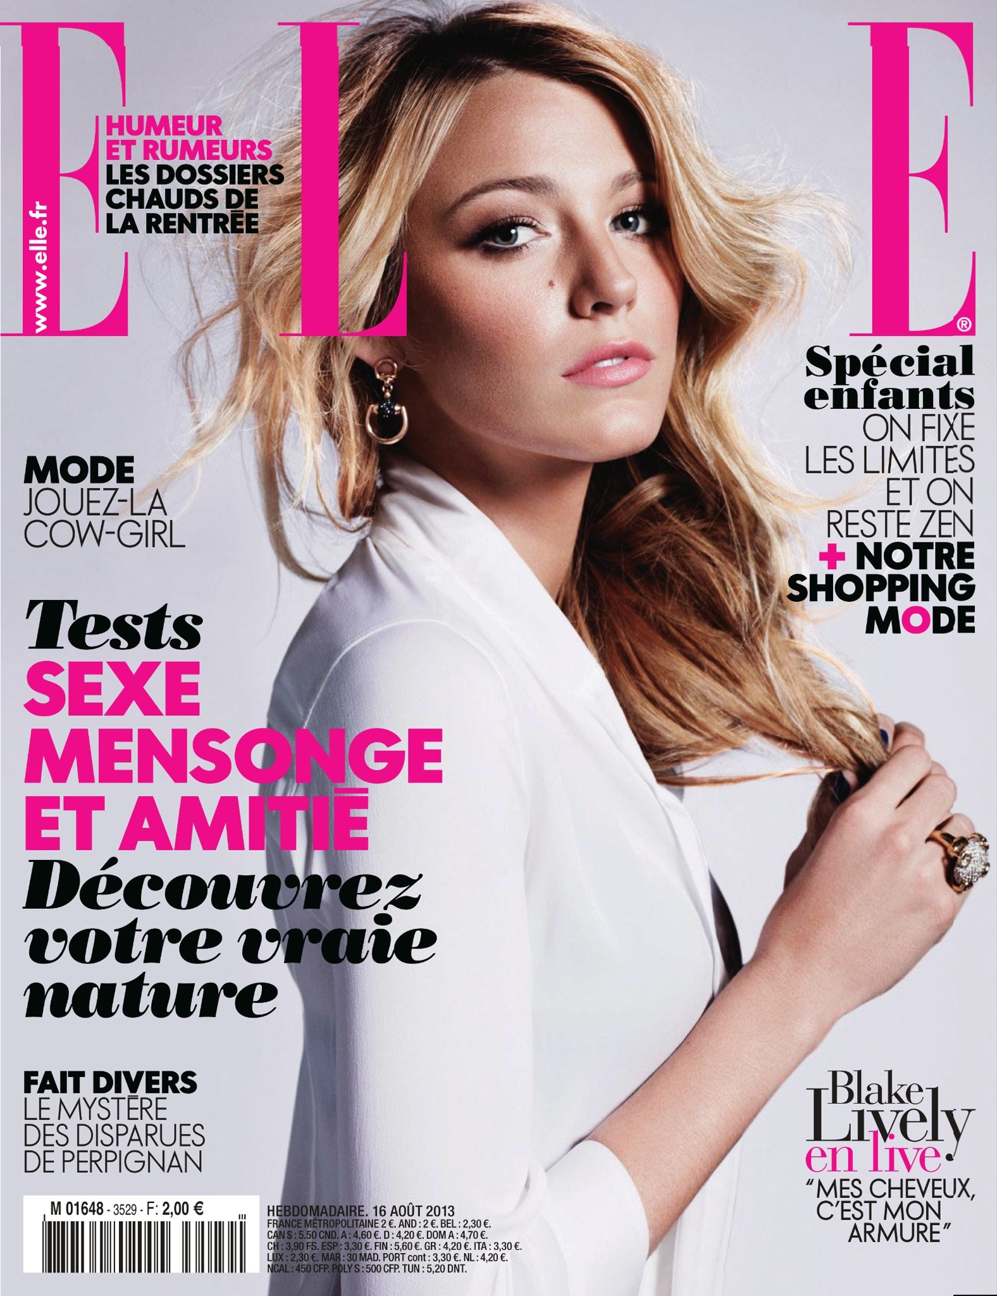
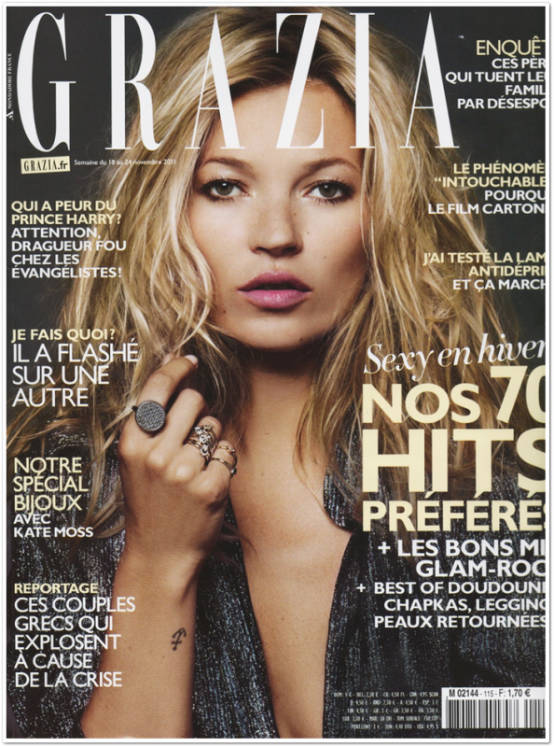

PR: Strategy with journalist
Creation of press release
Printing press release
Send to the journalist the media kit, with a little product of the brand and invitation for the cocktail the first day in the city
Cocktail - Press launch
To adhere the journalists and they talk about the brand: press coverage

Slide 34

PR: press release

Slide 35





BLOGGeRs RELATION
Why bloggers? Because they are influencers and
they are followed by a large community
Targeting the same universe bloggers
Contact + Send press release + Invitation for the breakfast the first day in the city
During the event/breakfast: discovery and sharing with employees, brand presentation. And offer a small gift !
To adhere the bloggers, to talk about us, relay information

