Slide 1

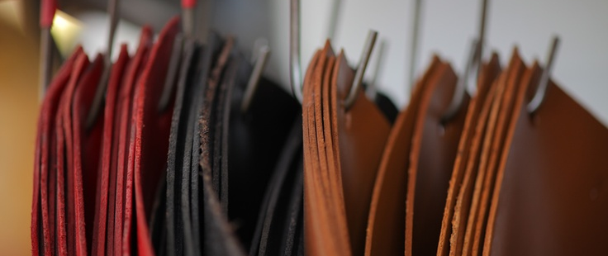
Alizée BOMBARDIER
Marie GAY
Hélène MATHIS
MSc Luxury and Design Management
ICN Business School

Slide 2
BRAND

Slide 3
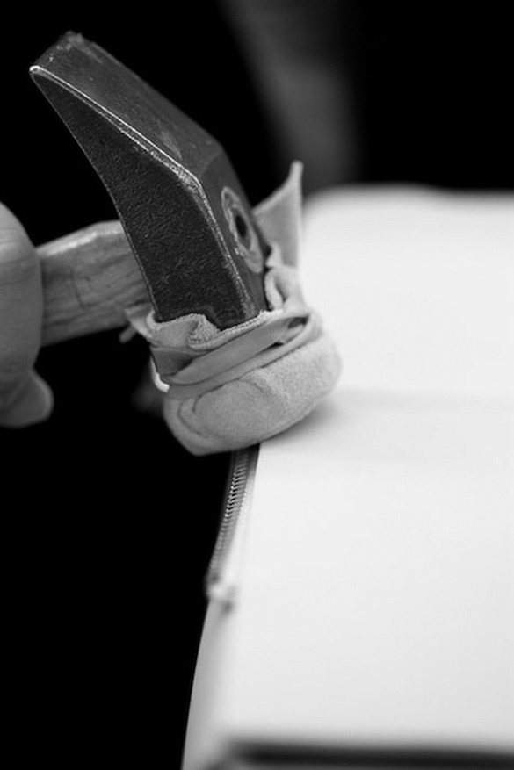
Presentation
Birth date : 27 June, 2015
New concept with new services
New organisation of the work inside the fabric
Only workers
Bespoke product
Share and meet the client: transparency

Slide 4
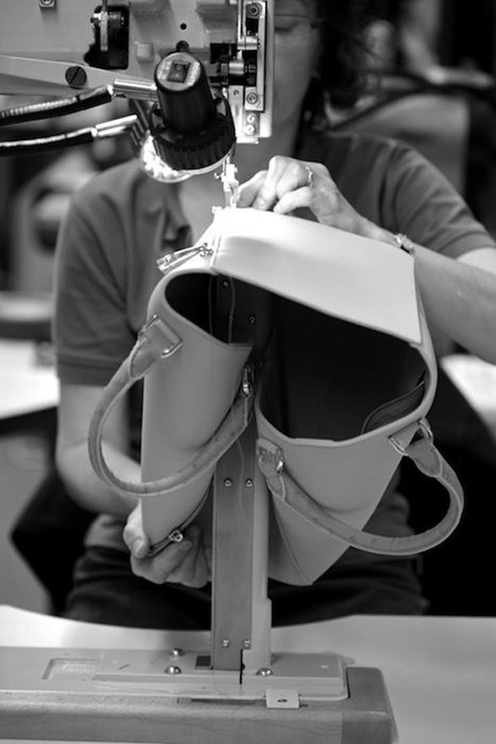
WHICH PRODUCTS?
Specialised in leather goods :
Bags
Wallet
iPad & iPhone cases
Bracelet
Belt
Raw material: using leather: calf skin, lamb skin…
Starting with Fall-Winter collection presentation and creation of SS collection later on

Slide 5
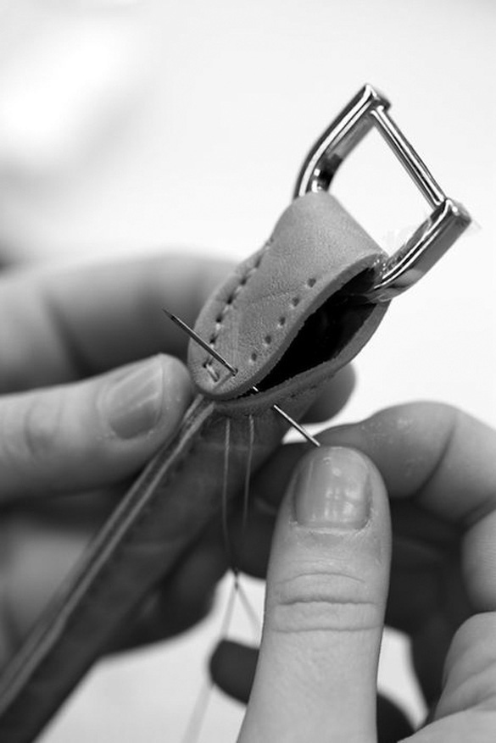
FUNCTIONING OF THE BRAND
Sharing and collaborating
Benefits are reinvested annually
In this company employees are the investors

Slide 6
Manifesto

Slide 7
Attention:
Ce n’est pas le définitif

Slide 8
MOODBOARD and inspiration

Slide 9
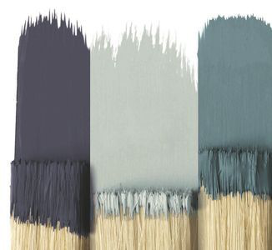
COLORS

Slide 10
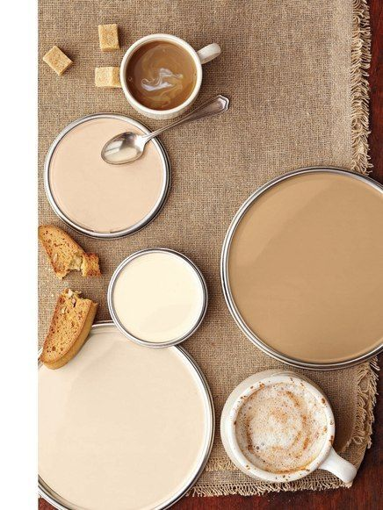
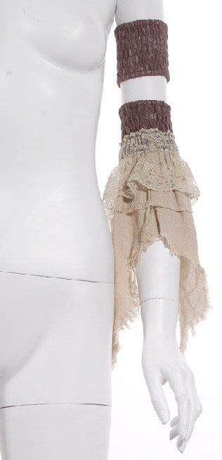

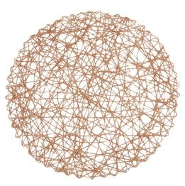
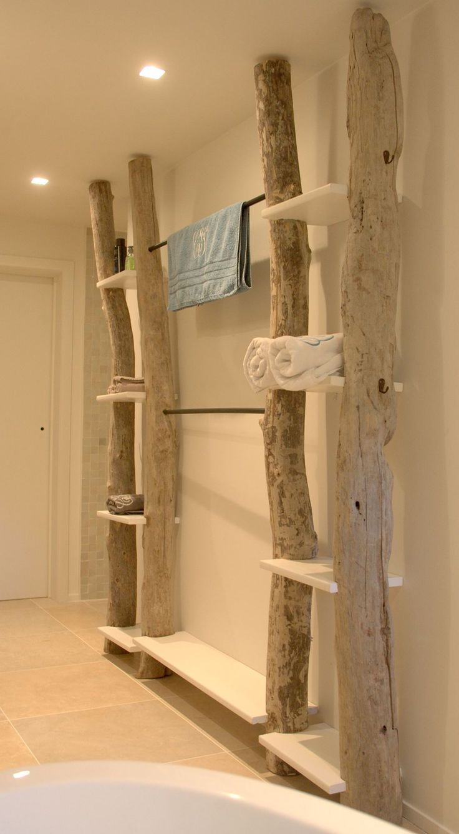
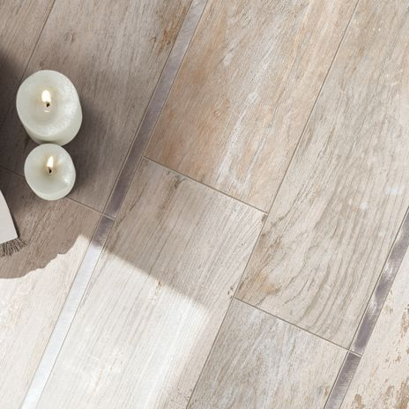
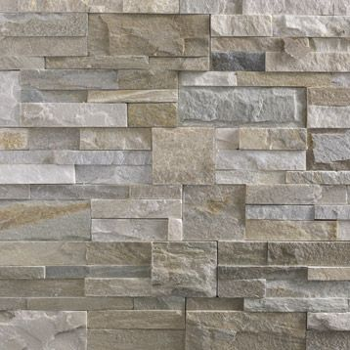
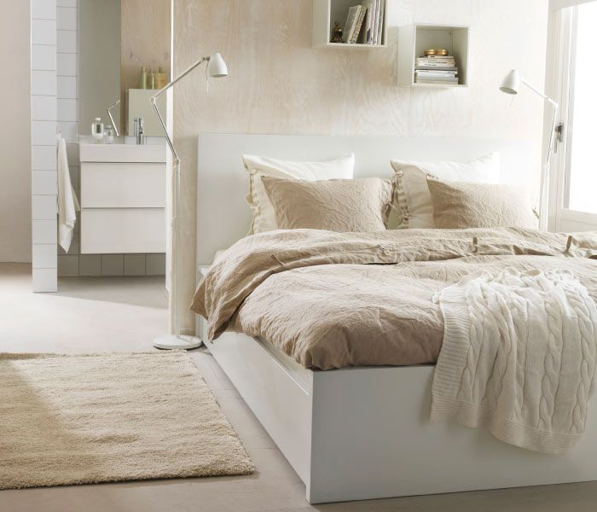
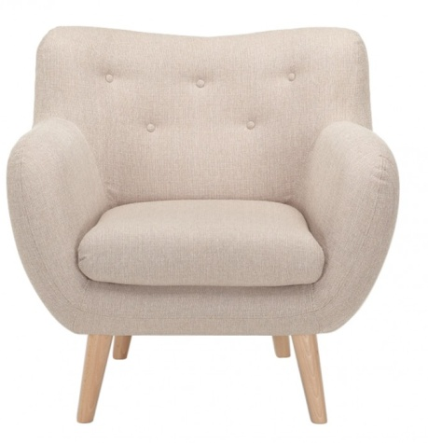
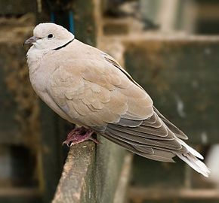
COLORS

Slide 11
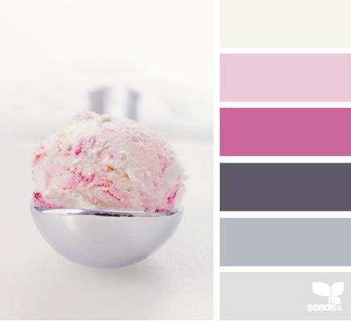
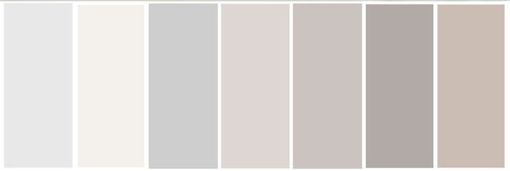
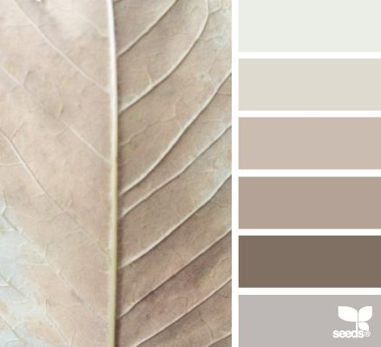
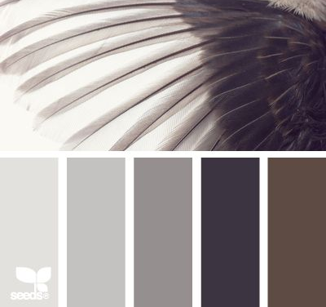
COLORS

Slide 12
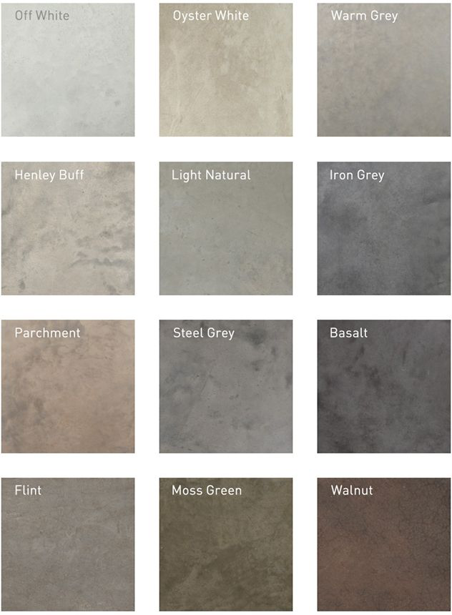
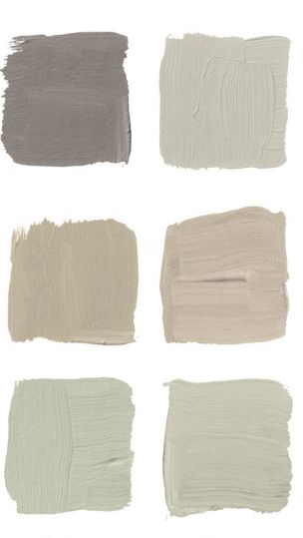
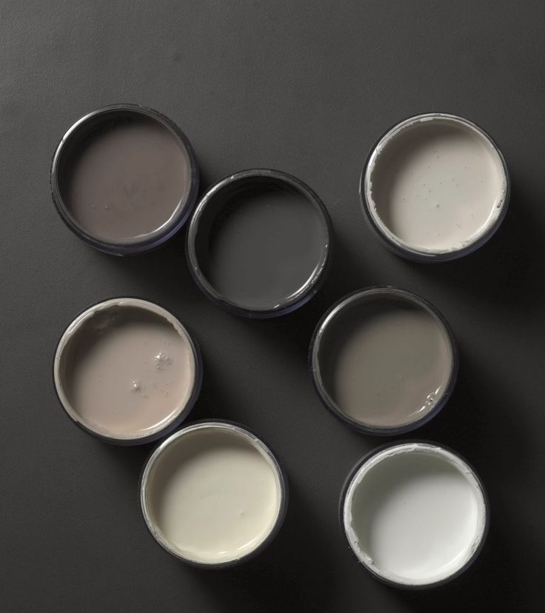
COLORS

Slide 13
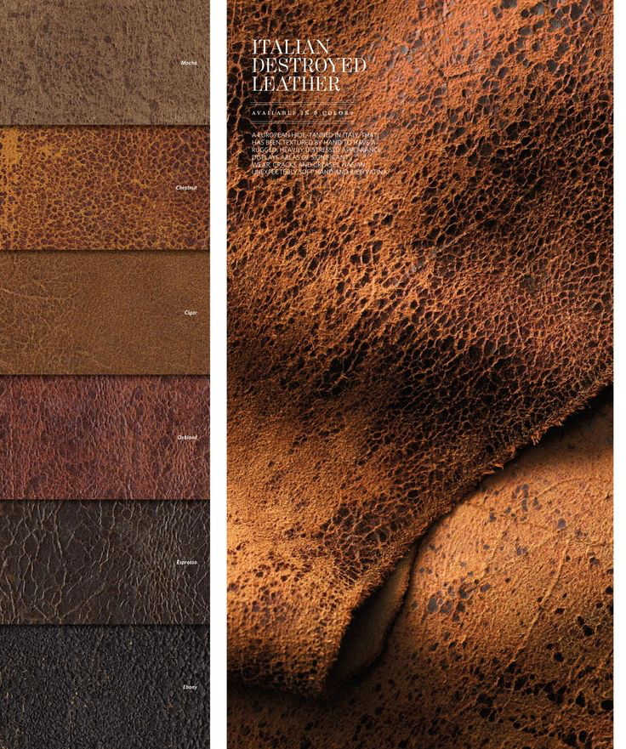
MATERIAL :
LEATHER

Slide 14
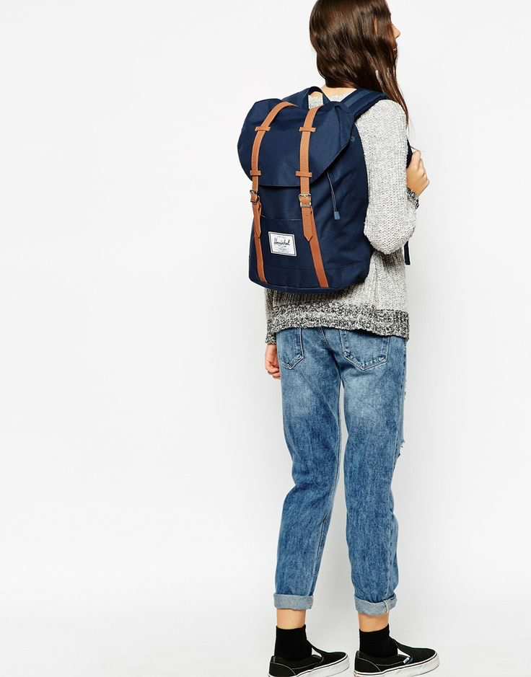
AMBIANCE OF THE BRAND

Slide 15
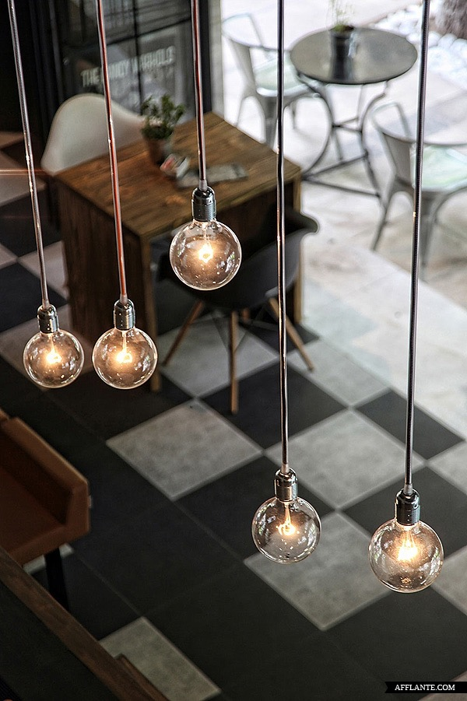
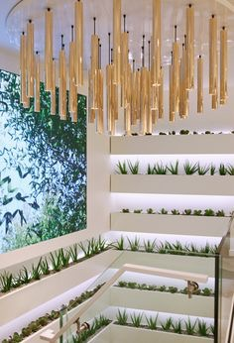
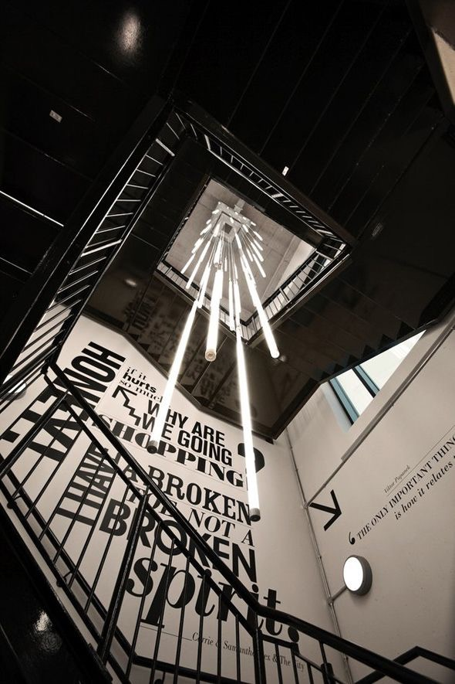
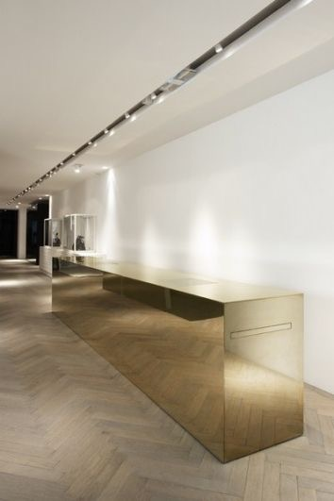
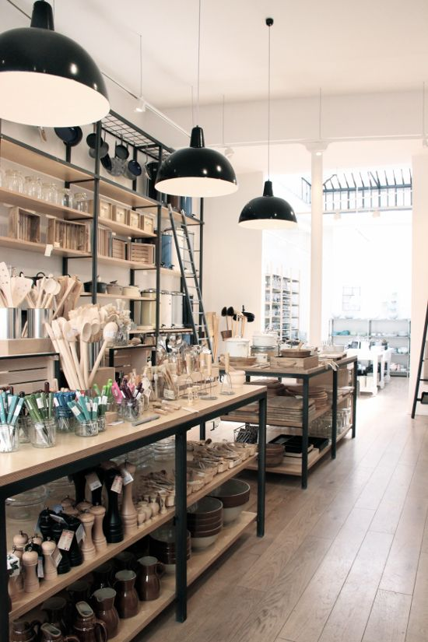
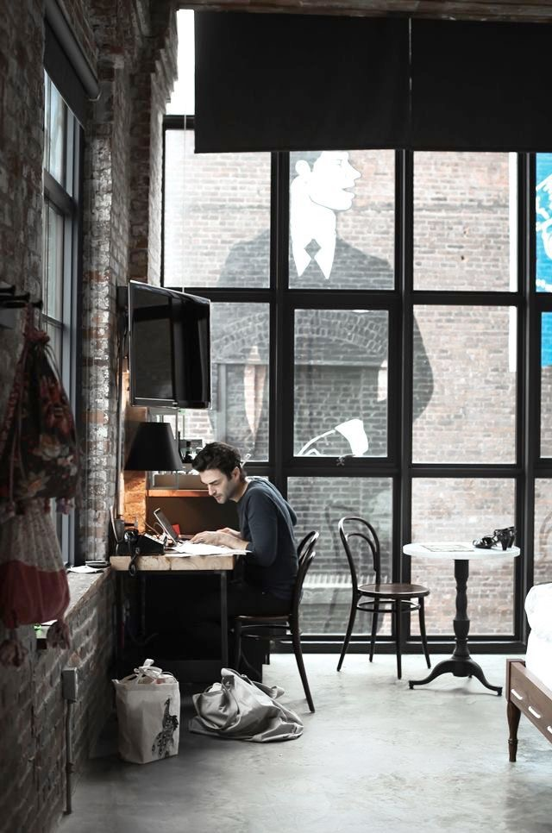
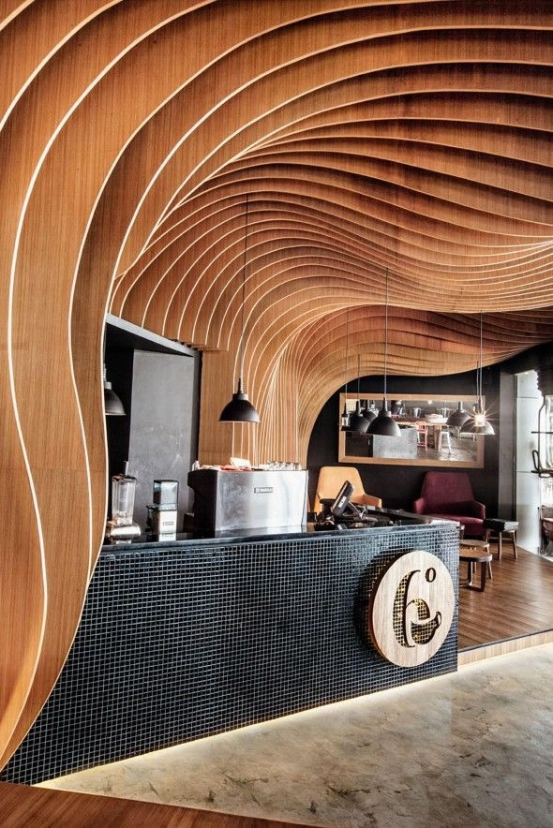
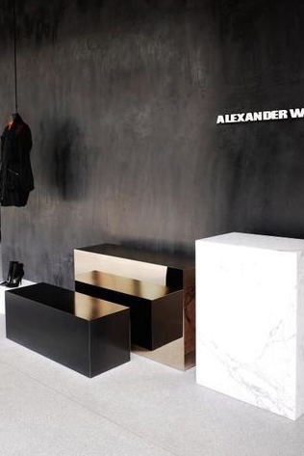
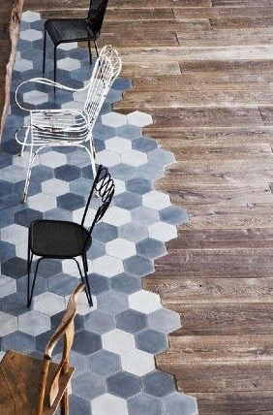
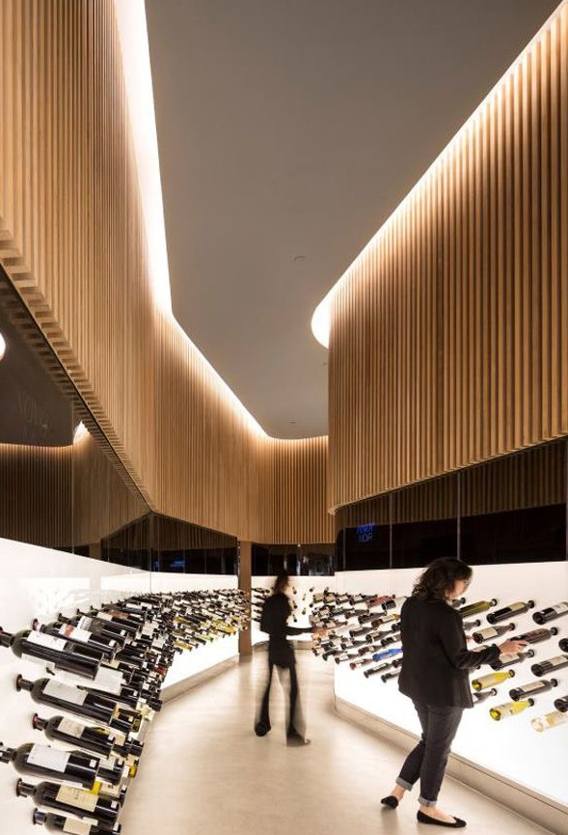
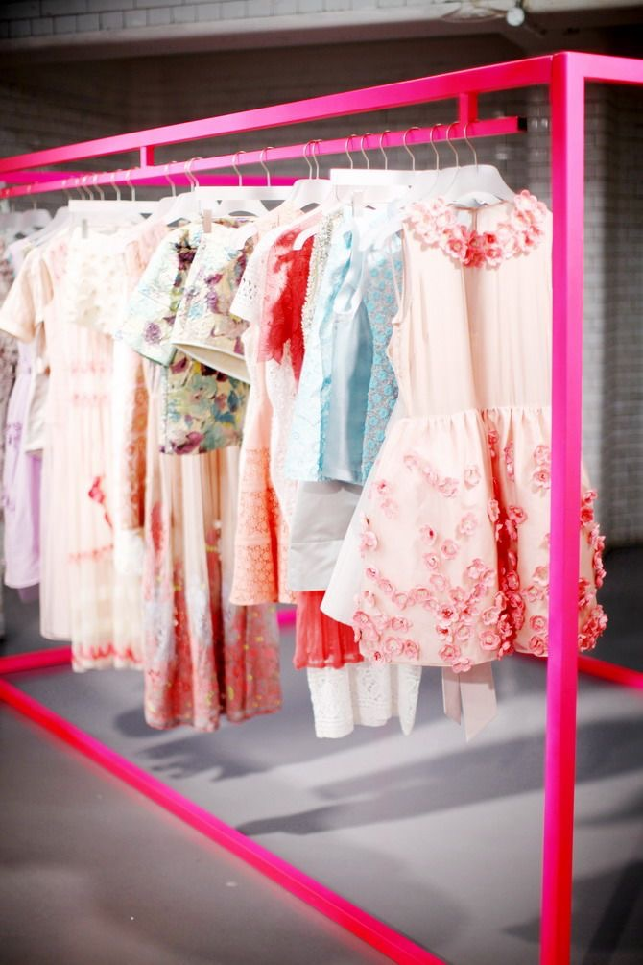
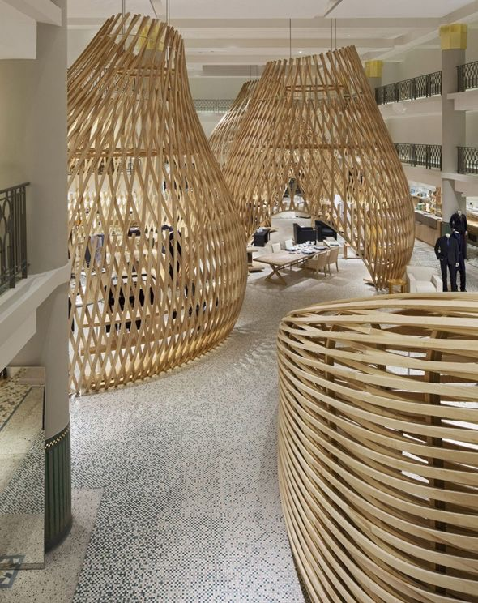
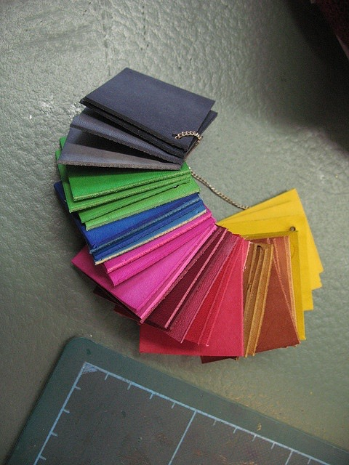
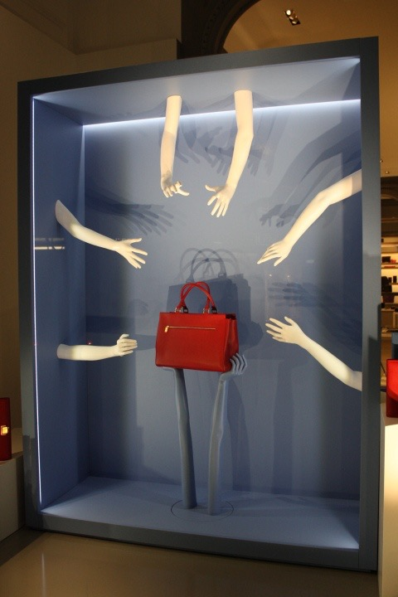

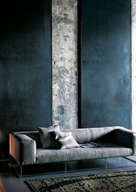

Slide 16
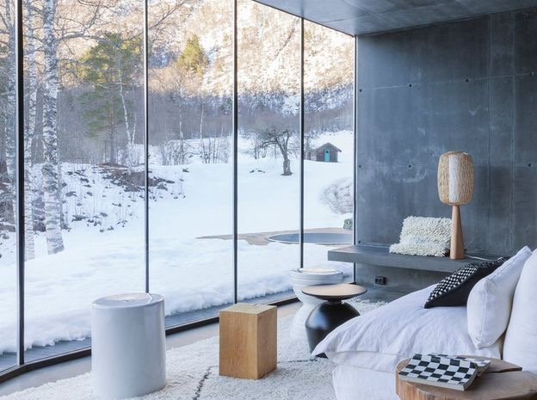
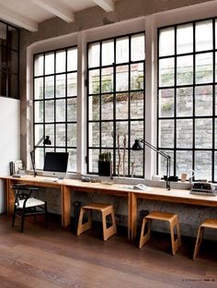
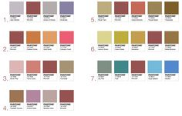
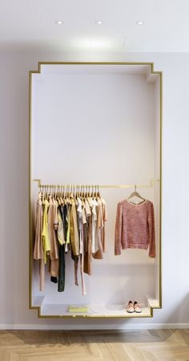
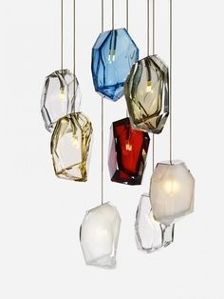
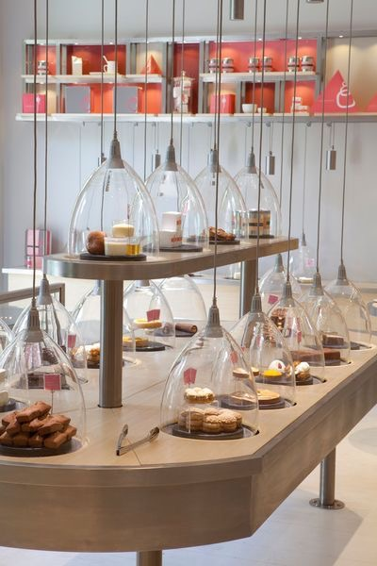
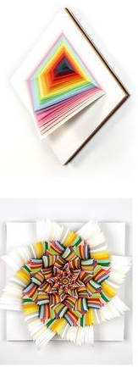
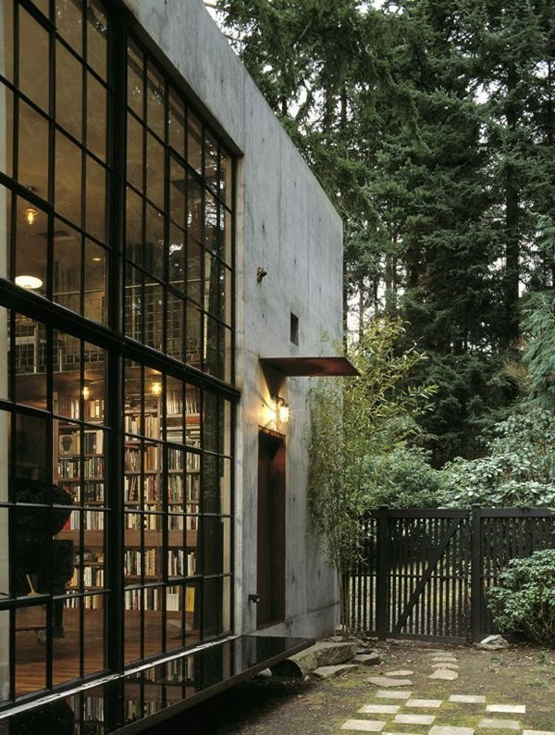
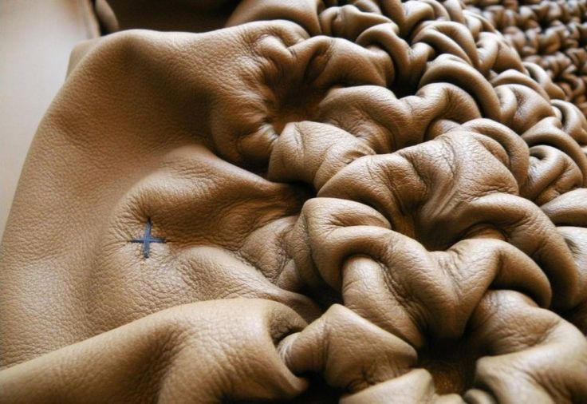
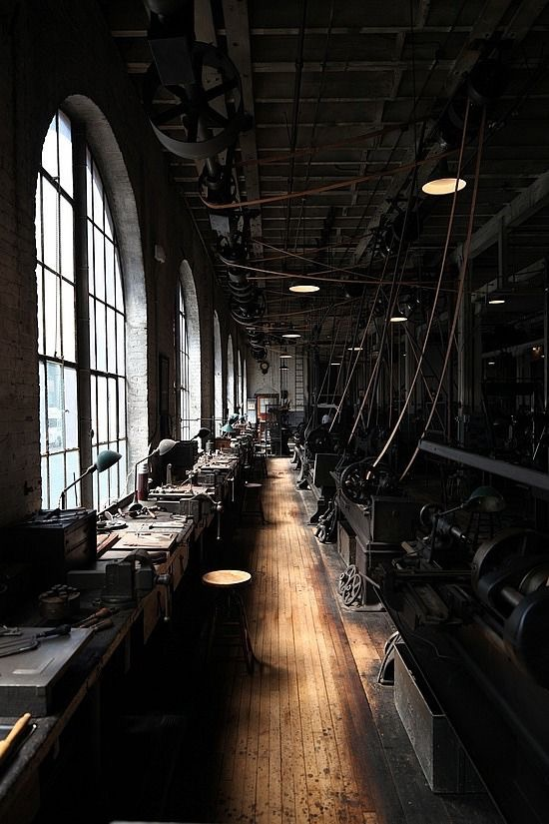
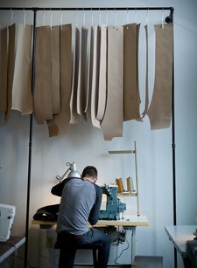
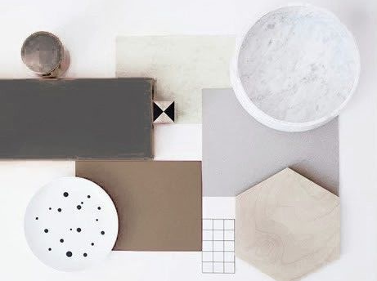


Slide 17














Slide 18












Slide 19








Slide 20

WEBSITE INSPIRATION

Slide 21

TEMPLATE 1

Slide 22

TEMPLATE 2

Slide 23

TEMPLATE 3

Slide 24
OUR BRAND: DIAPHANE

Slide 25
BRAND NAME
Transparency
(figurative sens)
Diaphanês
Dépoli
DIAPHANE

Slide 26

logo
Logo
Logo with baseline

Slide 27

BASELiNE
« Handmade in
your hands… »

Slide 28

FONT
BASELINE
Goudy Old Style Italic
abcdefghijklmnopqrstuvwxyz
1234567890 + = * % ^ ( ) ! ? ‘ " & @ # / ;

Slide 29
BRAND VALUES
Democratic
Product Concept
Unique
Fair trade
Collectivism spirit
Sharing
Team spirit

Slide 30

TARGET
Woman
35-55
Wealthy
Urban
Elegant and sophisticated
Fed up with marketing
Searching for authenticity
Give a big importance to accessories
Luxury connoisseur
Seeking for a non-ostentatious luxury

Slide 31



COMPETITORS

Slide 32

PRODUCTs
Backpack
Model: Emile
Calf Skin
Full grain leather
Mineral tanning
KAKI

Slide 33


PRODUCTs
Handbag
Model: Andrea
Handbag
Model: Andrea
Calf Skin
Full grain leather
Tumbled grain leather
BROWN
Calf Skin
Full grain leather
Tumbled grain leather
BROWN and BLACK
Calf Skin
Calf Skin
Lamb Skin
Lamb Skin

Slide 34

PRODUCTs
Handbag
Model: Carole
Wallet
Model: Emma
Calf Skin
Split leather
Mineral tanning
RED
Lamb Skin
With glazed finishing
GREY
Mettalic
Goat Skin
Lamb Skin

Slide 35

PRODUCTs
Handbag and Wallet
Model: Diaphanesse
Calf Skin
Full grain leather
Mineral tanning
BROWN and BLACK
Lamb Skin
Calf Skin

Slide 36

PRODUCTs
Bracelet
Model: Diaphanesse
Calf Skin
Full grain leather
Mineral tanning
SILVER
BROWN

Slide 37

BRACELET BOX

Slide 38

BAG BOX

Slide 39

SHOPPING BAG

Slide 40





MATERIAL OF THE PRODUCTs
LAMB SKIN
Black
Brown
Grey
CALF SKIN
Kaki
Brown
Red

Slide 41


















A LOT OF OTHER MATERIAL TO CHOSE
Exotic leathers

Slide 42



PRICE RANGE
900 < 4700 > 8500 euros
400 < 650 > 900 euros
300 < 450 > 600 euros

Slide 43


PRICE RANGE
250 < 400 > 550 euros
150 < 250 > 350 euros

Slide 44
DIAPHANE
WEBSITE

Slide 45


Slide 47
BRAND SPACE: POP-UP STORE
1/ Bus space: 2m50 x 6,5
2/ Bus space: 2m50 sur 8

Slide 48
MERCHANDISING
OLIFACTORY
Smell leather to create an atmosphere
AUDITORY
A dynamic music to:
create an ambiance
influence customer’s mood

Slide 49
DRAW PLAN

Slide 50


Slide 51


Slide 52


Slide 53


Slide 54


Slide 55



Slide 56


Slide 57
3 dimension PLANS

Slide 58



Slide 59



Slide 60



Slide 61
WHY POP-UP STORE?
Create a surprise effect
Generate media attention
Test the products
Test the concept
Test the locations

Slide 62




BRAND DRESS-CODE
In accordance with the values of the brand
Bring to light the craftmanship spirit

Slide 63
BUDGET

Slide 64
EXPANSION STRATEGY
Enjoy low costs of the use of the bus
Invest in new locations with the profitability margin
Create new pop-up-store in luxurious locations

Slide 65
COST PRICES
Bus and isurance | Products | Staff salaries | Petrol | Communication | Rental location
With layout and material | 42% of gross margin Average of the products (about 600) | 8 employees About 60K/year For 2 months |  | Magazine publication : 4000 Website creation : 14 000 | 10 000 euros per week
110 000 euros | 448 920 euros | 80 000 euros | 1 000 euros | 18 000 euros | 60 000 euros
TOTAL : 717 920 euros

Slide 66
LOW FORCAST
Traffic rate :
Average basket in €
Expected footfall 8%
Expected conversion rate 14%
Paris | Strasbourg | Lyon | Cannes | Saint-Tropez | Nice
14 500 | 8 000 | 10 000 | 21 000 | 14 000 | 13 000
Paris | Strasbourg | Lyon | Cannes | Saint-Tropez | Nice
750 | 450 | 500 | 900 | 800 | 750
Paris | Strasbourg | Lyon | Cannes | Saint-Tropez | Nice
1160 | 640 | 800 | 1680 | 1120 | 1040
Paris | Strasbourg | Lyon | Cannes | Saint-Tropez | Nice
162 | 90 | 112 | 235 | 157 | 146

Slide 67
ROI
Turnover expected
Total : 664 600 euros
ROI = (664 600 – 717 920) / 717 920
ROI = -0,07%
Paris | Strasbourg | Lyon | Cannes | Saint-Tropez | Nice
121 500 | 40 500 | 56 000 | 211 500 | 125 600 | 109500

Slide 68
HIGH FORCAST
Traffic rate :
Average basket in €
Expected footfall 18%
Expected conversion rate 22%
Paris | Strasbourg | Lyon | Cannes | Saint-Tropez | Nice
18 500 | 12 000 | 15 000 | 35 000 | 25 000 | 21 000
Paris | Strasbourg | Lyon | Cannes | Saint-Tropez | Nice
850 | 550 | 600 | 2000 | 1050 | 850
Paris | Strasbourg | Lyon | Cannes | Saint-Tropez | Nice
3330 | 2160 | 2700 | 6300 | 4500 | 3780
Paris | Strasbourg | Lyon | Cannes | Saint-Tropez | Nice
733 | 475 | 594 | 1386 | 990 | 832

Slide 69
ROI
Turnover expected
Total : 6 800 000 euros
ROI = ( 6 800 000 – 717 920) / 717 920
ROI = 8,47 %
Paris | Strasbourg | Lyon | Cannes | Saint-Tropez | Nice
623 050 | 261 250 | 356 400 | 2 772 000 | 1 039 500 | 707 200

Slide 70
AVERAGE SALES
(6 800 000 + 664 600) / 2 = 3 732 300 euros
ROI = (3 732 300 - 717 920) / 717 920
ROI = 4,2 %

Slide 71
COMMUNICATION STRATEGY

Slide 72

MAPPING OF THE CAMPAIGN
Pathway:
Paris / 1 week
Strasbourg / 1 week
Lyon / 1 week
Saint-Tropez / 1 week
Cannes / 1 week
Nice / 1 week

Slide 73






Saint germain des prEs - paris
PLACE KLeBER - STRASBOURG

Slide 74





PLACE DES TERREAUX
- LYON
HARBOUR –
SAINT-TROPEZ

Slide 75





VOIE PROMENADE DE LA PANTIERO - CANNES
PLACE MASSENA –
NICE

Slide 76
CAMPAIGN STRATEGY
EARNED MEDIA
OWNED MEDIA
PAID MEDIA
Articles published by journalists and photos published by boggers
Comments and actions on Facebook, IG, Twitter
Word-of-mouth thanks to the pop-up bus
« In-store » communication
Diaphane website
Media Kit
Social Network
ELLE magazine partnership

Slide 77

WEBSITE

Slide 78


Slide 79


Slide 80


Slide 81
VISUAL OF THE
CAMPAIGN

Slide 82
SOCIAL NETWORKS ADAPT FOR THE CAMPAIGN
FACEBOOK PAGE

Slide 83
SOCIAL NETWORKS ADAPT FOR THE CAMPAIGN

Slide 84



PR: Strategy with journalist
Creation of press release
Printing press release
Send to the journalist the media kit, with a little product of the brand and invitation for the cocktail the first day in the city
Cocktail - Press launch
To adhere the journalists and they talk about the brand: press coverage

Slide 85

PR: press release

Slide 86





BLOGGeRs RELATION
Why bloggers? Because they are influencers and
they are followed by a large community
Targeting the same universe bloggers
Contact + Send press release + Invitation for the breakfast the first day in the city
During the event/breakfast: discovery and sharing with employees, brand presentation. And offer a small gift !
To adhere the bloggers, to talk about us, relay information

