Slide 1
Passion for software engineering
Amine Belhassine
Software Engineer @ nostatiK media
Founder of INSAT Android Club
Notes:
Hello everyone, i’am amine belhassine, 27 years old software engineer. Today i will tell you a story about my passion for software engineering. Are you ready ? Let’s go !

Slide 2

Big Bang !!
1999
Notes:
The big bang !! It started at the age of 10 years old when i had my first computer at 1999. I started by video games, internet and writing documents

Slide 3


The beginning of the expansion
2002
Notes:
On 2002 I asked myself some questions :
How « Age of empires game » is created ?
How « .exe » is created ?
Then I asked some geeks around me about the possible answers

Slide 4
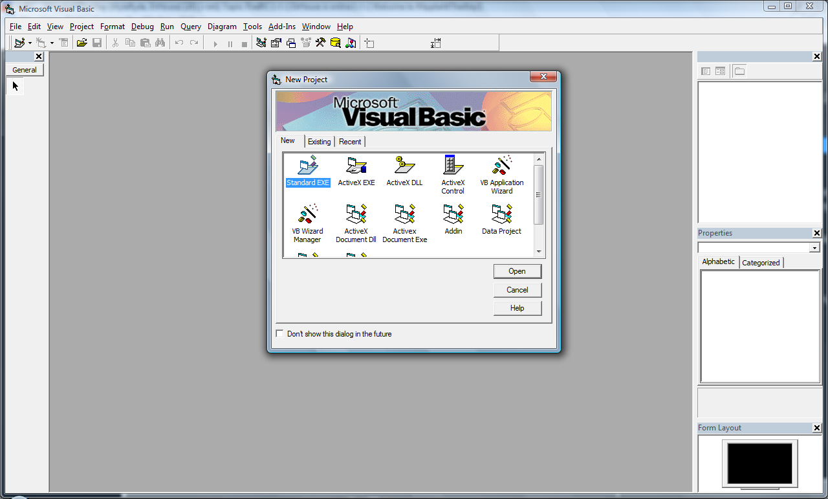
The passion was born !
Notes:
I ended with a CD of Visual basic 6 in hands, installed it and started to discover this magic world called “software developement” then i did my first Hello World : what a moment !!!

Slide 5
Passion more and more 2002 - 2005
PLAYING WITH VB 6
Discovering other programming languages
Coding for games
Notes:
After that i spent 3 years playing with Visual basic 6 , i did a media player, a cyptographic tool and many other cool things.
I discovered other programming languages like / Javascript / C / C++
And finally i coded some CS mods, maps and even cheats for sim city
And yes i also hacked the slide ;)

Slide 6
Passion more and more 2002 - 2005
PLAYING WITH VB 6
Discovering other programming languages
Coding for games
Notes:
After that i spent 3 years playing with Visual basic 6 , i did a media player, a cyptographic tool and many other cool things.
I discovered other programming languages like / Javascript / C / C++
And finally i coded some CS mods, maps and even cheats for sim city
And yes i also hacked the slide ;)

Slide 7
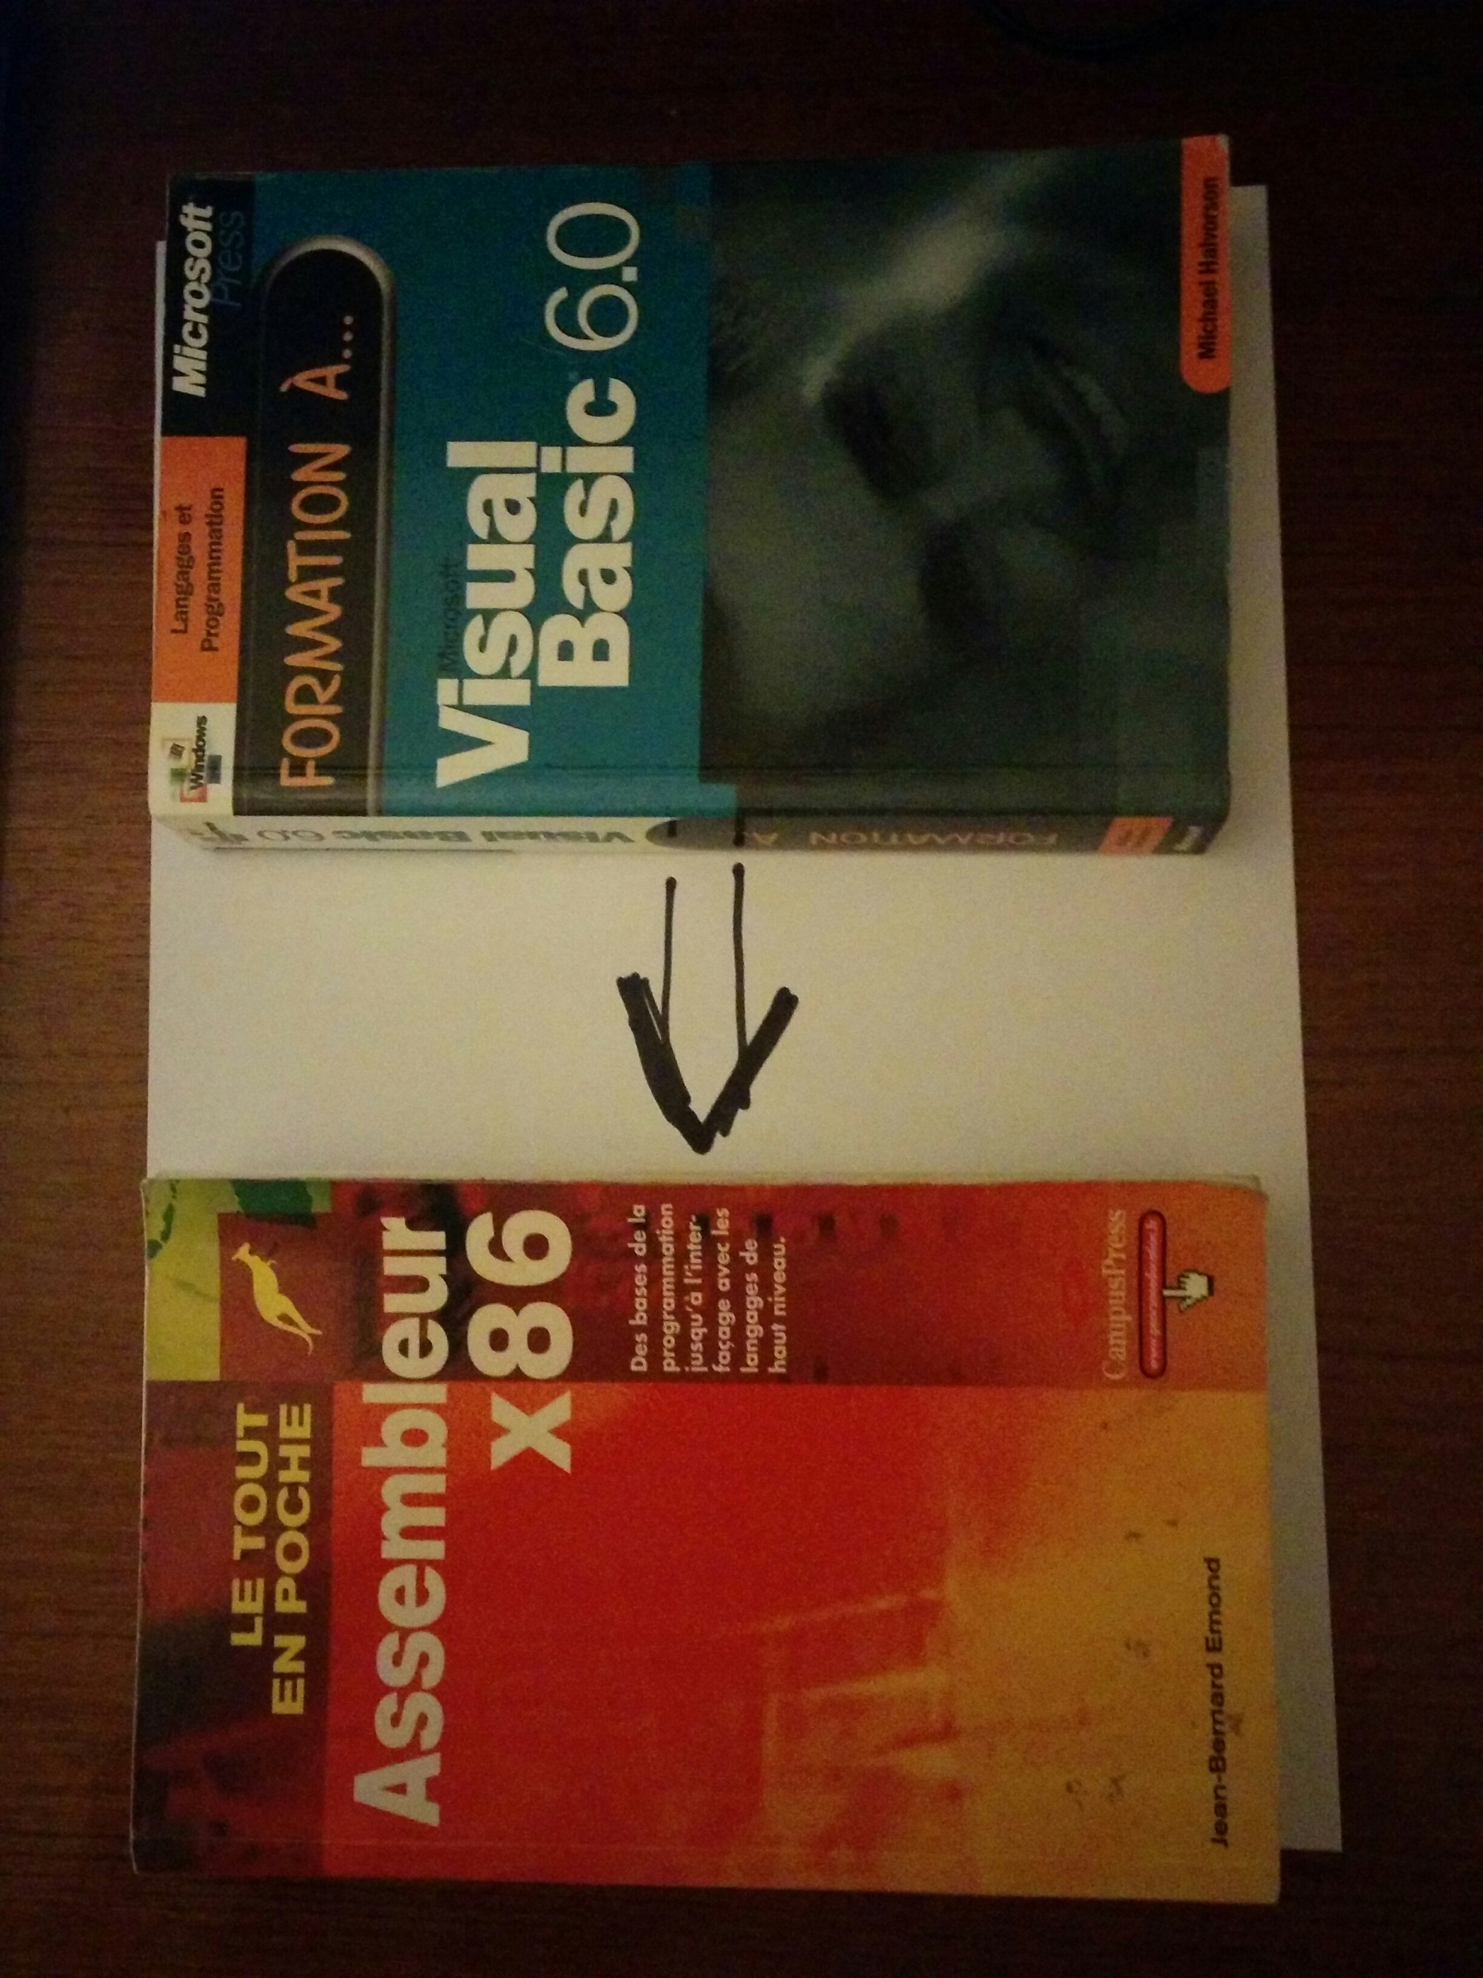
The abyssal zone 2005 - 2007
Going low level
Notes:
Then i entred the abyssal zone or low level for geeks and started to discover assembly, decompile software and cracking it, decompile worms, and creating system fixes

Slide 8

What about a computer science career ?
Date= 06 – 2007 // after BAC 2007
If (Computer science)
if (Software engineering)
else if (Network)
else if (Security)
else if ……
else
What ?
Notes:
Then I reached the crossroads and had to choose a path for my carreer
I hesitated beetween networks , general computer science, software engineering , and others

Slide 9

Software engineering studies 2007-2012
Keep it simple stupid ! & call Reason
Compass passion = « software engineering »
result = reason(passion)
Print result
-> Software engineering @ INSAT
Notes:
But why not keeping it simple stupid !! Let’s call Reason and use passion as a compass. And the result was beautiful : software engineering @ INSAT

Slide 10
Software engineering studies 2007-2012
WITHOUT PASSION
NO MOTIVATION
Notes:
During my SE studies I remember some of the courses i attended without passion
It was boring, hard to understand Too much effort to master Feel forced to study ….. Motivation was not here

Slide 11
Software engineering studies 2007-2012
WITH PASSION
PASSION IS A POWERFUL MOTIVATOR
Notes:
And i remember the courses i attended with passion : software engineering ones
It was interesting and easy to understand because passion is a powerful motivator
Interesting
Easy to understand
Little effort to master

Slide 12
A software engineering career ? 2013 - NOW
“Choose a job you love, and you will never have to work a day in your life” - Confucius
Notes:
As my software engineering studies were successful, software engineering carreer become natural

Slide 13

Start your day with motivation
Notes:
When you wake up it’s very important to know that you are going to spent your day doing something you really love

Slide 14

Very beautiful but ?
Notes:
Very beautiful but welcome to reality and reality is hard ! Do we have always the choice ?

Slide 15

REALITY IS HARD
Notes:
The cost for me was 3 companies in two years to finally find a job that fits my passion

Slide 16
And I joined nostatiK media
STARTUP
AGILE
TECH CHALLENGES
ADD VALUE TO PEOPLE
Notes:
A startup with an agile process, tech challenges and where i can add value to people

Slide 17
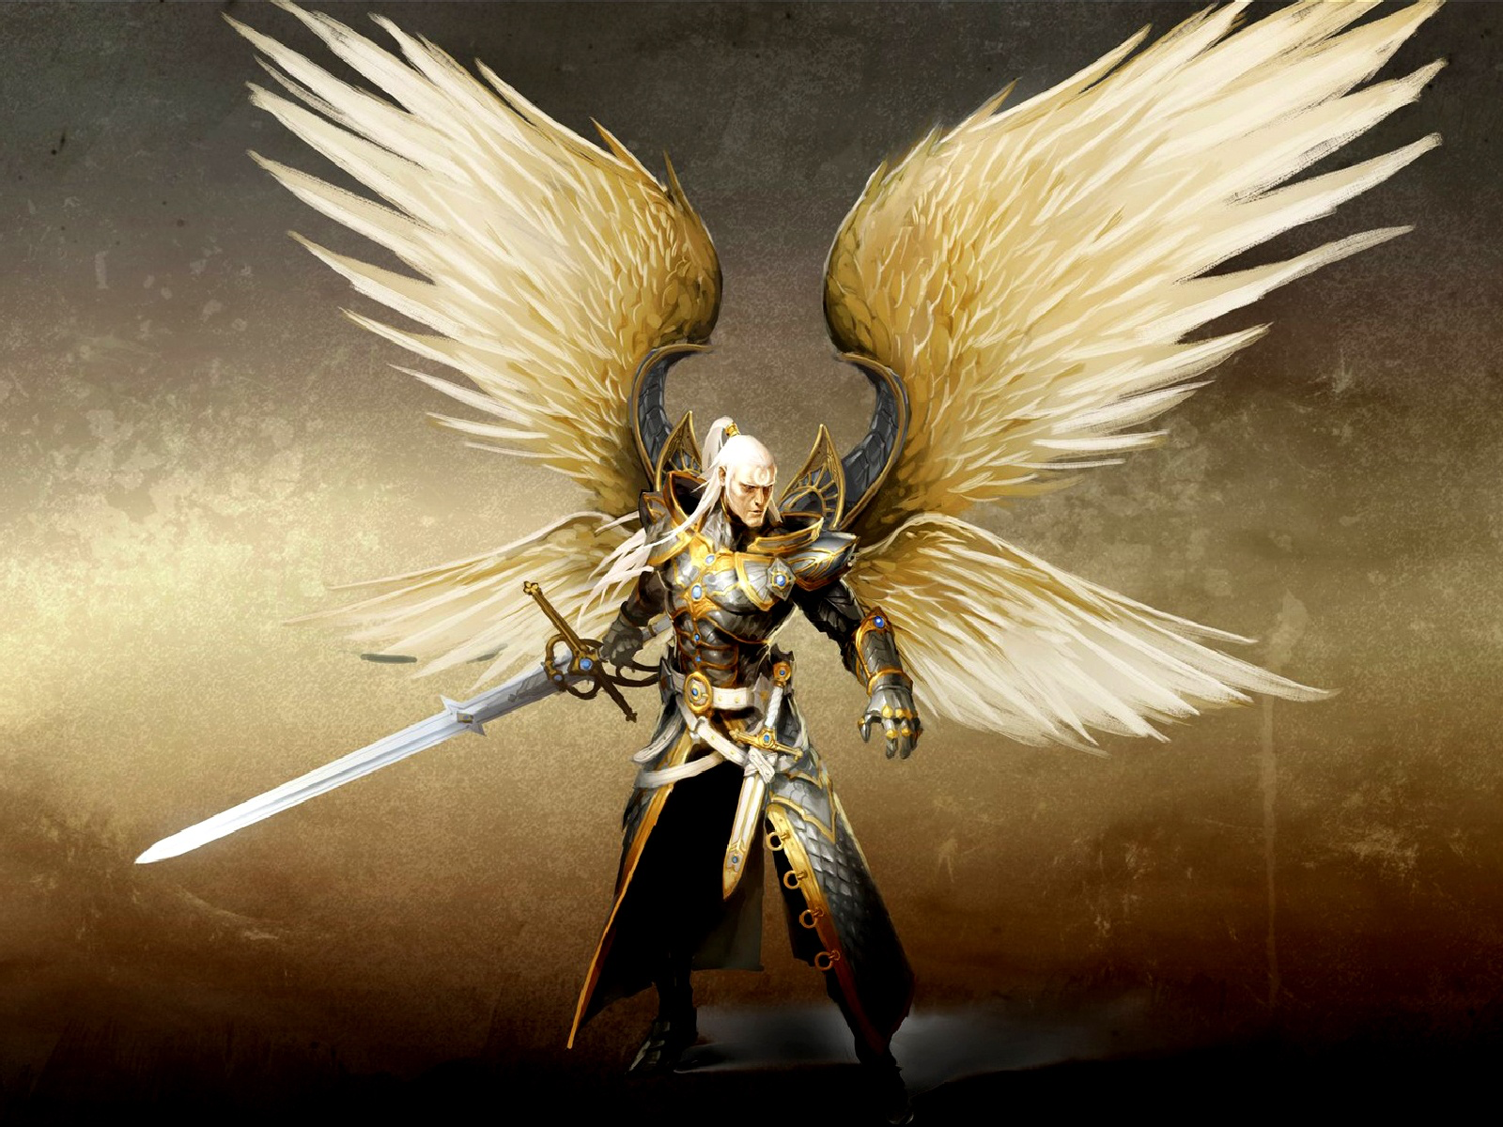
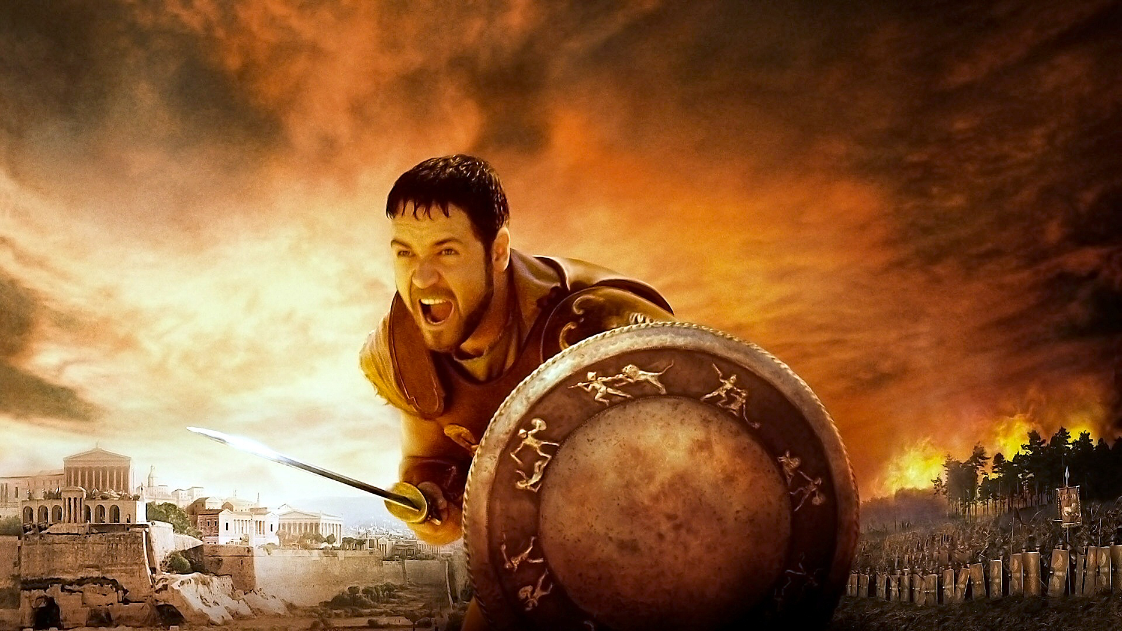
P
R
O
B
L
E
M
S
D
I
F
F
I
C
U
L
T
I
E
S
Notes:
And of course when you face some difficulties, Passion gives you power, and it will be your guardian angel

Slide 18
And your passion ?
Find it or Fake it 'til you make it
Practice it ( study / work )
Do something special / crazy !

Slide 19
“The road to success is not easy to navigate, but with hard work, drive and passion, it's possible to achieve the American dream” - Tommy Hilfiger
And US can we achieve a Tunisian Dream with our Passion for IT,CS,SE ?

Slide 20


