Slide 1
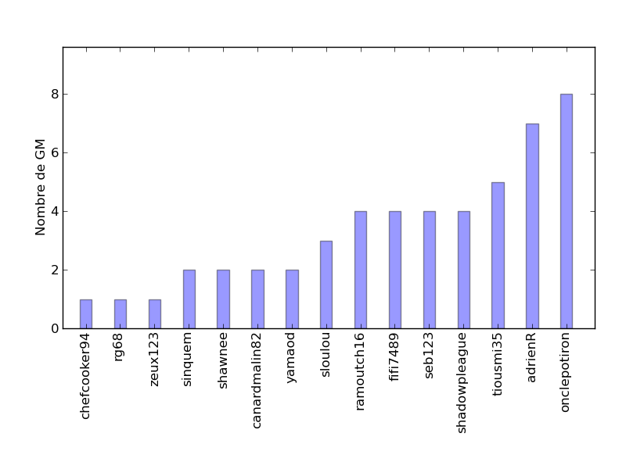
WIP

Slide 2
Overview
Mass reconstruction
background estimation
results
limit

Slide 3
Mass reconstruction

Slide 4
Background estimation
Use parametrization:

